Slide 1
Phonics
Thursday 4th February 2021

Slide 2
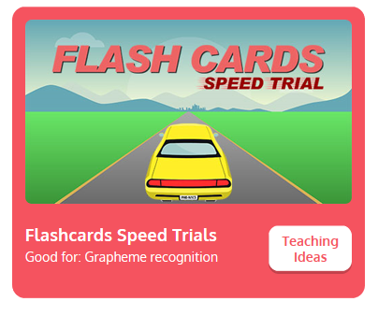
Practise your sounds using Flashcards Speed Trial on Phonics Play
Pick individual graphemes – Sets 1-8 + ai, ee, igh
Username: jan21
Password: home
https://www.phonicsplay.co.uk/resources/phase/2/flashcards-speed-trials

Slide 3

Practise reading your keywords using Tricky Word Trucks on Phonics Play
Pick Individual Tricky Words: all Phase 2 + he, she, me, we, be
Username: jan21
Password: home
https://www.phonicsplay.co.uk/resources/phase/2/tricky-word-trucks

Slide 4

This week we are looking at vowel digraphs – two vowels that go together to make 1 sound.
Today’s sound is:
oa
https://www.youtube.com/watch?v=X7t60TYrvr8
Can you draw the digraph in the air?

Slide 5
Watch the video and find the words that use the oa sound.
https://www.bbc.co.uk/bitesize/topics/zvq9bdm/articles/zh4j47h
Watch the video of Geraldine the Giraffe looking at the oa sound:
https://www.youtube.com/watch?v=KCJyHN0IFE8

Slide 6
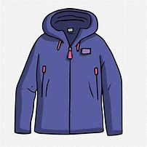
Main Activity
Can you segment the sounds in the words to spell them?
Remember, some of the sounds may be made with 2 letters.

Slide 7
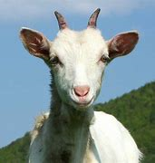
Can you spell the word to match the picture?

Slide 8

Can you spell the word to match the picture?

Slide 9

Can you spell the word to match the picture?

Slide 10

Can you spell the word to match the picture?

Slide 11
Can you write the sentence?
See the guidance sheet.

