Slide 1
Phonics
Thursday 4th March 2021

Slide 2
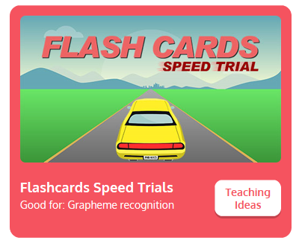
Practise your sounds using Flashcards Speed Trial on Phonics Play
Pick individual graphemes – Sets 1-11
Username: jan21
Password: home
https://www.phonicsplay.co.uk/resources/phase/2/flashcards-speed-trials

Slide 3

Practise reading your keywords using Tricky Word Trucks on Phonics Play
Pick Individual Tricky Words: all Phase 2 and all Phase 3
Username: jan21
Password: home
https://www.phonicsplay.co.uk/resources/phase/2/tricky-word-trucks

Slide 4

Today we are going to read some questions containing the sounds that we have focussed on this term.
Can a rabbit yell at a man?

Slide 5
Main Activity
Yes or No?
Can a boat sail?

Slide 6
Main Activity
Yes or No?
Is all hair fair?

Slide 7
Main Activity
Yes or No?
Is the moon far off?

Slide 8
Main Activity
Yes or No?
Are fish and chips food?

Slide 9
Main Activity
Yes or No?
Is it dark at night?

Slide 10
Main Activity
Yes or No?
Will six cows fit in a car?

