Slide 1
Phonics
Tuesday 23rd February 2021

Slide 2
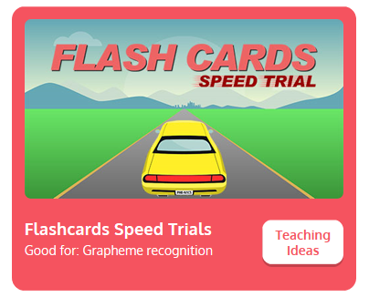
Practise your sounds using Flashcards Speed Trial on Phonics Play
Pick individual graphemes – Sets 1-10 + ow
Username: jan21
Password: home
https://www.phonicsplay.co.uk/resources/phase/2/flashcards-speed-trials

Slide 3

Practise reading your keywords using Tricky Word Trucks on Phonics Play
Pick Individual Tricky Words: all Phase 2 + he, she, me, we, be, was, my
Username: jan21
Password: home
https://www.phonicsplay.co.uk/resources/phase/2/tricky-word-trucks

Slide 4

This week we are looking at a digraph – two letters that go together to make 1 sound.
Today’s sound is:
oi
https://www.youtube.com/watch?v=AcCIAgvjjt0
Can you draw the digraph in the air?

Slide 5
Watch the video and find the words that use the oi sound.
https://www.bbc.co.uk/bitesize/topics/zvq9bdm/articles/zfj6jhv
Watch the video of Geraldine the Giraffe looking at the oi sound:
https://www.youtube.com/watch?v=IRTITdRL_cU

Slide 6

Main Activity
Can you segment the sounds in the words to spell them?
Remember, some of the sounds may be made with 2 letters.

Slide 7
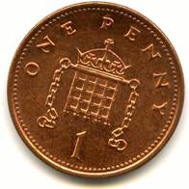
Can you spell the word to match the picture?

Slide 8
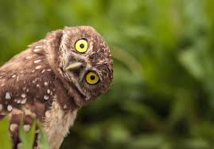
Can you spell the word to match the picture?

Slide 9

Can you spell the word to match the picture?

Slide 10
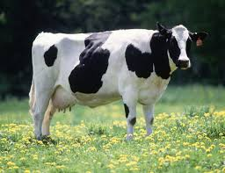
Can you spell the word to match the picture?

Slide 11
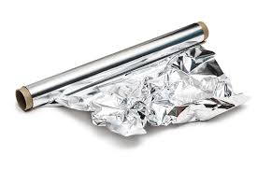
Can you spell the word to match the picture?

Slide 12
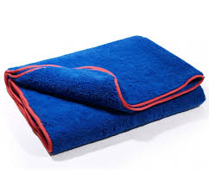
Can you spell the word to match the picture?

Slide 13
Can you write the sentence?
See the guidance sheet.

