Slide 1
Phonics
Tuesday 2nd March 2021

Slide 2
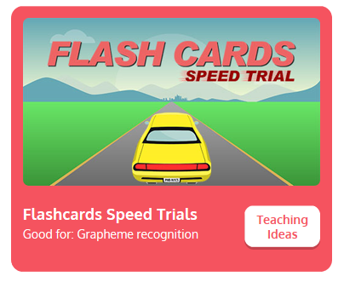
Practise your sounds using Flashcards Speed Trial on Phonics Play
Pick individual graphemes – Sets 1-11
Username: jan21
Password: home
https://www.phonicsplay.co.uk/resources/phase/2/flashcards-speed-trials

Slide 3

Practise reading your keywords using Tricky Word Trucks on Phonics Play
Pick Individual Tricky Words: all Phase 2 + he, she, me, we, be, was, my, you
Username: jan21
Password: home
https://www.phonicsplay.co.uk/resources/phase/2/tricky-word-trucks

Slide 4

This week we are looking at a digraph – two letters that go together to make 1 sound.
Today’s sound is:
er
Can you draw the digraph in the air?

Slide 5
Watch the video and find the words that use the er sound.
https://www.bbc.co.uk/bitesize/topics/zvq9bdm/articles/zvmnmfr
Watch the video of Geraldine the Giraffe looking at the er digraph:
https://www.youtube.com/watch?v=WaxZN4BZjgc

Slide 6
Main Activity
Can you blend the sounds in the words to read them?
rocker

Slide 7
Can you identify the different sounds in the words and blend them to read them?
supper

Slide 8
Can you identify the different sounds in the words and blend them to read them?
dinner

Slide 9
Can you identify the different sounds in the words and blend them to read them?
better

Slide 10
Can you identify the different sounds in the words and blend them to read them?
banner

