Slide 1
Phonics
Tuesday 2nd January 2021

Slide 2
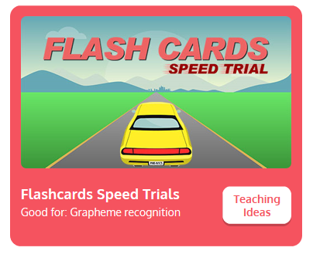
Practise your sounds using Flashcards Speed Trial on Phonics Play
Pick individual graphemes – Sets 1-8 + ai
Username: jan21
Password: home
https://www.phonicsplay.co.uk/resources/phase/2/flashcards-speed-trials

Slide 3

Practise reading your keywords using Tricky Word Trucks on Phonics Play
Pick Individual Tricky Words: all Phase 2 + he, she, me, we, be
Username: jan21
Password: home
https://www.phonicsplay.co.uk/resources/phase/2/tricky-word-trucks

Slide 4

This week we are looking at vowel digraphs – two consonants that go together to make 1 sound.
Today’s sound is:
ee
Can you draw the digraph in the air?

Slide 5
Watch the video and find the words that use the ee sound.
https://www.bbc.co.uk/bitesize/topics/zvq9bdm/articles/zn9q92p
Watch the video of Geraldine the Giraffe looking at the sh sound:
https://www.youtube.com/watch?v=qfM7Hz7US0U

Slide 6
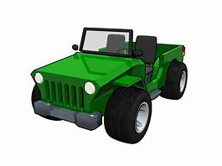
Main Activity
Can you segment the sounds in the words to spell them?
Remember, some of the sounds may be made with 2 letters.

Slide 7

Can you spell the word to match the picture?

Slide 8

Can you spell the word to match the picture?

Slide 9

Can you spell the word to match the picture?

Slide 10
Can you write the sentence?
See the guidance sheet.

