Slide 1
Phonics
Wednesday 3rd February 2021

Slide 2
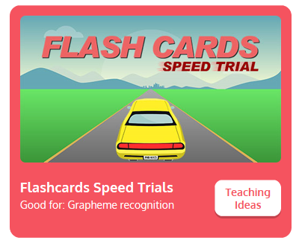

Practise your sounds using Flashcards Speed Trial on Phonics Play
Pick individual graphemes – Sets 1-8 + ai, ee
Username: jan21
Password: home
https://www.phonicsplay.co.uk/resources/phase/2/flashcards-speed-trials

Slide 3

Practise reading your keywords using Tricky Word Trucks on Phonics Play
Pick Individual Tricky Words: all Phase 2 + he, she, me, we, be
Username: jan21
Password: home
https://www.phonicsplay.co.uk/resources/phase/2/tricky-word-trucks

Slide 4
Today week we are looking at a trigraph – three letters that go together to make 1 sound.
Today’s sound is:
igh
Can you draw the trigraph in the air?

Slide 5
Watch the video and find the words that use the igh sound.
https://www.bbc.co.uk/bitesize/topics/zvq9bdm/articles/zkhvhbk
Watch the video of Geraldine the Giraffe looking at the igh sound:
https://www.youtube.com/watch?v=OYCR2RZ4ZYY

Slide 6
Main Activity
Can you blend the sounds in the words to read them?
Remember to look out for two letters that make one sound.
high

Slide 7
Can you identify the different sounds in the words and blend them to read them?
sigh

Slide 8
Can you identify the different sounds in the words and blend them to read them?
feel

Slide 9
Can you identify the different sounds in the words and blend them to read them?
might

Slide 10
Can you identify the different sounds in the words and blend them to read them?
meet

Slide 11
Can you identify the different sounds in the words and blend them to read them?
sight

Slide 12
Can you identify the different sounds in the words and blend them to read them?
keep

Slide 13
Can you read the caption by identifying and blending the sounds in the words? Remember to look out for keywords to read by sight.
He got it right.

