Slide 1
Phonics
Wednesday 9th February 2021

Slide 2
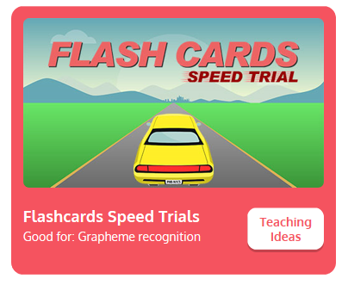

Practise your sounds using Flashcards Speed Trial on Phonics Play
Pick individual graphemes – Sets 1-9 + oo, ar
Username: jan21
Password: home
https://www.phonicsplay.co.uk/resources/phase/2/flashcards-speed-trials

Slide 3

Practise reading your keywords using Tricky Word Trucks on Phonics Play
Pick Individual Tricky Words: all Phase 2 + he, she, me, we, be, was
Username: jan21
Password: home
https://www.phonicsplay.co.uk/resources/phase/2/tricky-word-trucks

Slide 4
Today week we are looking at a digraph – two letters that go together to make 1 sound.
Today’s sound is:
or
https://www.youtube.com/watch?v=0_TiU-5dHpo
Can you draw the digraph in the air?

Slide 5
Watch the video and find the words that use the or sound.
https://www.bbc.co.uk/bitesize/topics/zvq9bdm/articles/zr6f6v4
Watch the video of Geraldine the Giraffe looking at the or sound:
https://www.youtube.com/watch?v=33kvsqyOYdg

Slide 6
Main Activity
Can you blend the sounds in the words to read them?
Remember to look out for two letters that make one sound.
Today’s words will focus on the digraphs ar and or.
for

Slide 7
Can you identify the different sounds in the words and blend them to read them?
cord

Slide 8
Can you identify the different sounds in the words and blend them to read them?
cart

Slide 9
Can you identify the different sounds in the words and blend them to read them?
sort

Slide 10
Can you identify the different sounds in the words and blend them to read them?
hard

Slide 11
Can you identify the different sounds in the words and blend them to read them?
worn

Slide 12
Can you identify the different sounds in the words and blend them to read them?
market

Slide 13
Can you read the caption by identifying and blending the sounds in the words? Remember to look out for keywords to read by sight.
ships in the port

