Slide 1
Phonics
Wednesday 24th February 2021

Slide 2
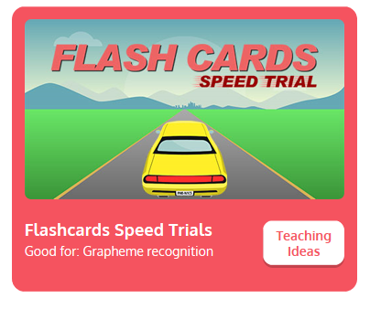

Practise your sounds using Flashcards Speed Trial on Phonics Play
Pick individual graphemes – Sets 1-10 + ow, oi
Username: jan21
Password: home
https://www.phonicsplay.co.uk/resources/phase/2/flashcards-speed-trials

Slide 3

Practise reading your keywords using Tricky Word Trucks on Phonics Play
Pick Individual Tricky Words: all Phase 2 + he, she, me, we, be, was, my
Username: jan21
Password: home
https://www.phonicsplay.co.uk/resources/phase/2/tricky-word-trucks

Slide 4
Today week we are looking at a trigraph – three letters that go together to make 1 sound.
Today’s sound is:
ear
Can you draw the digraph in the air?

Slide 5
Watch the video and find the words that use the ear sound.
https://www.bbc.co.uk/bitesize/topics/zvq9bdm/articles/z4p3pg8
Watch the video of Geraldine the Giraffe looking at the ear sound:
https://www.youtube.com/watch?v=EneZ1UubxSA

Slide 6
Main Activity
Can you blend the sounds in the words to read them?
Remember to look out for two and three letters that make one sound.
near

Slide 7
Can you identify the different sounds in the words and blend them to read them?
year

Slide 8
Can you identify the different sounds in the words and blend them to read them?
toil

Slide 9
Can you identify the different sounds in the words and blend them to read them?
rear

Slide 10
Can you identify the different sounds in the words and blend them to read them?
join

Slide 11
Can you read the sentence by identifying and blending the sounds in the words? Remember to look out for keywords to read by sight.
The fox can howl.

