Slide 1
Phonics
Wednesday 3rd March 2021

Slide 2
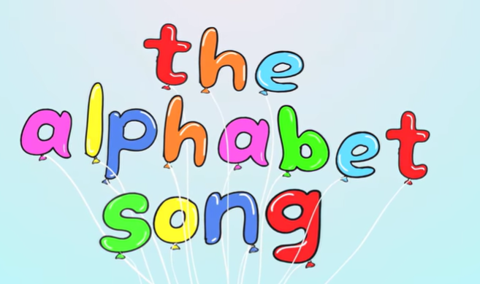

Can you sing the alphabet song?
Remember to say the names of the letters not the sounds.
https://www.youtube.com/watch?v=0FfcNgYCW18

Slide 3
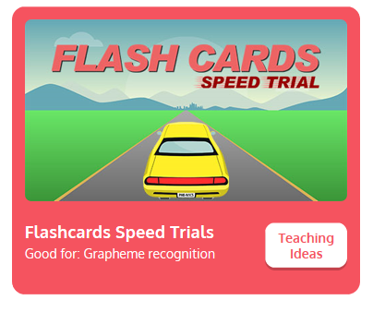
Practise your sounds using Flashcards Speed Trial on Phonics Play
Pick individual graphemes – Sets 1-11
Username: jan21
Password: home
https://www.phonicsplay.co.uk/resources/phase/2/flashcards-speed-trials

Slide 4
Can you read our tricky words:
we

Slide 5
Can you read our tricky words:
me

Slide 6
Can you read our tricky words?
my

Slide 7
Can you read our tricky words:
he

Slide 8
Can you read our tricky words:
she

Slide 9
Can you read our tricky words?
you

Slide 10
Can you read our tricky words:
was

Slide 11
Can you read our tricky words:
be

Slide 12
Can you read our new tricky words?
they

Slide 13
Can you read our new tricky words?
her

Slide 14
Can you read our new tricky words?
all

Slide 15
Can you read our new tricky words?
are

Slide 16

Practise reading your keywords using Tricky Word Trucks on Phonics Play
Pick Individual Tricky Words: all Phase 2 and all Phase 3
Username: jan21
Password: home
https://www.phonicsplay.co.uk/resources/phase/2/tricky-word-trucks

Slide 17
Can you spell the tricky word?

Slide 18
the

Slide 19
Can you spell the tricky word?

Slide 20
go

Slide 21
Can you spell the tricky word?

Slide 22
Can you spell the tricky word?
to

Slide 23
Can you spell the tricky word?

Slide 24
Can you spell the tricky word?
no

Slide 25

Main Activity:
Can you use your phonics and keyword knowledge to write the sentences?

Slide 26
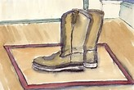
Main Activity:
Can you use your phonics and keyword knowledge to write the sentences?

Slide 27

Main Activity:
Can you use your phonics and keyword knowledge to write the sentences?

