Slide 1
Phonics
Wednesday 27th January 2021

Slide 2
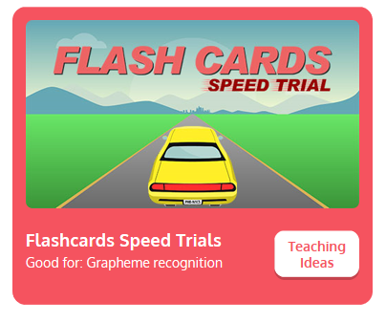
Practise your sounds using Flashcards Speed Trial on Phonics Play
Pick individual graphemes – Sets 1-7 + ch, sh
Username: jan21
Password: home
https://www.phonicsplay.co.uk/resources/phase/2/flashcards-speed-trials

Slide 3

Practise reading your keywords using Tricky Word Trucks on Phonics Play
Pick Individual Tricky Words: all Phase 2 + he, she
Username: jan21
Password: home
https://www.phonicsplay.co.uk/resources/phase/2/tricky-word-trucks

Slide 4
This week we are looking at consonant digraphs – two consonants that go together to make 1 sound.
Today’s sound is:
th
https://www.youtube.com/watch?v=TQYDbZ8gqow
Can you draw the digraph in the air?

Slide 5
Watch the video and find the words that use the th sound.
https://www.bbc.co.uk/bitesize/topics/zvq9bdm/articles/zk6f6v4
Watch the video of Geraldine the Giraffe looking at the th sound:
https://www.youtube.com/watch?v=6hZMjZGNq4g

Slide 6
Main Activity
Today we are going to blend the sounds in words to read them. that
You might want to put sound buttons underneath

Slide 7
Can you read the words:
them

Slide 8
Can you read the words:
thin

Slide 9
Can you read the words:
then

Slide 10
Can you read the words:
thick

Slide 11
Can you read the sentence?
The ship hit the rocks with a thud.

