Slide 1
Friday
WB 1.2.21

Slide 2
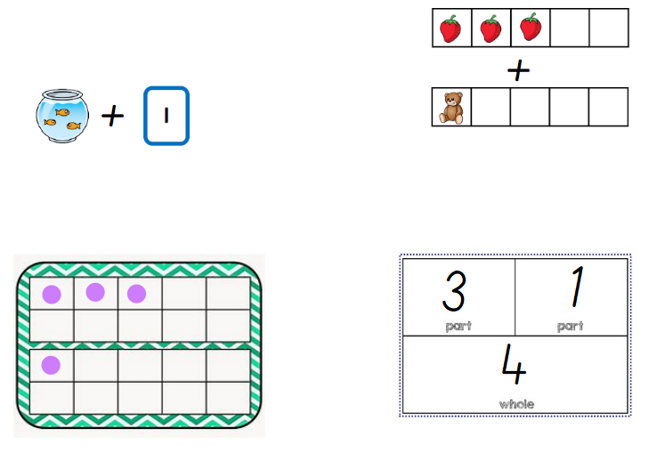
White Rose Challenge -
Notes:
3+1= 4

Slide 3
Starter-
Months of the year - https://www.youtube.com/watch?v=Fe9bnYRzFvk

Slide 4
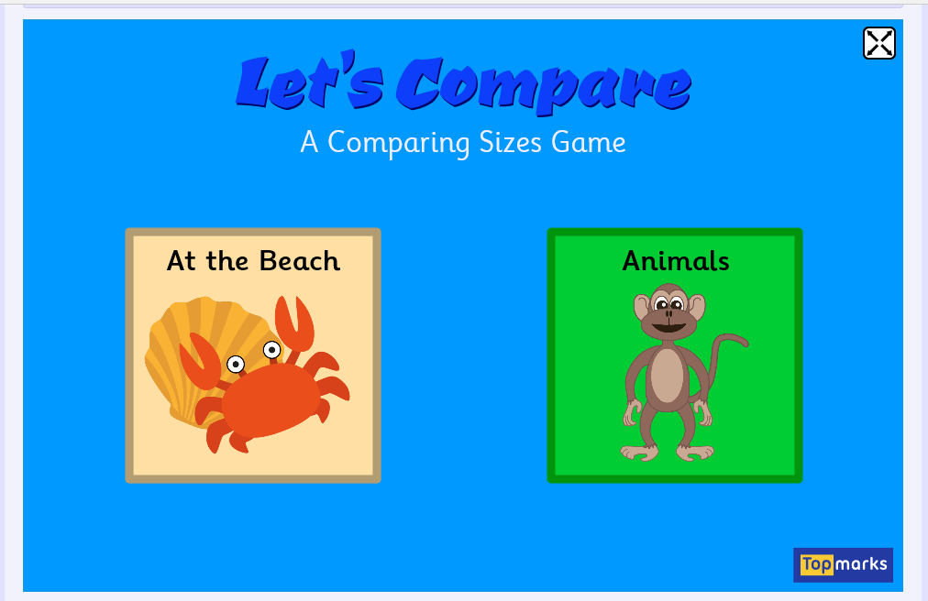
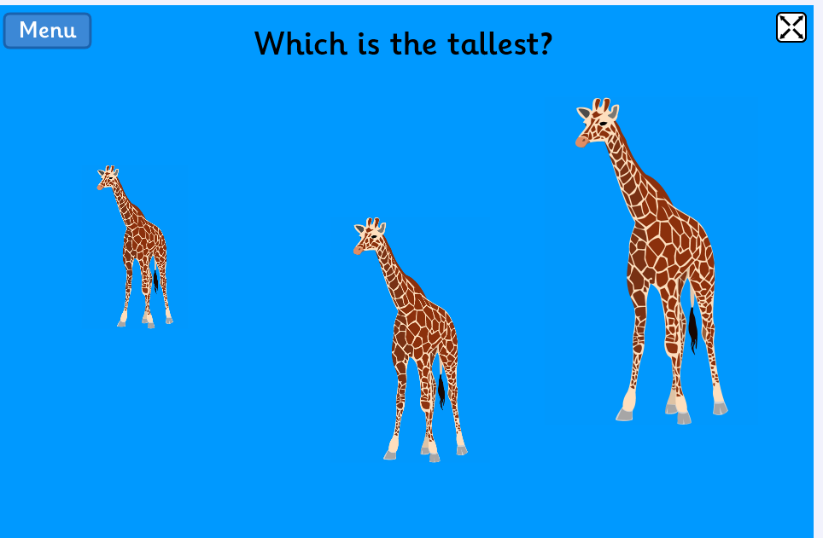
Main Input – Length
Lets play compare the object using top marks animal section
https://www.topmarks.co.uk/early-years/lets-compare

Slide 5
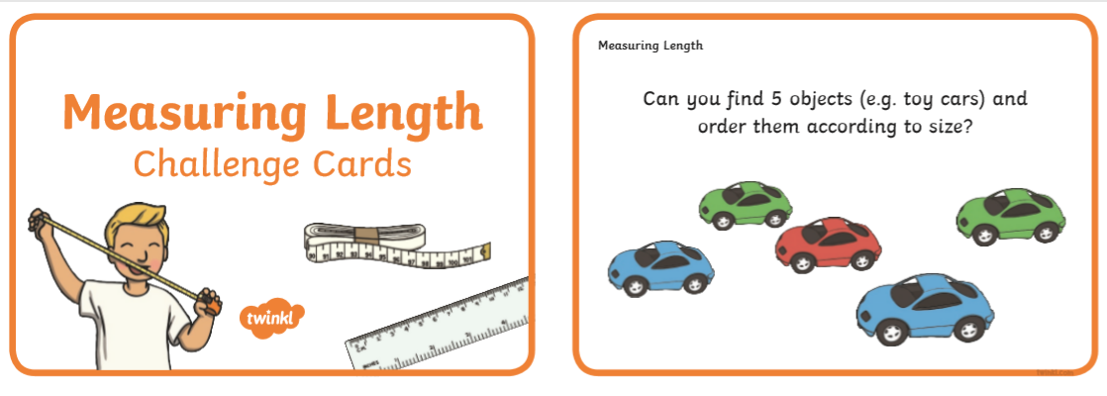
Main Activity
Choose 3-4 of the challenge cards to complete using objects from around your house.

Slide 6
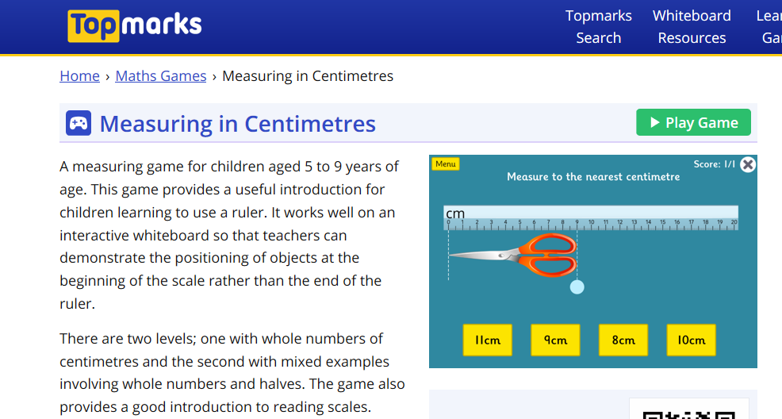
Work through the activity measuring the lengths of different objects – how many did you get right?
https://www.topmarks.co.uk/maths-games/measuring-in-cm

