Slide 1
Maths PowerPoint
WB 22.2.21

Slide 2
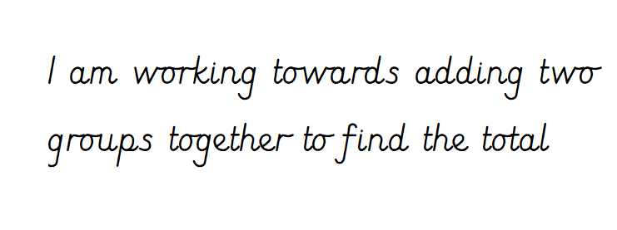
Friday

Slide 3
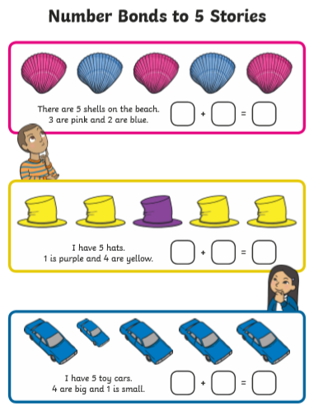
White rose starter
Can you work out the answer to these number bond stories?

Slide 4
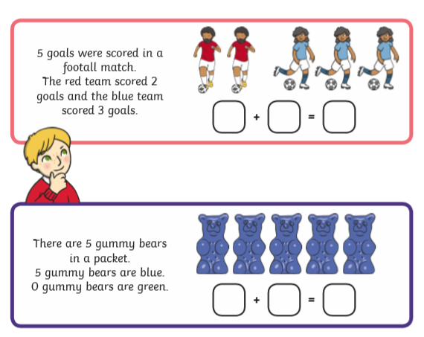
White rose starter
Can you work out the answer to these number bond stories?

Slide 5
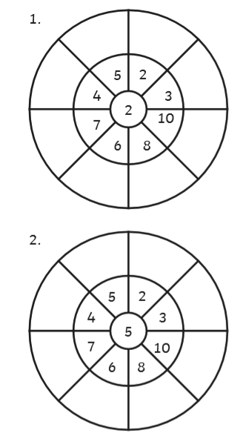
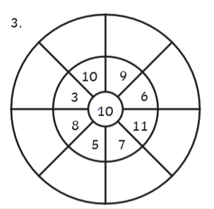
Starter
Use the 2, 5 and 10 times table knowledge you have gained this week to identify the numbers that you would find in these times tables. Some have been done for you.

Slide 6
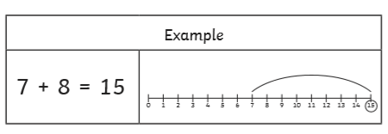
Main Input
You can also use smaller steps to help you find the answer!
See the next slides to help you…

Slide 7

6 + 5 =

Slide 8
7 + 3 =

Slide 9
8 + 4 =

Slide 10
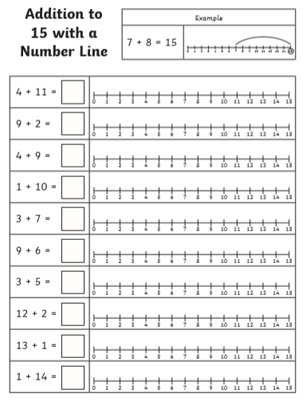
Main Activity
Work through the number sentences.
Don’t forget to use the number line to help you!
Always start with the largest number to make the jumps easier!

