Slide 1
Maths
WB 25.1.21

Slide 2
Monday

Slide 3
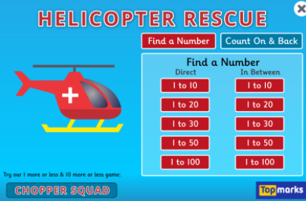
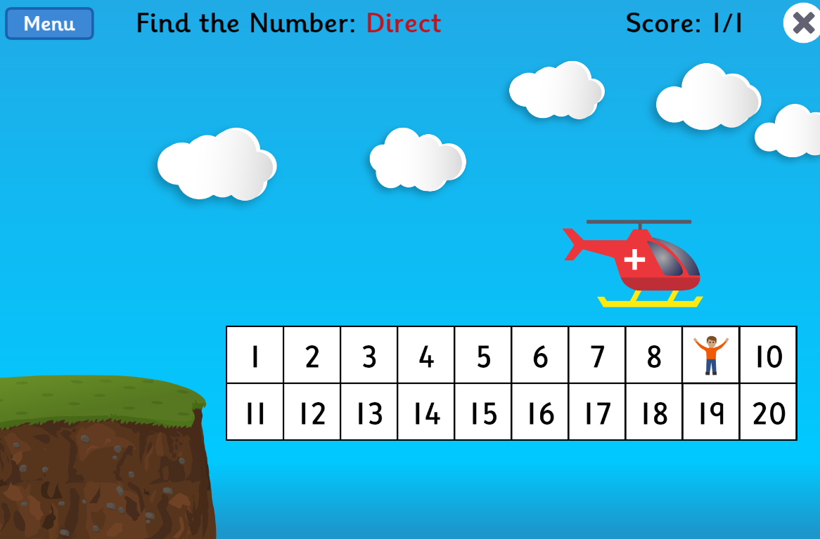
Complete the number game on Top Marks –
Children are to listen to the number they are asked to find and click on it to reveal if they have the answer correct.
https://www.topmarks.co.uk/learning-to-count/helicopter-rescue
Click on find a number – direct – work through numbers 1-10 if child is confident move to 1-20.

Slide 4
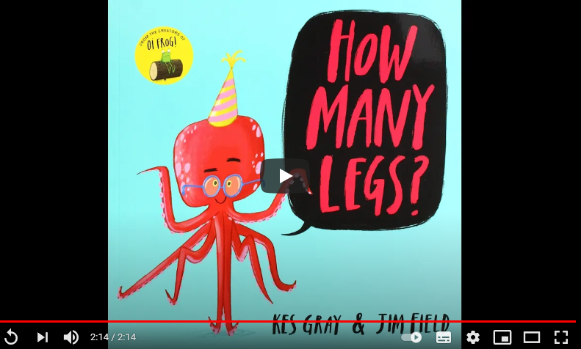
Main Input –
Introduce the book ‘How many legs’ https://www.youtube.com/watch?v=WPpkle9VHPU
Stop at the ‘page’ with the chimpanzee – 43 seconds in.
Can you work out how many legs there would be up until now in the book?

Slide 5
Today we are learning about doubling
What does doubling mean?
To get a double of a number, we add the same number to itself.
For example, double of 2 is 2 + 2 = 4.
Listen to the double song - https://www.youtube.com/watch?v=At0quRa90rs

Slide 6
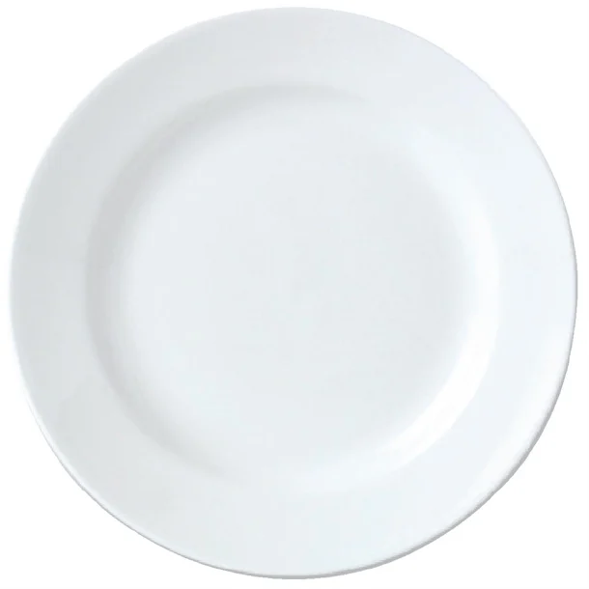
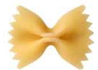
Today we are learning to double
Use two plates – place an amount i.e. 1 pasta shapes on one plate.
Now double this number by placing the same amount on the next plate.
Line your pasta up and count how many shapes you have altogether?
You have doubled 1!
Double 1 =2

Slide 7
Today we are learning to double
Use two plates – place an amount i.e. 2 pasta shapes on one plate.
Now double this number by placing the same amount on the next plate.
Line your pasta up and count how many shapes you have altogether?
You have doubled 2!
Double 2 = 4

Slide 8
Today we are learning to double
Use two plates – place an amount i.e. 3 pasta shapes on one plate.
Line your pasta up and count how many shapes you have altogether?
Now double this number by placing the same amount on the next plate.
You have doubled 3!
Double 3 = 6
Now complete the same activity with different number.

