Slide 1
Monday
WB 1.2.21

Slide 2
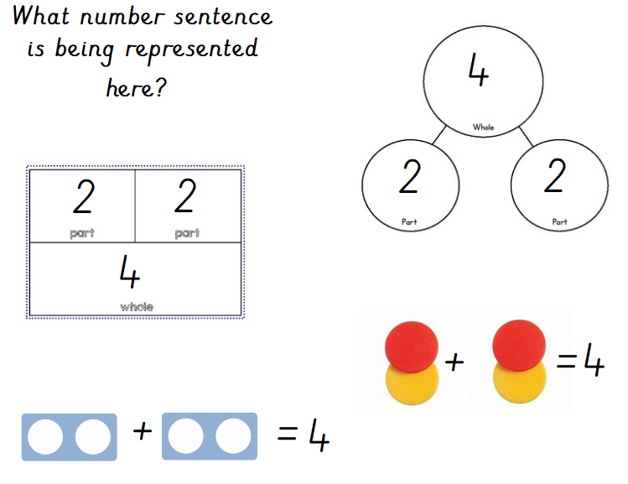
White Rose Challenge
Notes:
2+2=4

Slide 3
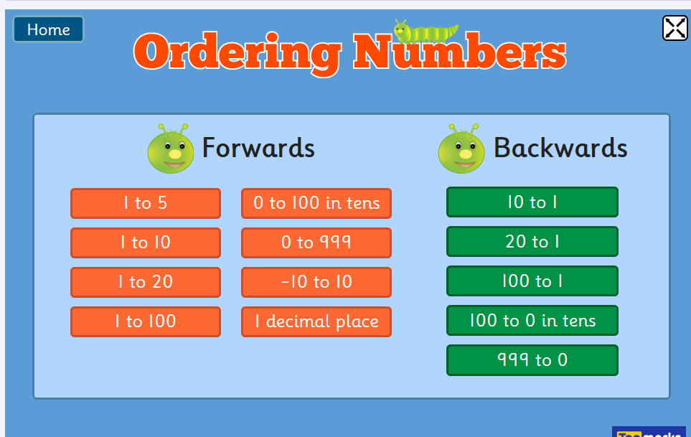
Starter
Put the numbers in the correct order – which number comes first, next etc.?
Work through ordering numbers 1-10 first and if you feel confident move to numbers 1-20

Slide 4
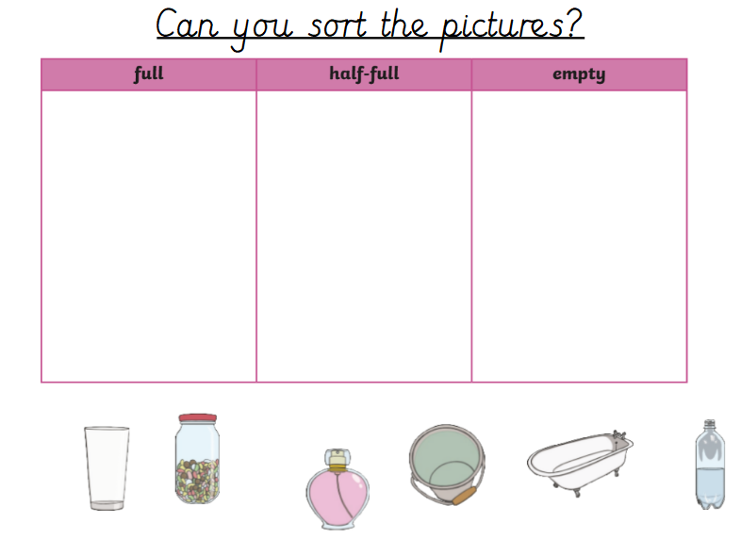
Look at the different pictures can you sort them into the correct category?
Main Input – Capacity

Slide 5
Watch the clip to help you understand more about the term capacity
https://www.youtube.com/watch?v=TkXxn0bJ4r0

Slide 6
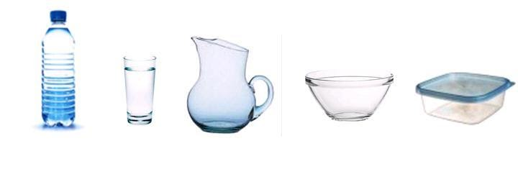
Main Activity– Capacity
Gather different sized containers from around your house up to 10 containers and label them with a number –
first write down which container you think will hold the most/least and order them.
Now find a resource e.g. pasta shells to fill the containers.
Where you right? Which container held the most/least etc.?

