Slide 1
Maths
WB 18.1.21

Slide 2
Monday

Slide 3
Starter –
https://www.youtube.com/watch?v=Fe9bnYRzFvk
Use this link to sing the months of the year song with your child. Can you say the months of the year in the correct order?
Notes:
Use this link to sing the months of the year song with your child. Can you say the months of the year in the correct order?

Slide 4
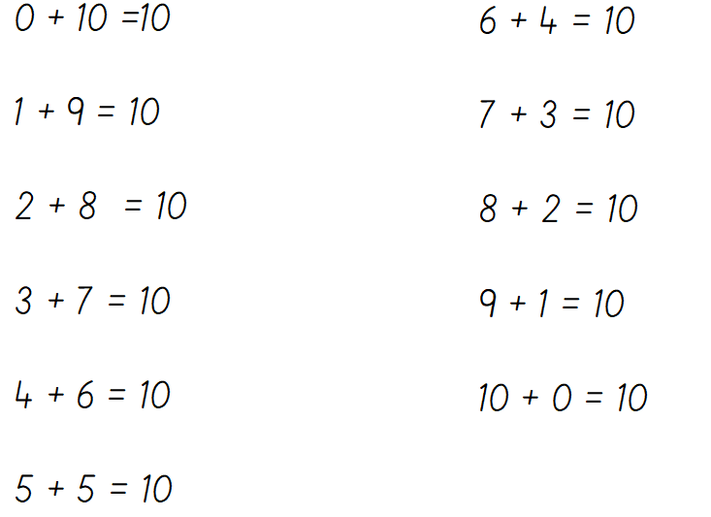
Main Input
Can you read them and say them aloud?
Notes:
Say the number sentence out loud.

Slide 5
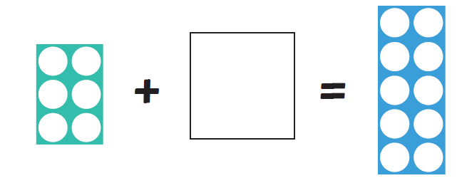
Can you identify the missing number?
Notes:
6 add a missing number = 10 which number is missing? E.g. 6 + 4 = 10

Slide 6
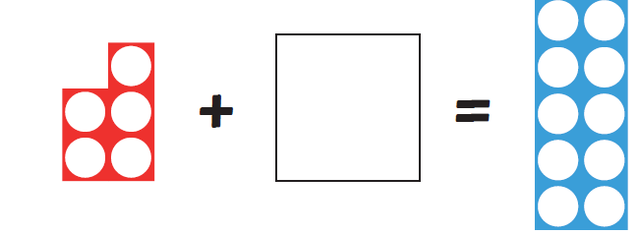
Can you identify the missing number?
Notes:
5 add a missing number = 10 which number is missing? E.g. 5+ 5 = 10

Slide 7
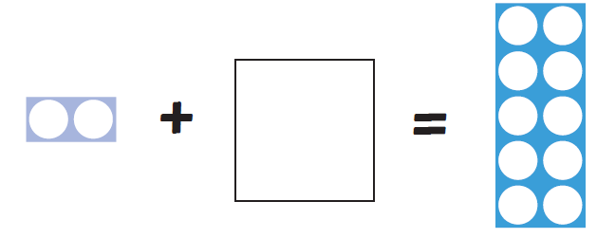
Can you identify the missing number?
Notes:
2 add a missing number = 10 which number is missing? E.g. 2+ 8 = 10

Slide 8
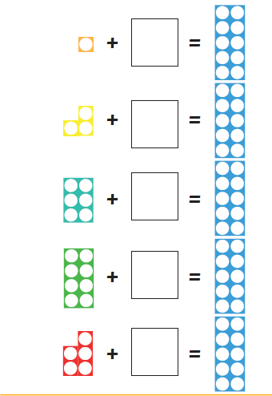
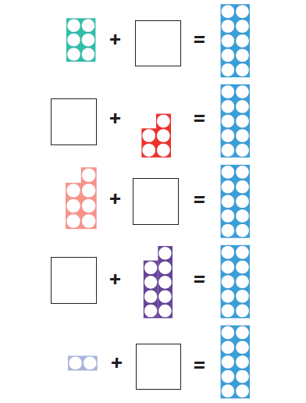
Now use this information to help you complete the main activity.

