Slide 1
Maths
WB 25.1.21

Slide 2
Thursday

Slide 3
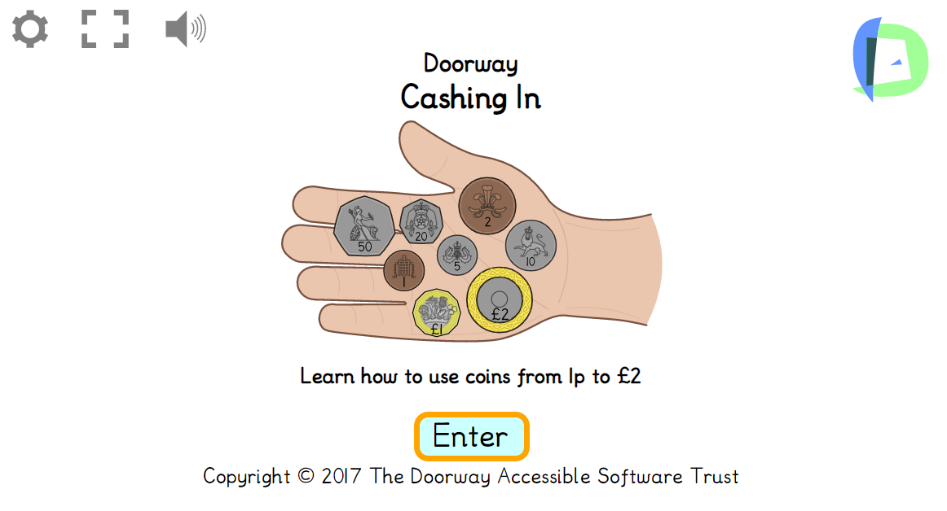
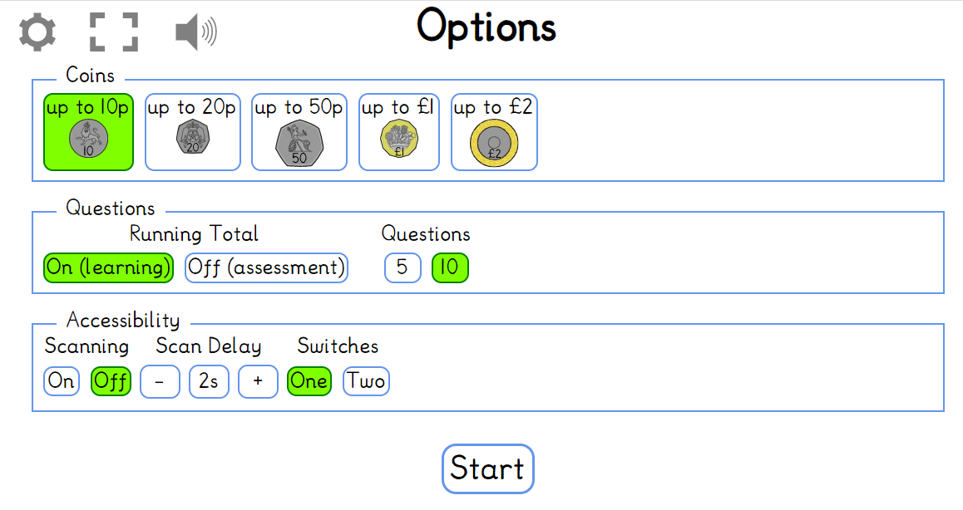
Starter – Lets recap our money knowledge using Cashing in, children will make an amount using the correct coins? Follow the instruction below.
https://www.doorwayonline.org.uk/activities/cashing-in/cashing-in.html
Click Enter
Make sure you are on coins up 10p & press start

Slide 4
Main Input
Today we are going to be learning how to half different numbers.
When we half a number we share the number equally between two.
Watch the clip about halving number
https://www.bbc.co.uk/programmes/p017kztf

Slide 5
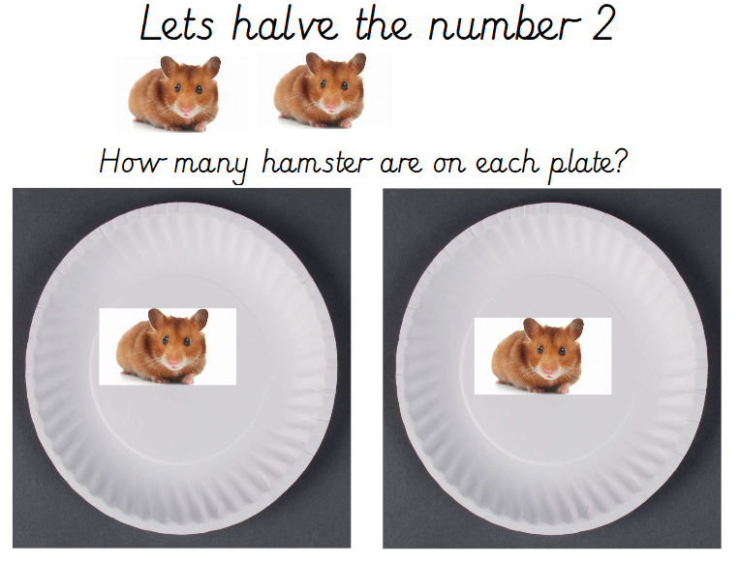
Half of 2 = ?

Slide 6
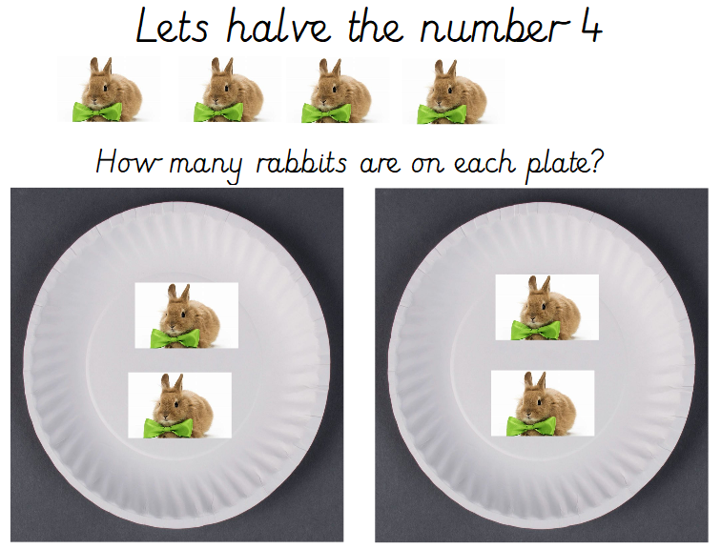
Half of 4 = ?

Slide 7
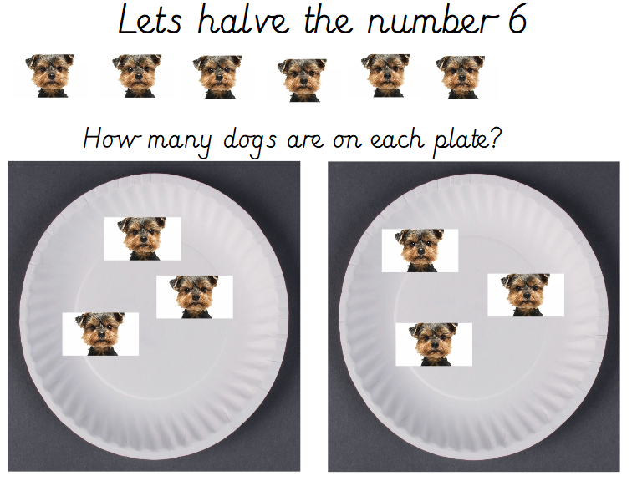
Half of 6 = ?

Slide 8
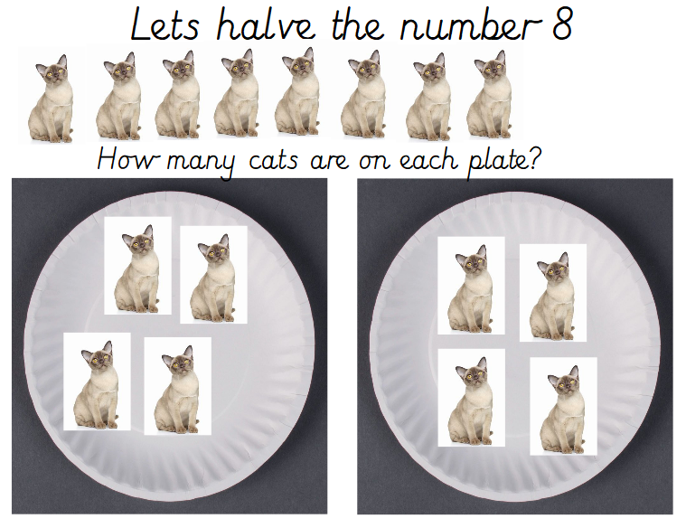
Half of 8 = ?

Slide 9
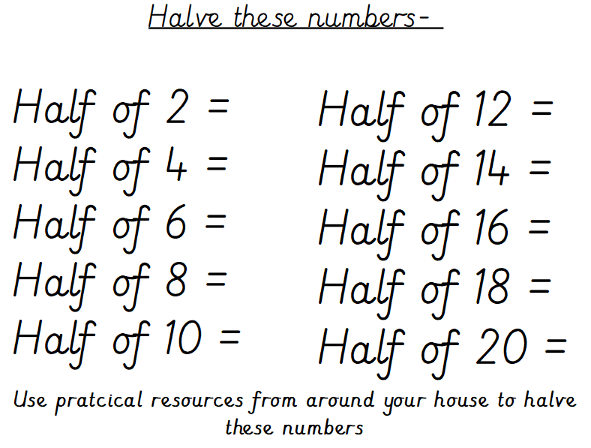
Main Activity

