Slide 1
Thursday
WB 1.2.21

Slide 2
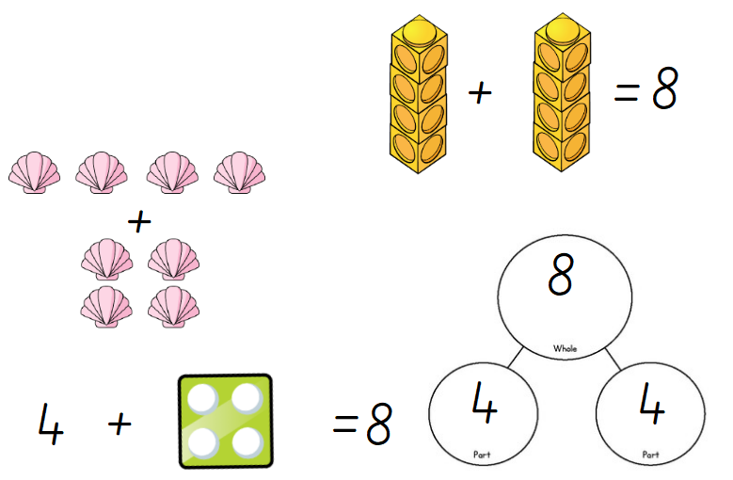
White Rose Challenge -
Notes:
4+4=8

Slide 3
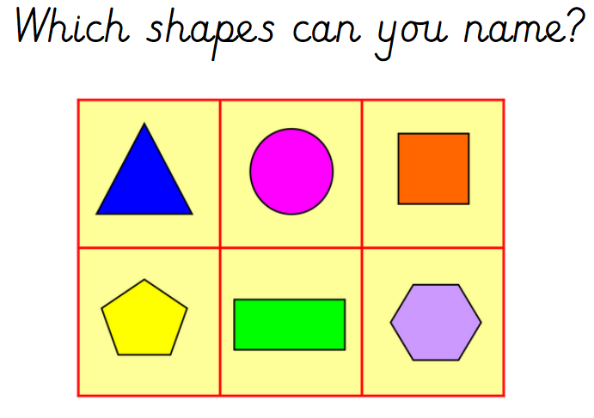
Starter- Lets recap our Shapes by singing our favourite Shape song
https://www.youtube.com/watch?v=OEbRDtCAFdU
Can you describe one of the shapes and let somebody guess which shape your describing?

Slide 4
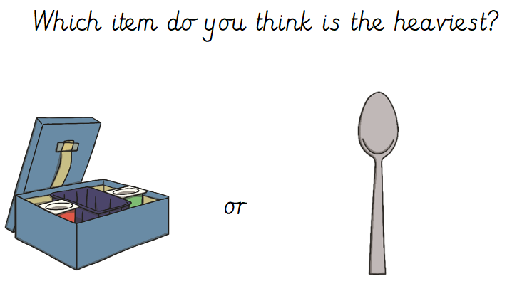
Main Input-

Slide 5
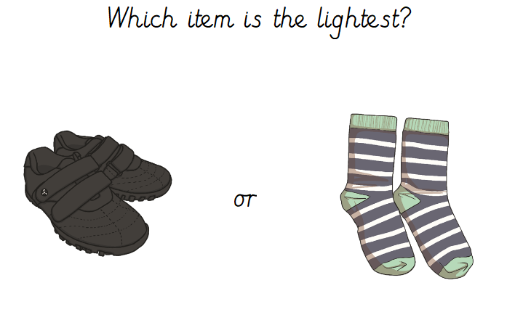
Main Input-

Slide 6
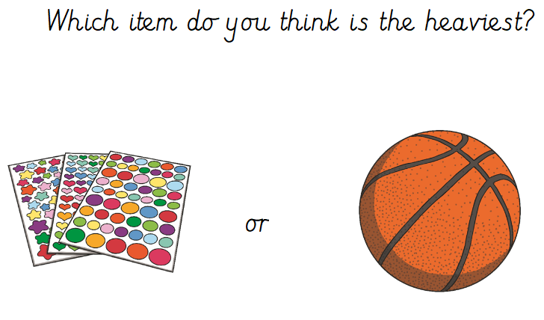
Main Input-

Slide 7
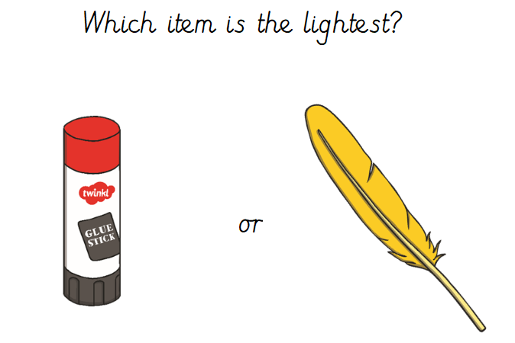
Main Input-

Slide 8
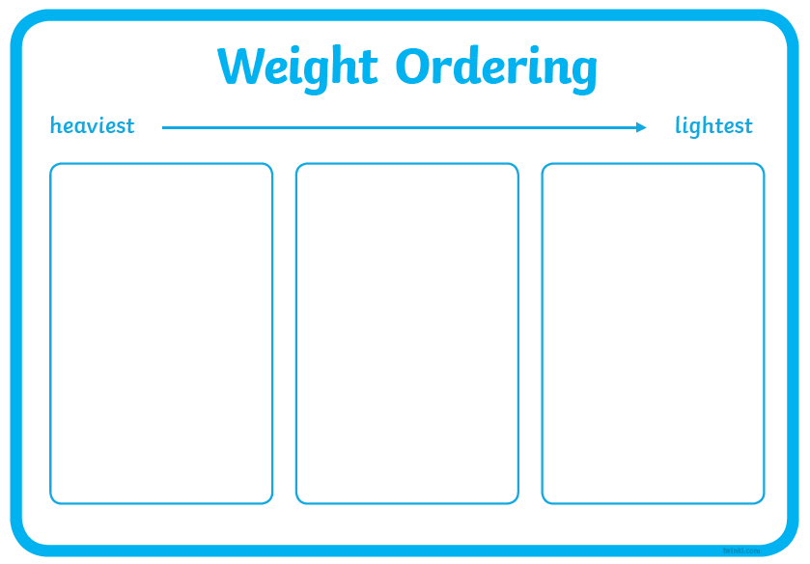

Main Activity –
Look at the 3 pictures.
Which picture do you think is the heaviest ?
Can you order the pictures from heaviest to lightest?
Complete the same activity with the pictures labelled ‘Items to sort – Maths’.

