Slide 1
Maths PowerPoint
WB 22.2.21

Slide 2
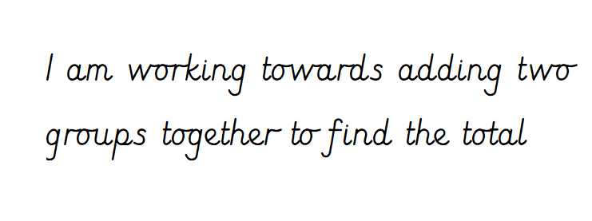
Thursday

Slide 3
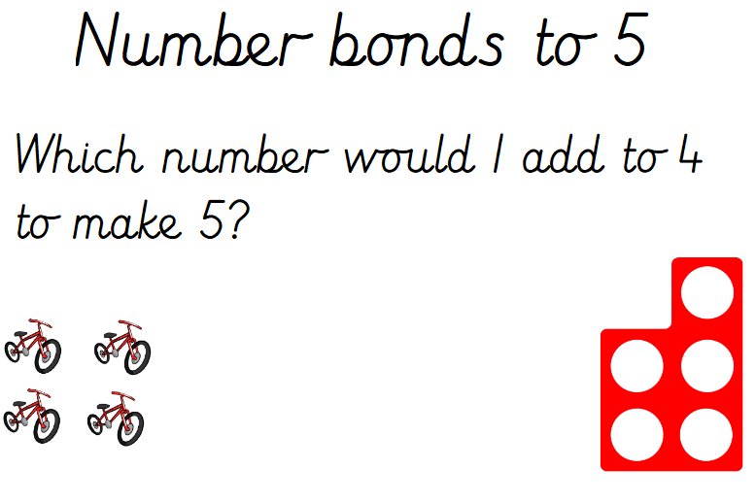
White rose starter

Slide 4
Starter
Let's recap counting in 2's 5's and 10's
https://www.youtube.com/watch?v=O-cARYvdtB4

Slide 5
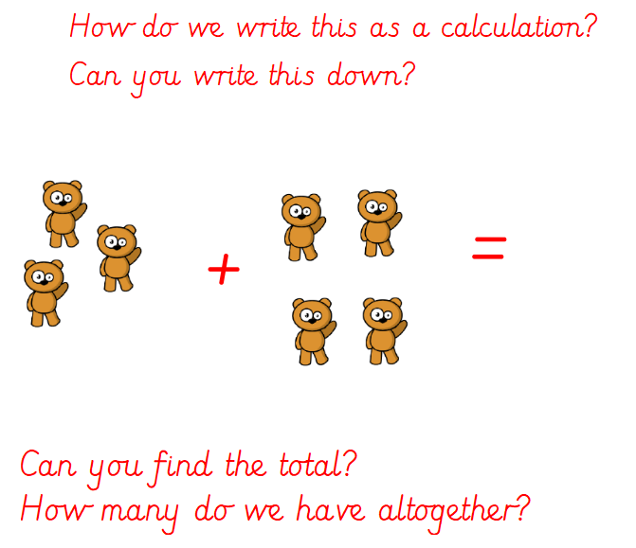
Main Input

Slide 6
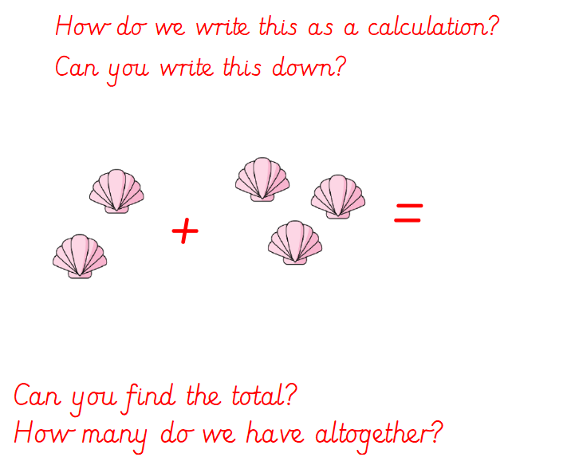

Slide 7
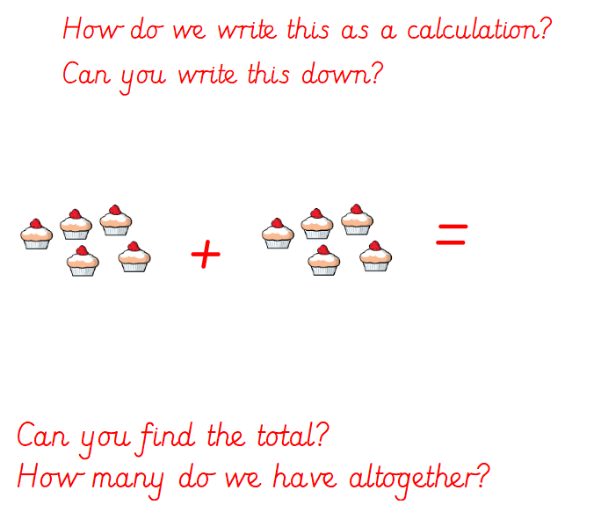

Slide 8
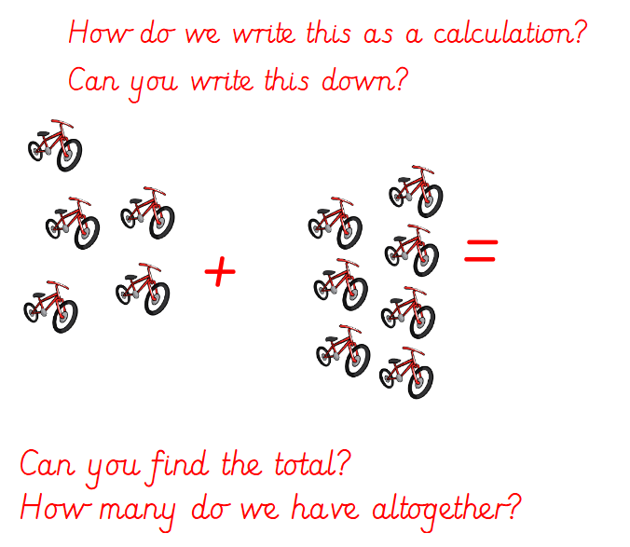

Slide 9
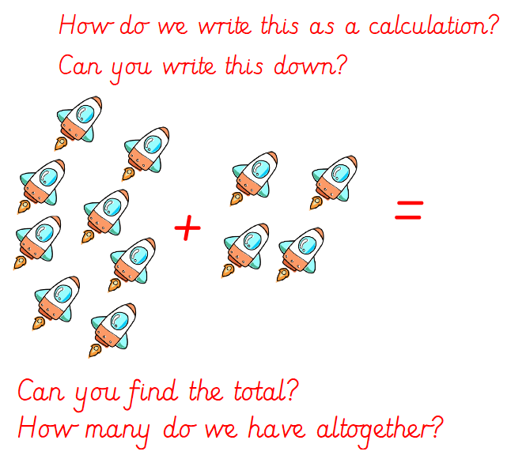

Slide 10
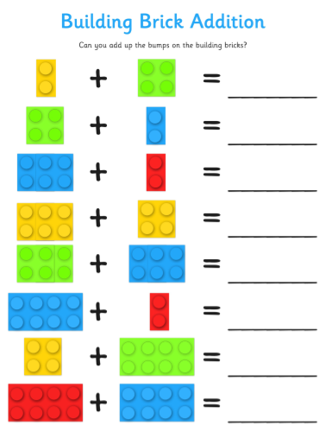
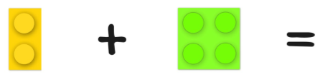
Main Activity
Complete the Building Bricks Addition Worksheet.
Can you write the number sentence next to the blocks.
1 + 4 =

