Slide 1
Maths
WB 18.1.21

Slide 2
Thursday

Slide 3
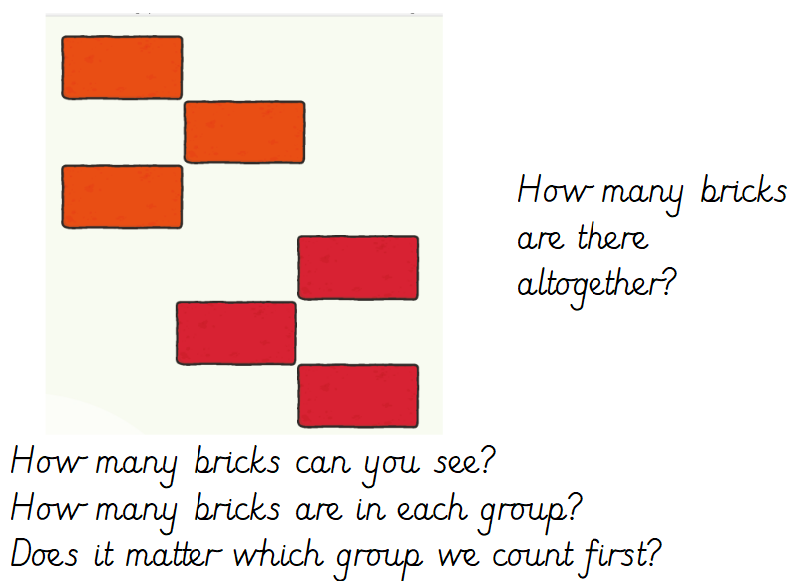
Starter –
Notes:
Look at the picture and answer the questions on the screen.

Slide 4
Main Input –
Work through the number bond rhymes

Slide 5

0 + 10
Big strong men

Slide 6

1 + 9
Feeling fine

Slide 7

2 + 8
Open the gate

Slide 8

3 + 7
Point to heaven

Slide 9
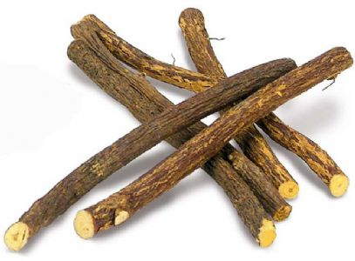
4 + 6
Pick up sticks

Slide 10
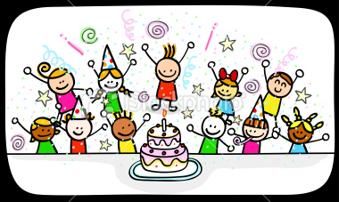
5 + 5
Come alive!

Slide 11

6 + 4
Knock on the door

Slide 12

7 + 3
Hot cup of tea

Slide 13

8 + 2
Feeling blue

Slide 14

9 + 1
Nearly done!

Slide 15
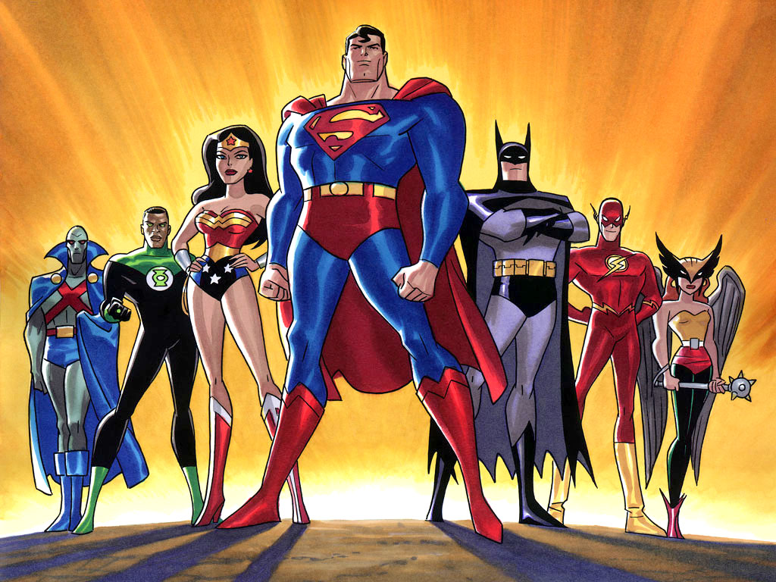
10 + 0
Are superheroes!

Slide 16
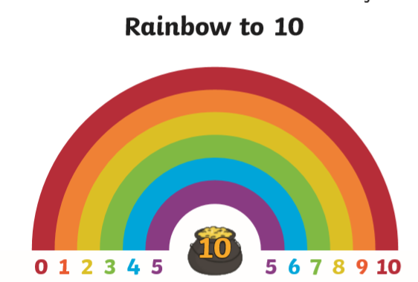
Use the number bonds rainbow to help you fill in the Rainbow Bonds worksheet
Notes:
Use the number bonds to 10 rainbow to help you fill in the blank rainbow worksheet.

