Slide 1
Maths
WB 25.1.21

Slide 2
Tuesday

Slide 3
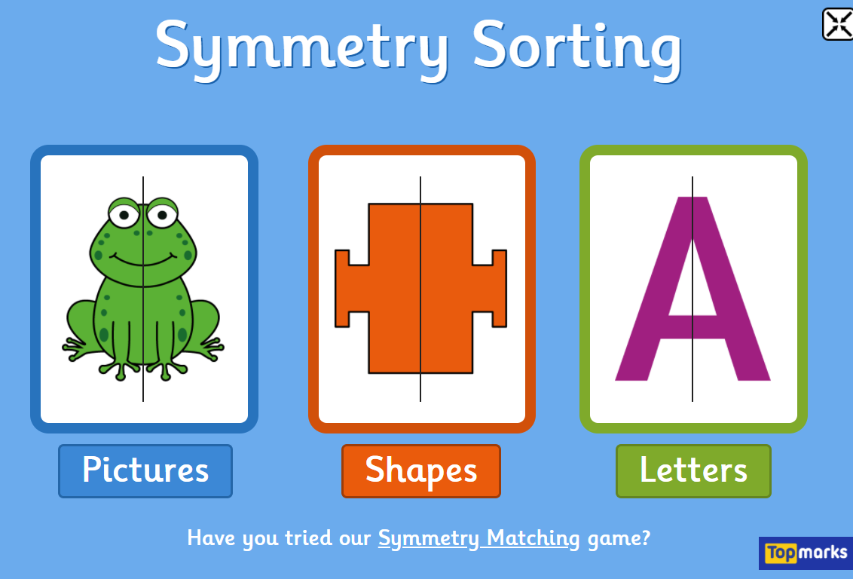
Starter- Today you will complete some symmetry sorting – remember the picture can only be symmetrical if it is exactly the same on both sides.
https://www.topmarks.co.uk/symmetry/symmetry-sorting
Complete the pictures section only – look at the picture and decide whether the picture is symmetrical or not and click on the correct heading.

Slide 4
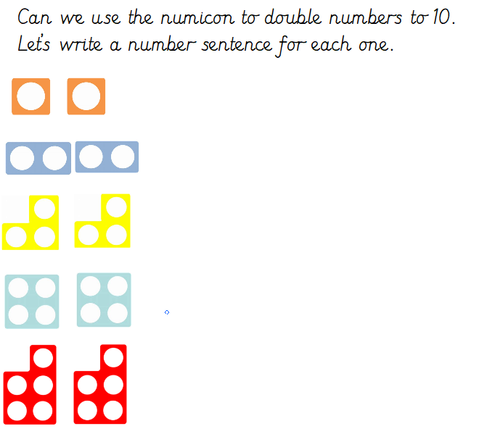
Today we are continuing to double numbers.
1 + 1 = 2
I have done the first one for you, can you use the numicon to help you complete the rest?

Slide 5
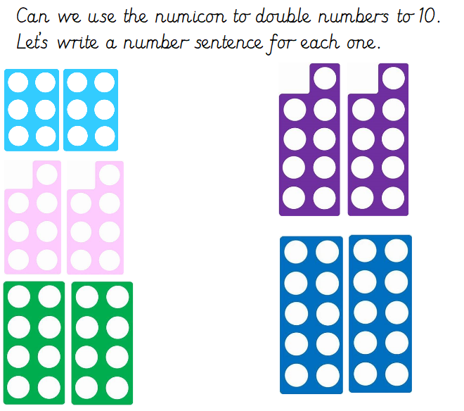

Slide 6
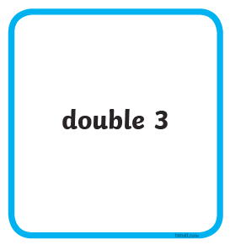

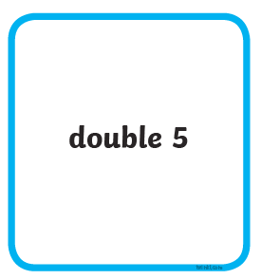

Now use the information you have learnt throughout the PowerPoint to help you match the correct statement with the picture.
I have done some for you!
3 + 3 = 6
5 + 5 = 10
Cut the statements and the pictures out and place them in front of you – can you match them correctly?

