Slide 1
Maths PowerPoint
WB 22.2.21

Slide 2
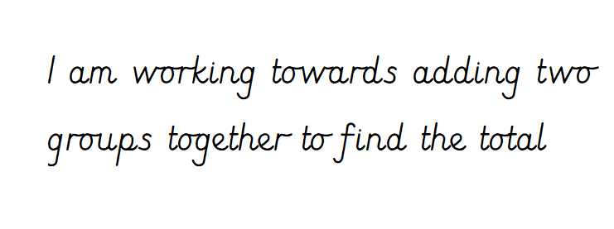
Tuesday

Slide 3
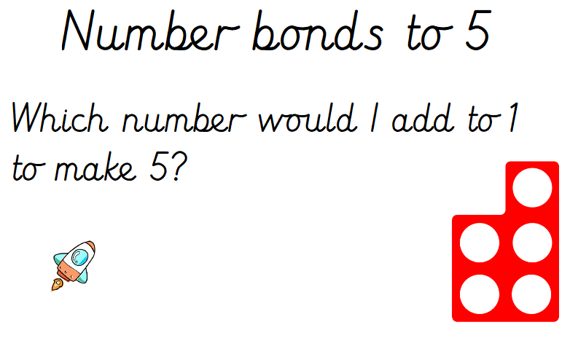
White rose starter

Slide 4
Starter
Lets practise our 5 times tables
https://www.bbc.co.uk/teach/supermovers/early-five-times-table/zfh6d6f
Can you count in steps of five ?

Slide 5
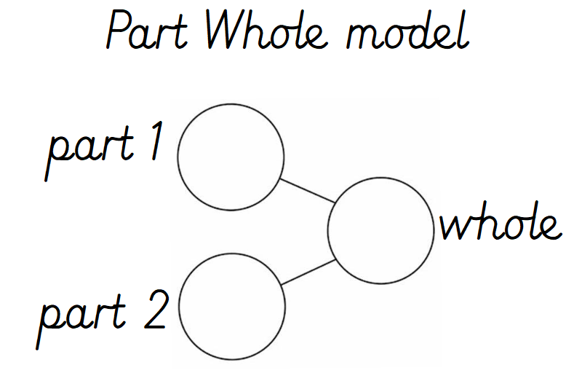
Main Input

Slide 6
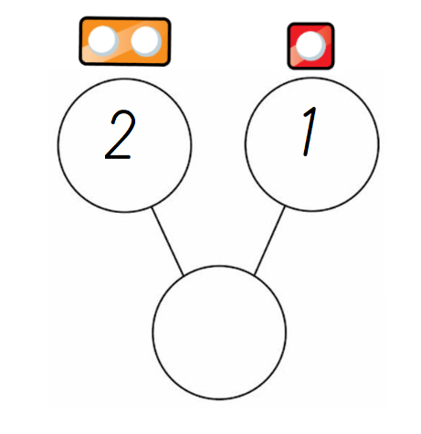
Can you add the two parts together to find the whole?

Slide 7
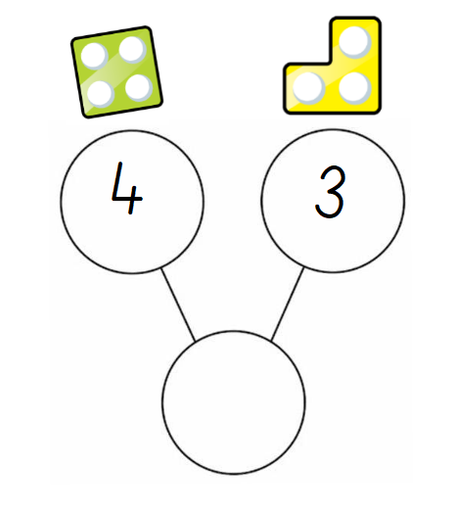
Can you add the two parts together to find the whole?

Slide 8
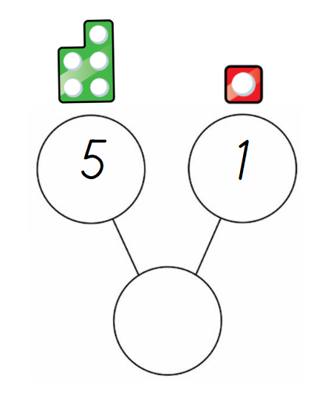
Can you add the two parts together to find the whole?

Slide 9
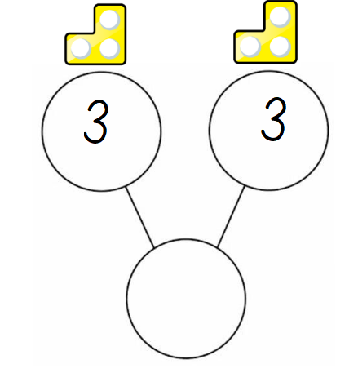
Can you add the two parts together to find the whole?

Slide 10
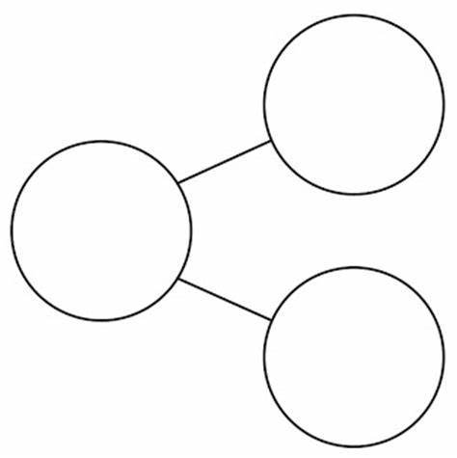

Main Activity
Can you use the part whole diagram and resources from around the house to answer these addition number sentences?
3 + 2 =
4 + 3 =
5 + 2 =
6 + 3 =
5 + 4 =
5 + 5 =
7 + 2 =
9 +2 =
E.g.
3 + 1 = 4

