Slide 1
Maths
WB 18.1.21

Slide 2
Tuesday

Slide 3
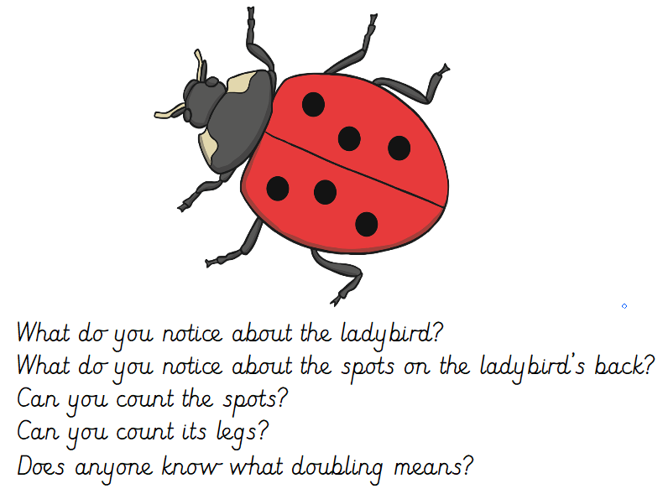
Starter –
Notes:
Look at the picture and answer the questions on the screen.

Slide 4
Main input –
Play the number bonds to 10 song
https://www.youtube.com/watch?v=OvbWuiYn-Uk

Slide 5
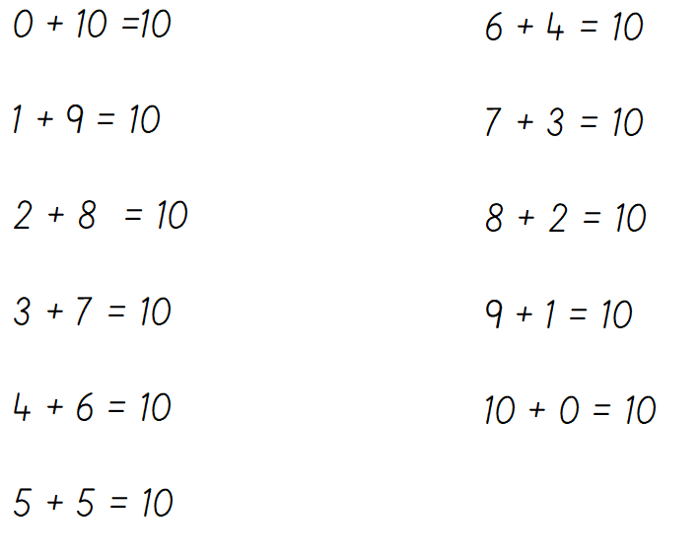
Use the song on the previous slide to help you fill in the missing numbers
Can you identify the missing number?
Notes:
Can you

Slide 6
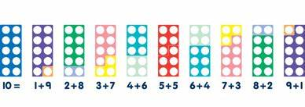
Without cheating can you write down your number bonds to 10
Use the Numicon you cut out last week or cut out the numicon worksheet to help you work out the answers.
Notes:
Children will use the numicon to work out the answers e.g. use the 10 plate on the bottom and place a 9 plate on top which plate is missing place a 1 plate to create 10. children would write 9 + 1 = 10

