Slide 1
Tuesday
WB 1.2.21

Slide 2
Starter- Can you order and sequence the patterns? https://www.topmarks.co.uk/ordering-and-sequencing/shape-patterns

Slide 3
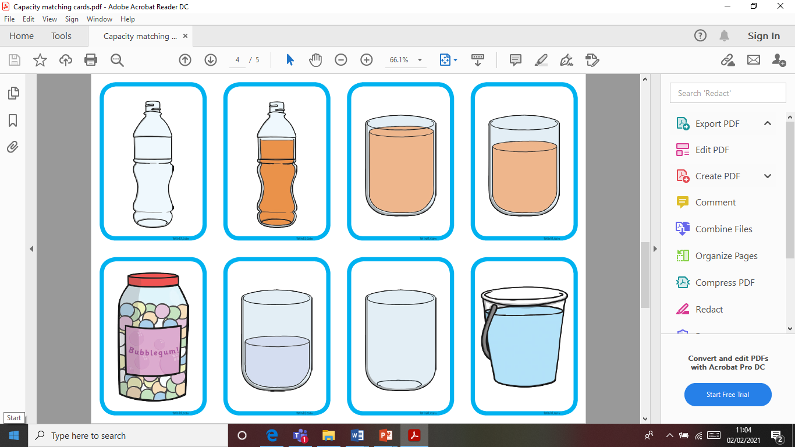
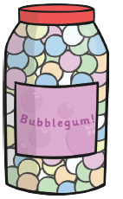
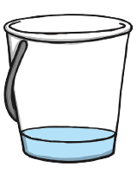
Main Input-
Look at the different containers, can you think of labels for each container e.g. empty, half-full, nearly full etc.

Slide 4
Main Activity –
Look at the labels and pictures attached. Can you match the different containers to the correct headings? What clues did you use? How did you work out where each container belongs?

