Slide 1
Maths
WB 25.1.21

Slide 2
Wednesday

Slide 3
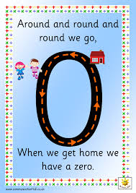
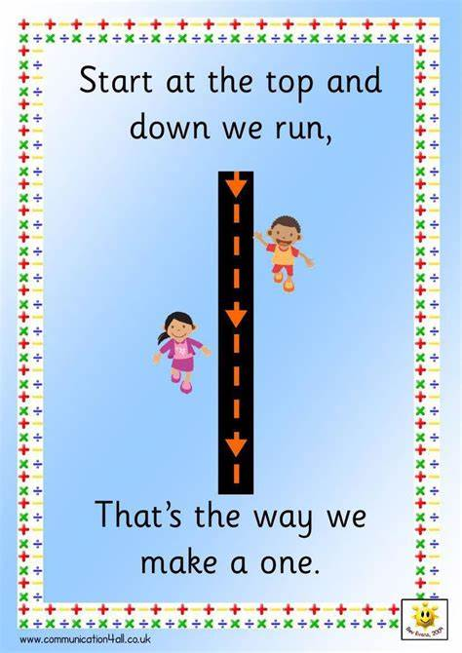
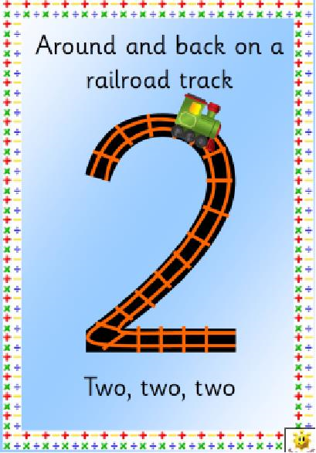
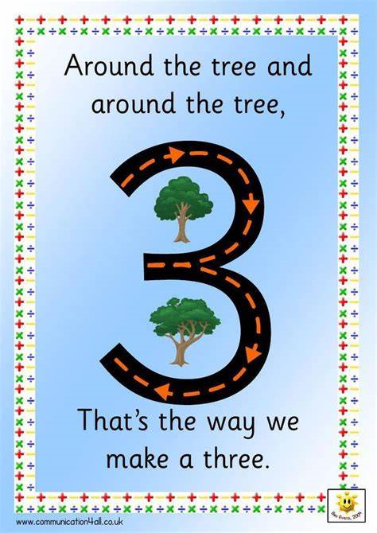
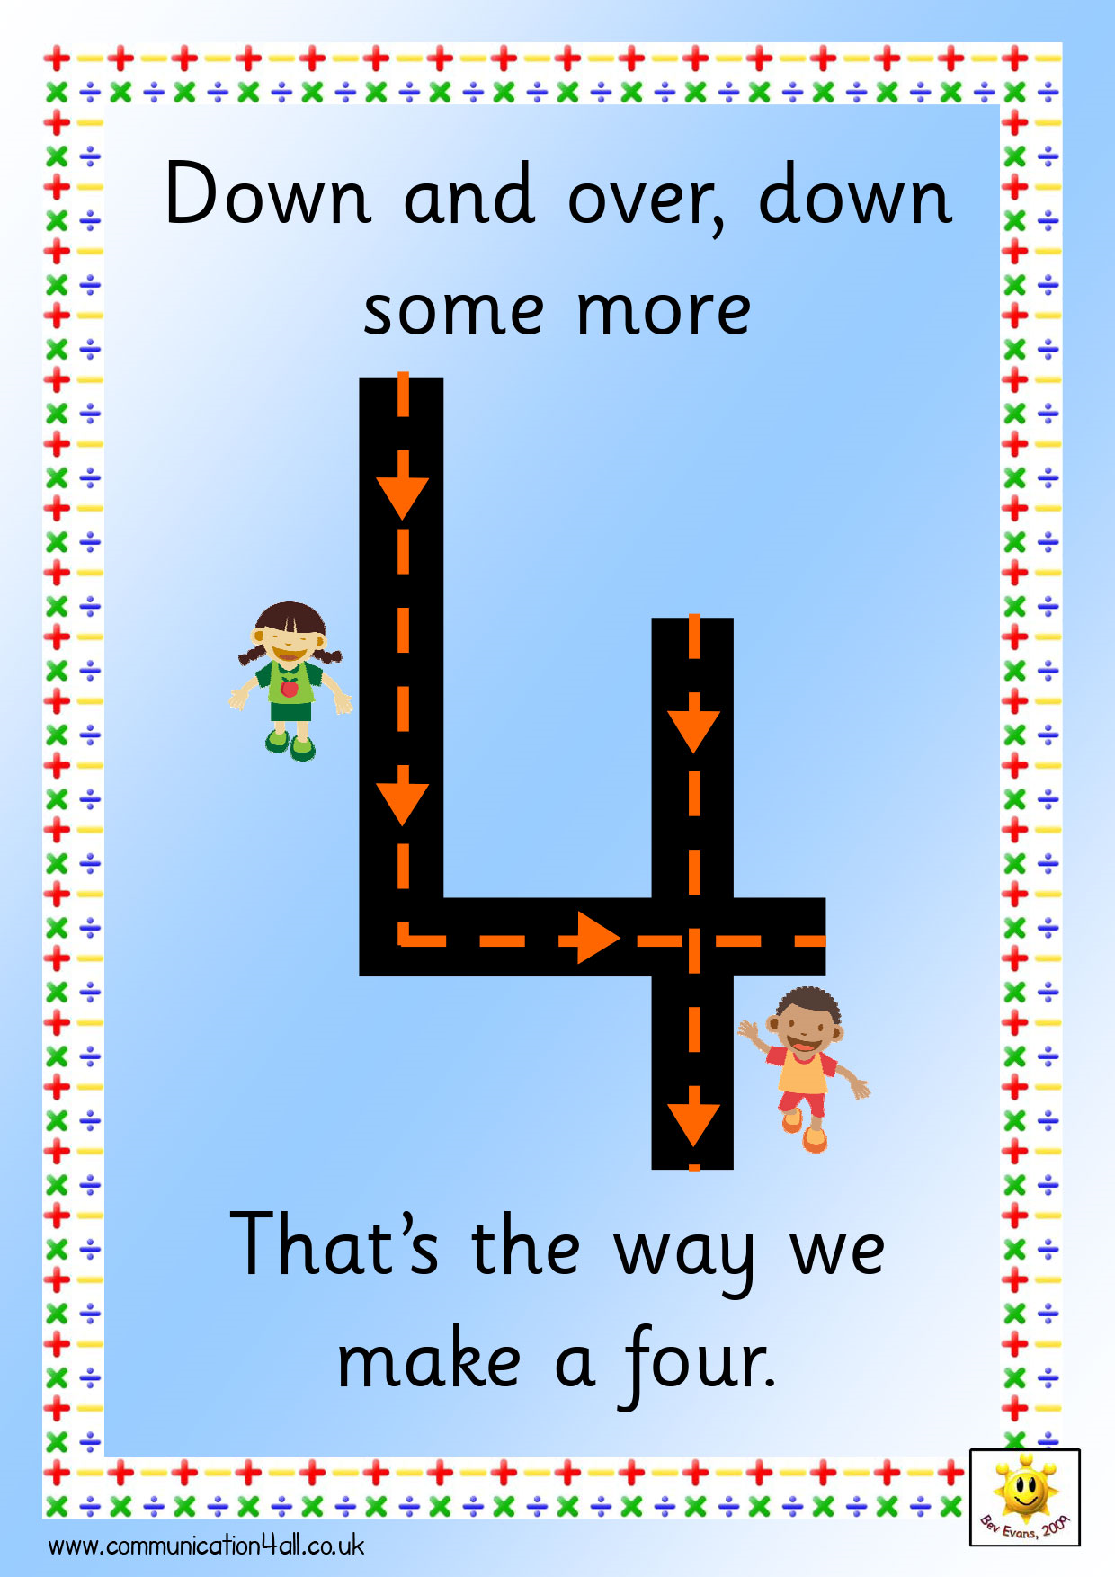
Starter-
Practise your number formation – write numbers 0-9 correctly.
Use our rhymes to support you.
Can you practise writing these numbers?

Slide 4
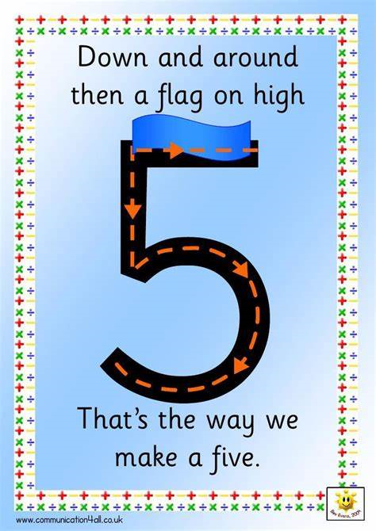
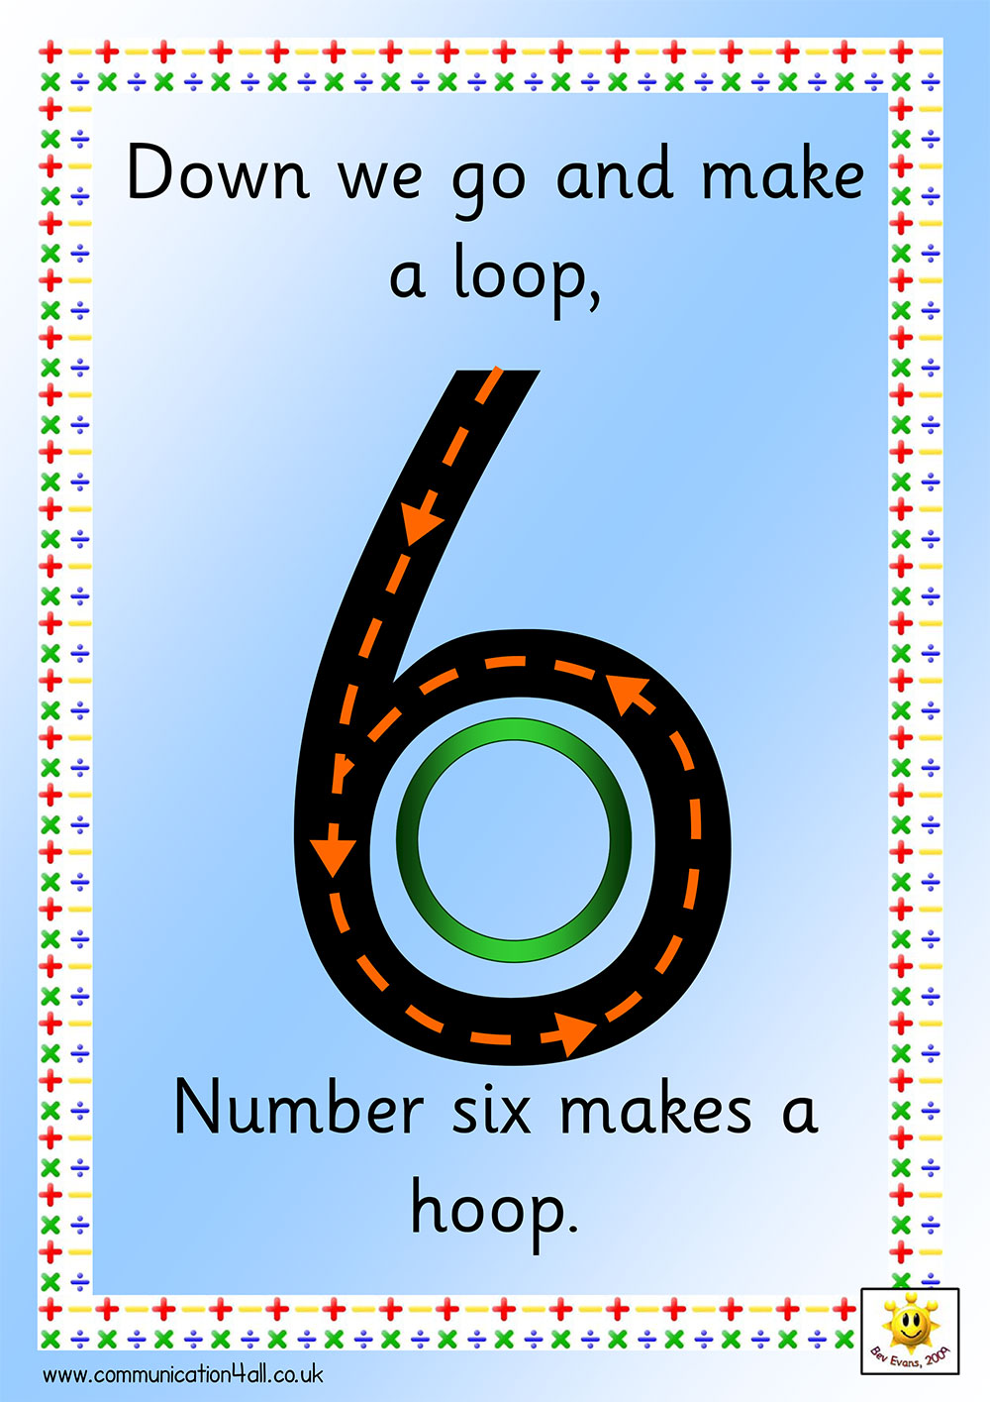
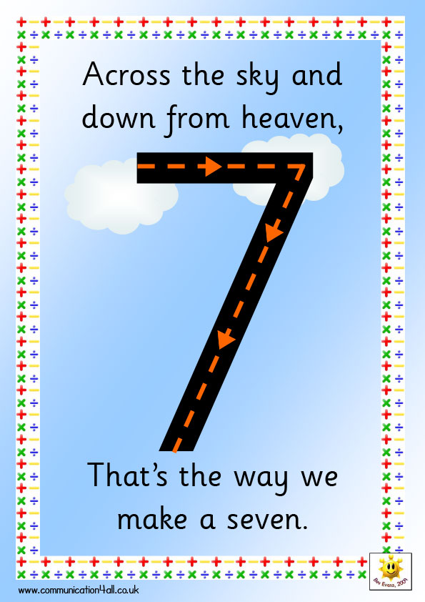
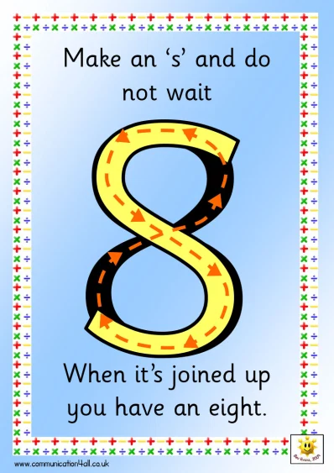
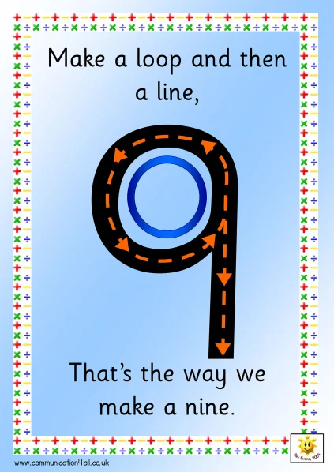
Remember if you can form your numbers 0 – 9 correctly you can write any number in the world – today we are only practising writing to 10.
Can you practise writing these numbers?

Slide 5
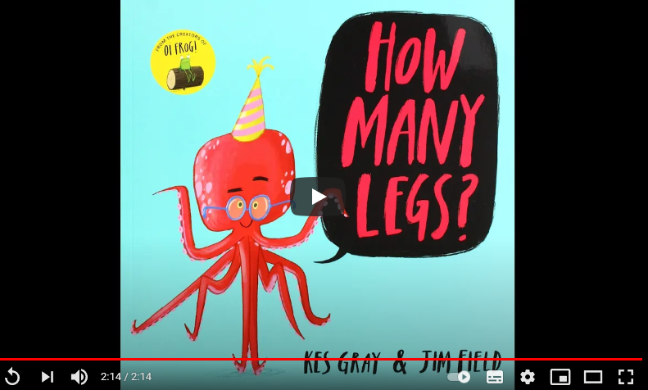
Main Input –
Read the book from beginning to end - ‘How many legs’ https://www.youtube.com/watch?v=WPpkle9VHPU
What did you think of the story?
Did you enjoy that it linked with our topic doubling?
Choose any page in the book – how many legs can you count on this page altogether?

Slide 6

Can you double this number use the apples to help you -
2

Slide 7
Can you double this number use the apples to help you -
4

Slide 8
Can you double this number use the apples to help you -
6

Slide 9
Can you double this number use the apples to help you -
8

Slide 10
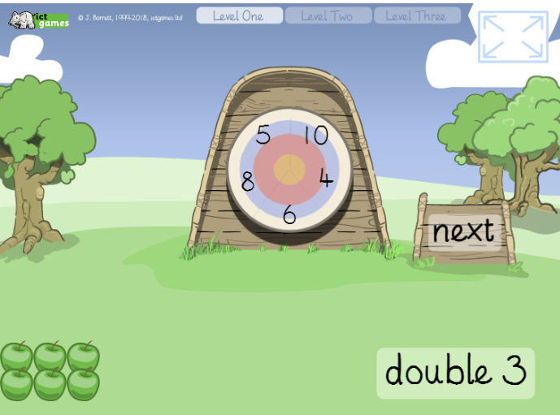
Work through the doubling computer game -
https://www.ictgames.com/mobilePage/archeryDoubles/index.html
Double 3
Count the apples
Click on the number 6
Press next

