Slide 1
Wednesday
WB 1.2.21

Slide 2
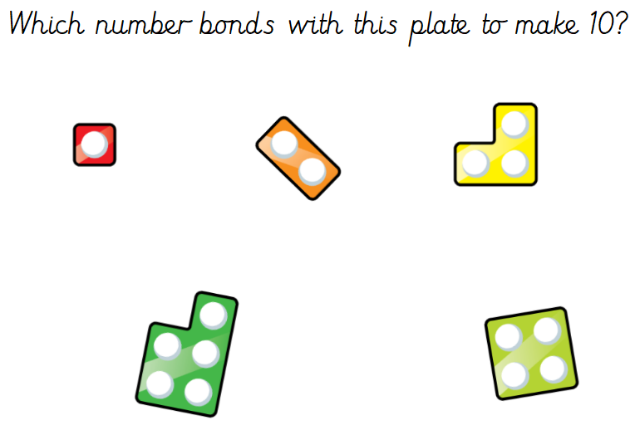
White Rose Challenge – Quick flash number bonds
Notes:
2+5=7

Slide 3
Starter- Lets recap our days of the week by singing one of our favourite songs. https://www.youtube.com/watch?v=mXMofxtDPUQ
If you want to test yourself try writing them down in the correct order – Remember to spell them correctly.

Slide 4
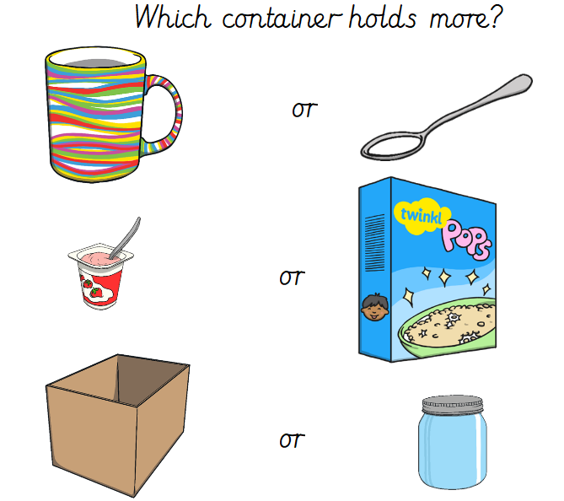
Main Input-
Imagine you had these containers in your kitchen and you were holding them-
Which container do you think would be the heaviest/lightest ?

Slide 5
Main Activity –
Step 1- Find some items around your house e.g. Teddy bear, beaker cup, cushion, book, pan.
Step 2- Pretend your hands are scales.
Step 3 – Compare the different objects and use the correct vocabulary to describe them
e.g. The Teddy is lighter than the pan.
The book is heavier than the cup.

