Slide 1
Maths PowerPoint
WB 22.2.21

Slide 2
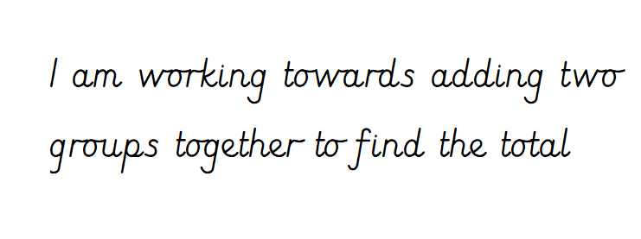
Wednesday

Slide 3
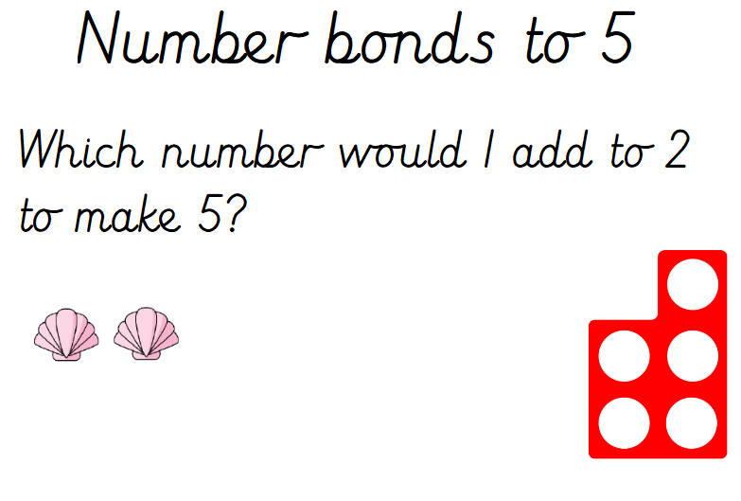
White rose starter

Slide 4
Starter
Lets practise our 10 times tables
https://www.bbc.co.uk/teach/supermovers/ks1-maths-the-10-times-table-with-webster-the-spider/zm32cqt
Can you count in steps of ten ?

Slide 5
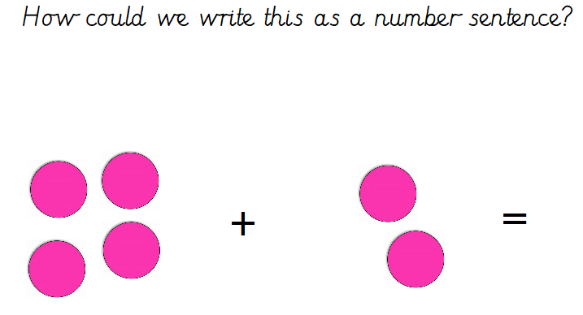
Main Input

Slide 6
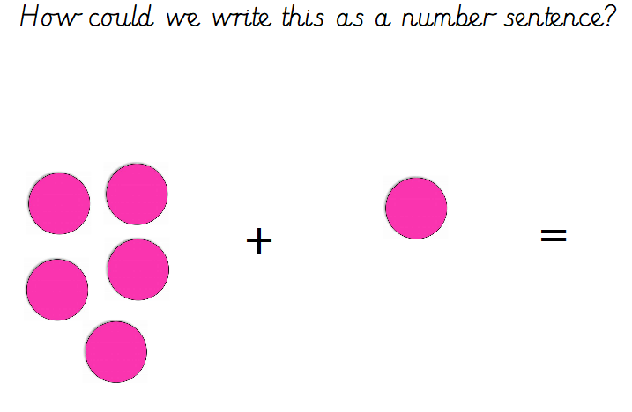

Slide 7
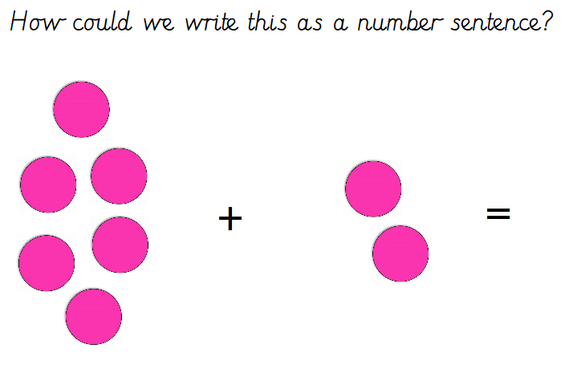

Slide 8
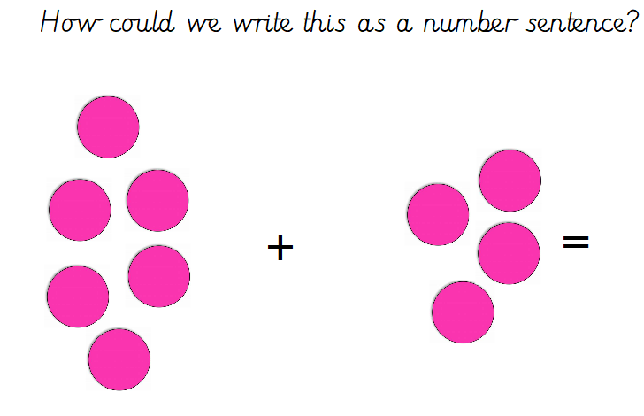

Slide 9


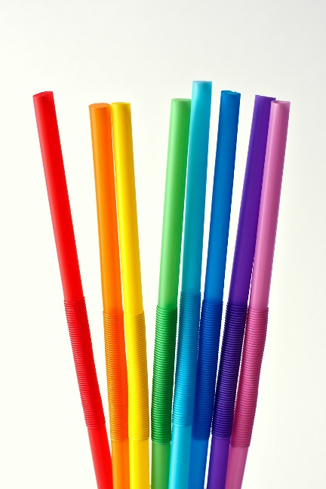
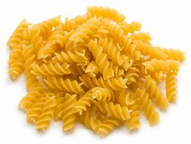
Main Activity
Work through these number sentences and find the total using resources from around your house.
3 + 4 =
5 + 1 =
4 + 4 =
6 + 3 =
7 + 3 =
8 + 3 =
9 + 4 =
10 + 2 =

Slide 10
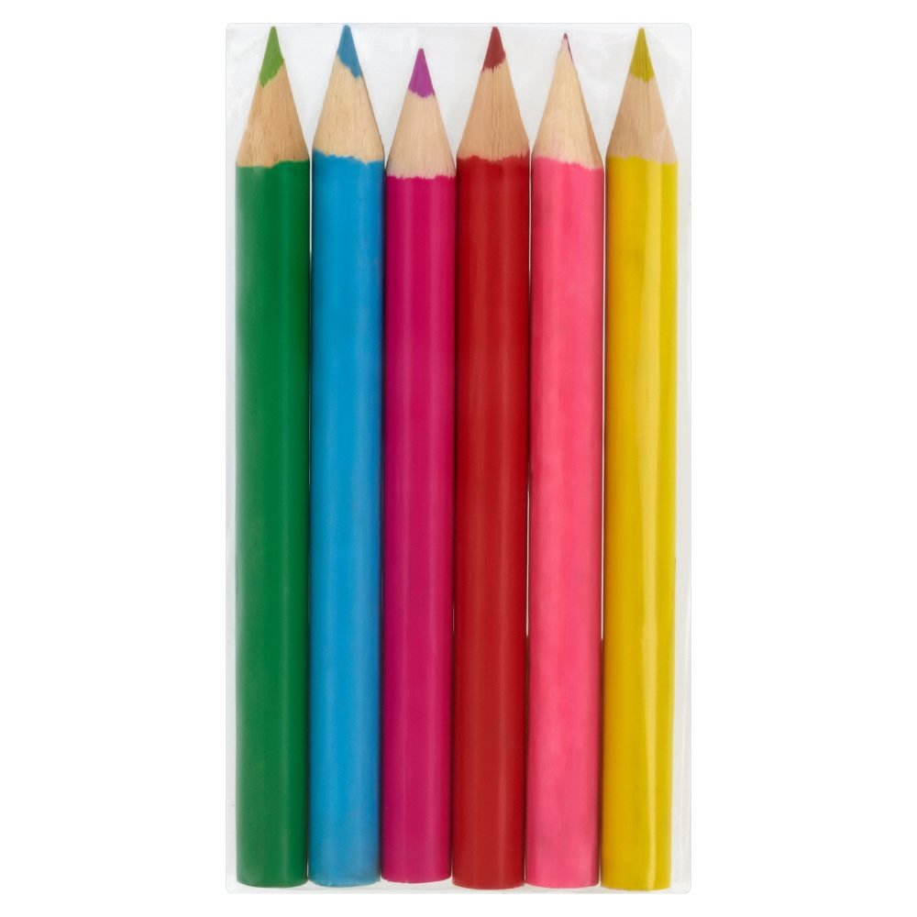
Remember to have two groups of the objects and when adding them together to find the total count each individual object 1:1. e.g. 2 + 4 =
+
=

