Slide 1
Maths
WB 18.1.21

Slide 2
Wednesday

Slide 3
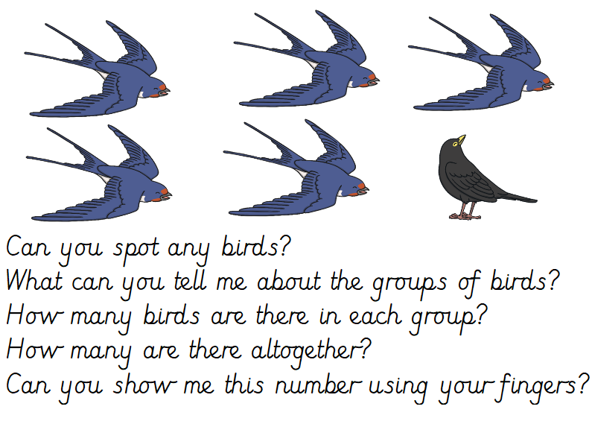
Starter –
Notes:
Look at the picture and answer the questions on the screen.

Slide 4








Main Input
Can you identify the missing number to complete the number sentence ?
5 + = 10
+ 9 = 10
3 + 7 =
4 + = 10
+ 2 = 10
+ 1 = 10
+ 8 = 10
6 + = 10
Notes:
Look at the different coloured counters count the number of orange counters and write the number down, count the blue counters and write the number down. Then you can compile a number sentence using the number e.g. 5+5=10, 1+9=10, 3+7=10, 4+6=10, 8+2=10, 9+1=10, 2+8=10, 6+4=10.

Slide 5

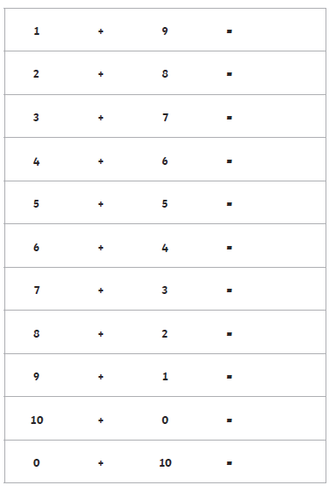
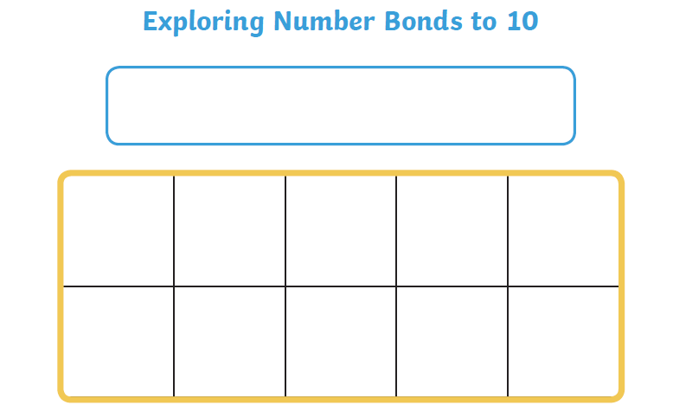
Main Activity
Cut out the counters and use them to create the different number bonds to 10.
Notes:
Use the worksheet to support your child in making the different number bonds – 1 orange counter and 9 blue counters = 1+9=10 etc.

