Slide 1
Maths
WB 25.1.21

Slide 2
Friday

Slide 3
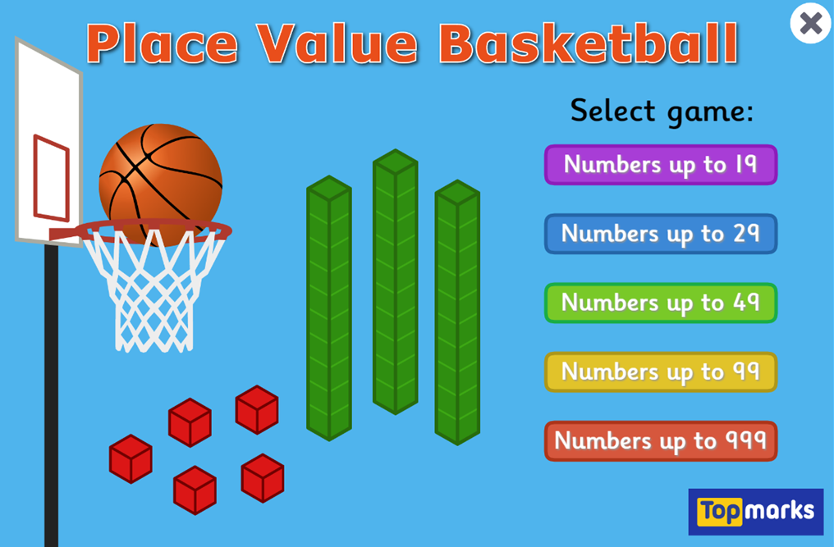
Starter -Children will be show a number represented by tens and ones. Count how many tens and ones there are to find the number – choose the correct number from the given option.
https://www.topmarks.co.uk/learning-to-count/place-value-basketball
Work on numbers up to 19 – if you would like to push your child further move up to 29 ( do not work on numbers beyond 29.

Slide 4

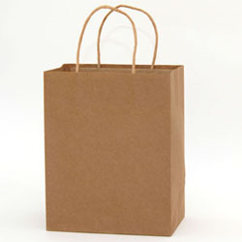






Main Input

Slide 5

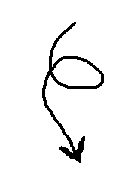

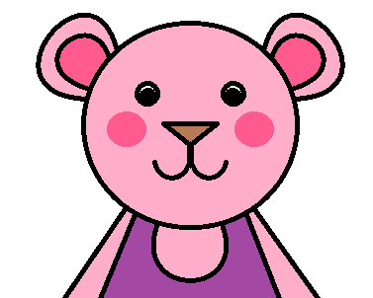
This is Meredith.
And this is her best friend, Harvey.

Slide 6
Everyday, after school, Meredith and Harvey walk to Mr. Matt’s Magic Sweet Shop.

Slide 7
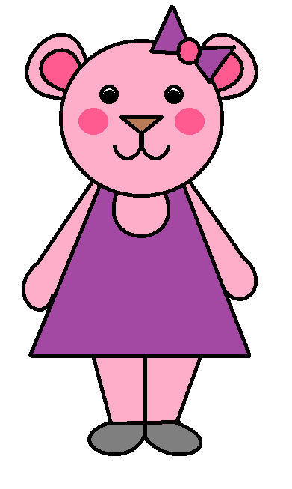


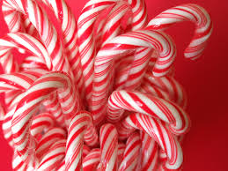
They help Mr. Matt walk his dog, Fluffy.
As a way of saying thank you. Mr. Matt gives Meredith and Harvey 1 bag of magic sweets to share with each other.
Can you help Meredith and Harvey share out the sweets?

Slide 8




In this bag of sweets, there are 2 candy canes. If we give both of them to Meredith, is that fair?
No
No

Slide 9
What about if we give one to Meredith and 1 to Meredith and 1 to Harvey?
A candy cane for Meredith
A candy cane for Harvey
Yes!
Yes!

Slide 10
So, half of 2, is 1

Slide 11
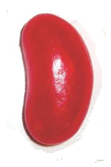
In this bag of sweets, there are 4 jumping jelly beans. If we give 3 of them to Meredith, is that fair?
No
No

Slide 12
How many do you think we have to give Meredith and to Harvey so that it is fair?
A Jelly bean for Meredith
A Jelly bean for Meredith
A Jelly bean for Harvey
A Jelly bean for Harvey
Yes!
Yes!

Slide 13
So, half of 4, is 2

Slide 14

In this bag of sweets, there are 6 chewy chocolate stars. How many do we have to give to Meredith and Harvey so that it is fair?
A star for Harvey
A star for Meredith
A star for Harvey
A star for Meredith
A star for Harvey
A star for Meredith
Yes!
Yes!

Slide 15
So, half of 6, is 3

Slide 16

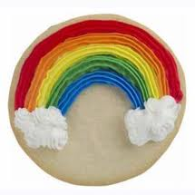
In this bag of sweets, there are 8 soft rainbow biscuits. How many do we have to give to Meredith and Harvey so that it is fair?
A biscuit for Meredith
A biscuit for Harvey
A biscuit for Meredith
A biscuit for Harvey
A biscuit for Meredith
A biscuit for Harvey
A biscuit for Meredith
A biscuit for Harvey
Yes!
Yes!

Slide 17
So, half of 8, is 4

Slide 18
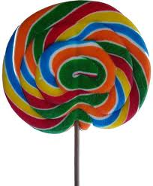
What do you think is half of 10?
5

