Slide 1
Maths PowerPoint
WB 1.3.21

Slide 2
Friday
I am working towards taking a number away from another number to find the answer

Slide 3
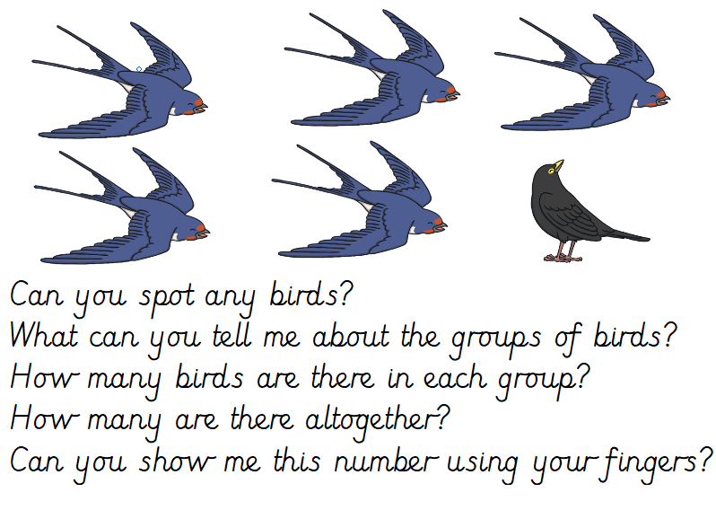
White rose starter

Slide 4
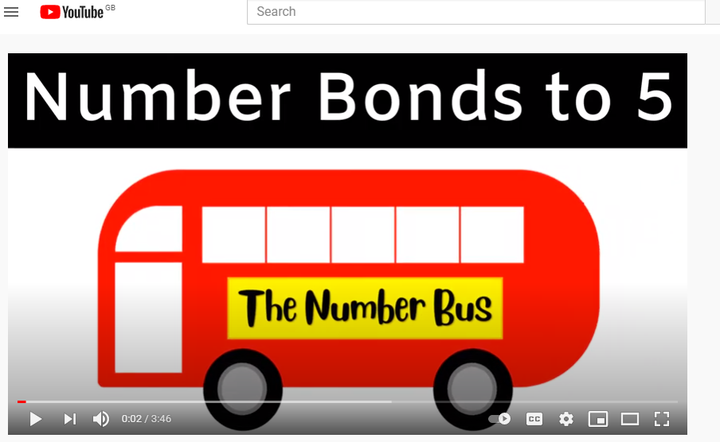
Starter
Lets recap our number bonds to 5 using the Number Bond bus!
https://www.youtube.com/watch?v=We0SUCcY_NY

Slide 5
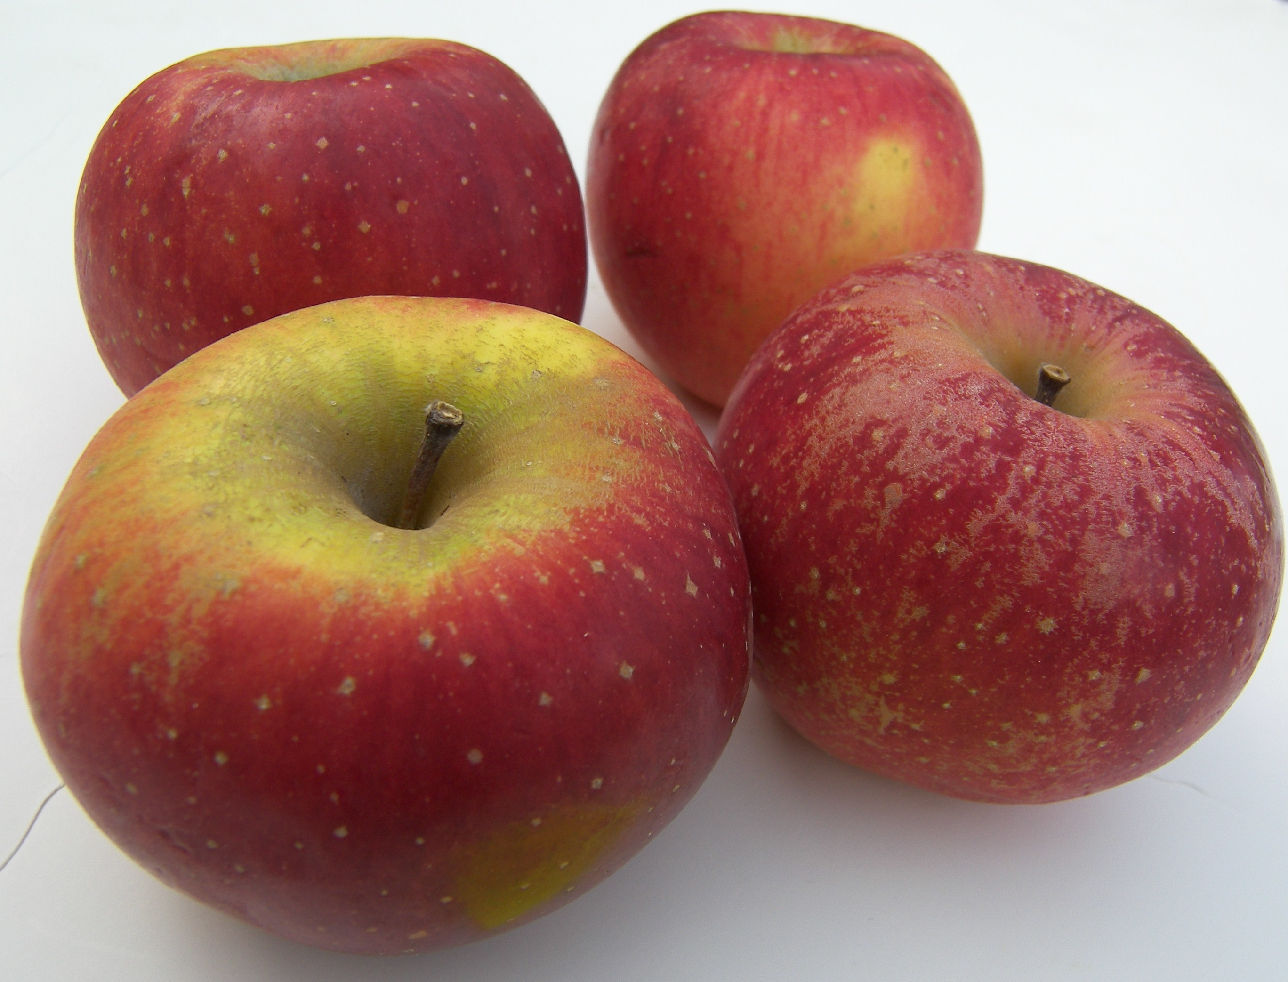
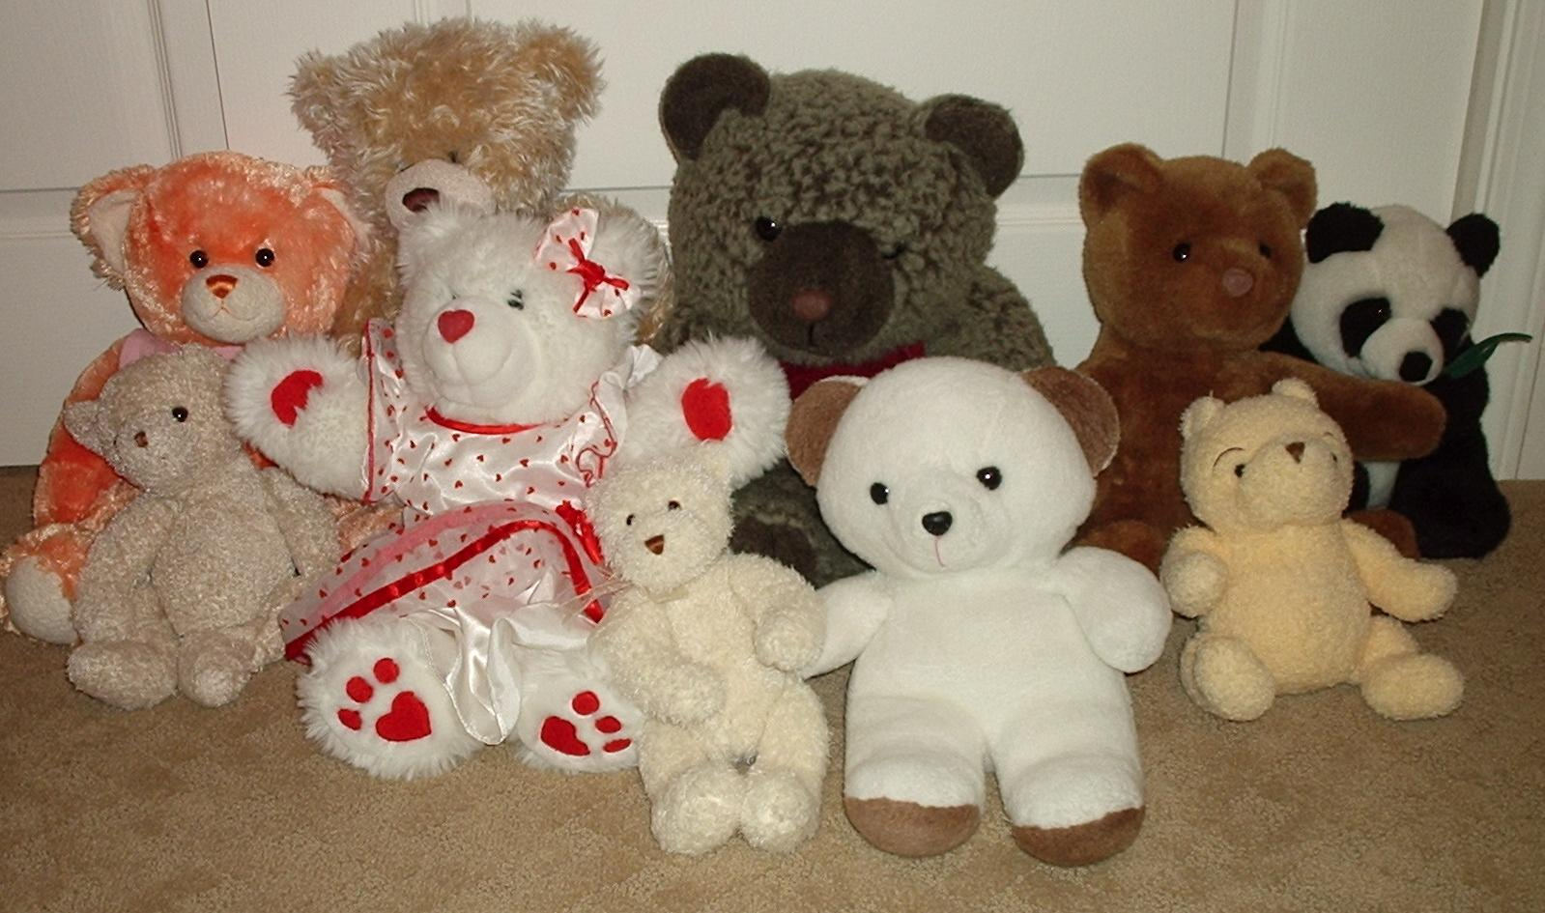
Main Input
Can you find objects from around the house to create your own take away sums?
For Example -
4
10
-
=

Slide 6
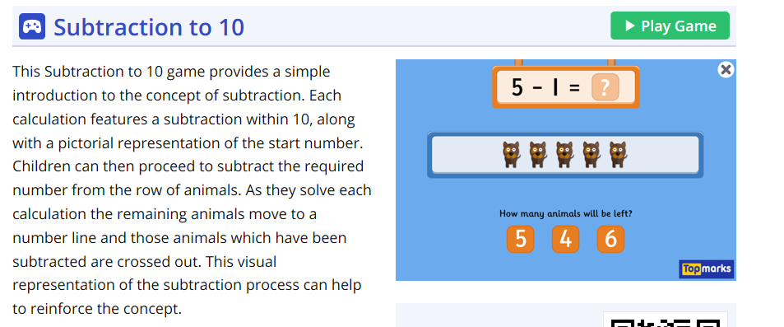
Main Activity
Today you will work out the answer to these subtraction question – if you struggle remember you can use any of the methods that you have learnt this week.
https://www.topmarks.co.uk/subtraction/subtraction-to-10

