Slide 1
Maths PowerPoint
WB 1.3.21

Slide 2
Monday
I am working towards taking a number away from another number to find the answer

Slide 3
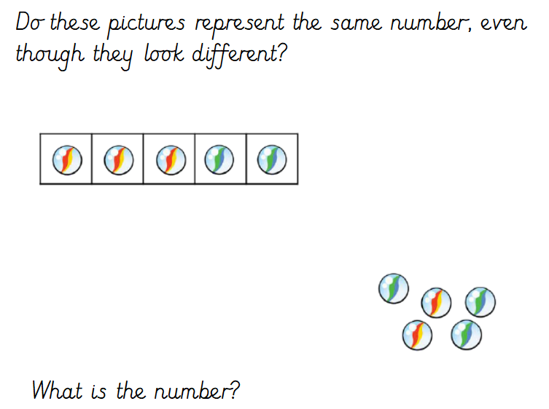
White rose starter

Slide 4


Starter
Can you use the Numicon to make a pattern?

Slide 5
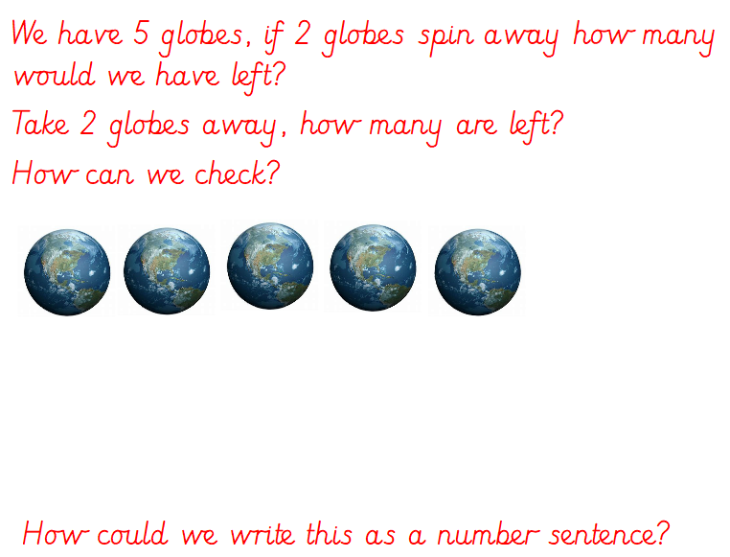
Main Input

Slide 6
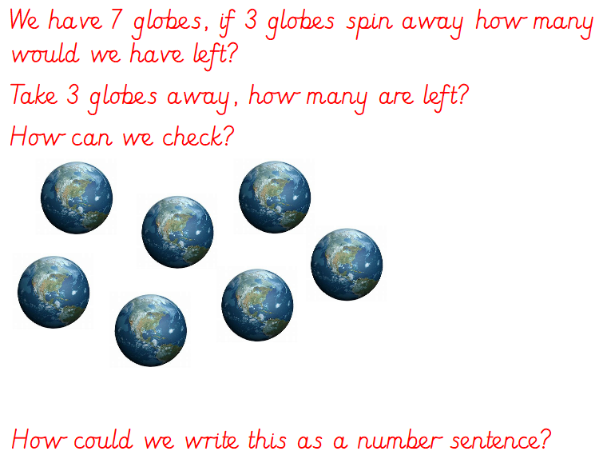

Slide 7
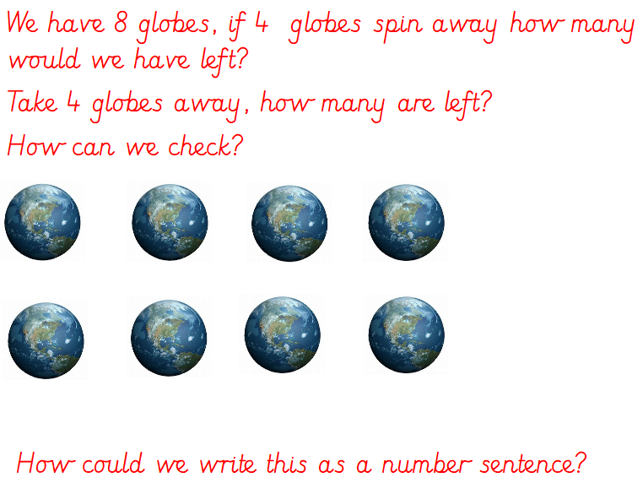

Slide 8
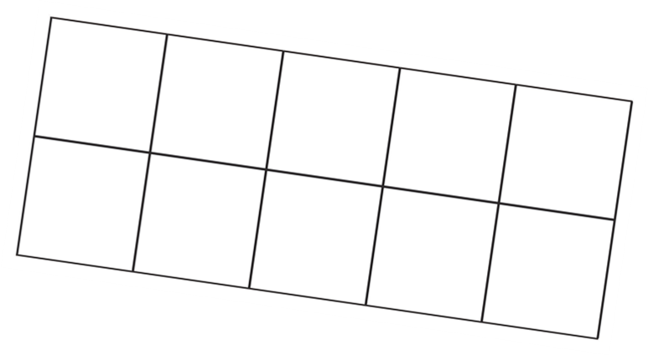

Main Activity
Can you use the tens frame to work out the answer to the different take away number sentences?
4 - 1 =
Count out 4 counters and place them on the tens frame, now take 1 away. How many are left?

Slide 9
Today we will use the Tens Frame to work out the answer to these take away number sentences.
2 - 1 =
3 - 2 =
5 - 3 =
4 - 2 =
6 - 4 =
7 - 1 =
8 - 3 =
Challenge - Can you think of your own number sentences?

