Slide 1
Maths PowerPoint
WB 1.3.21

Slide 2
Thursday
I am working towards taking a number away from another number to find the answer

Slide 3
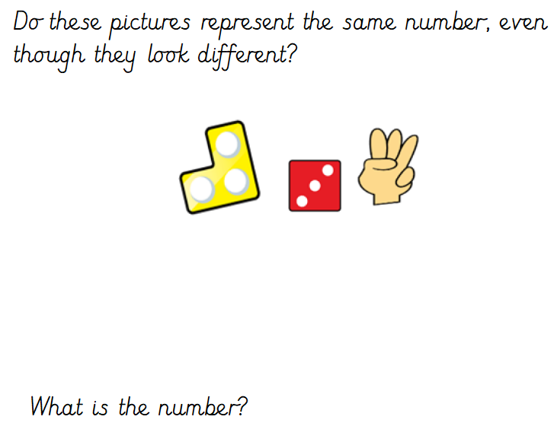
White rose starter

Slide 4
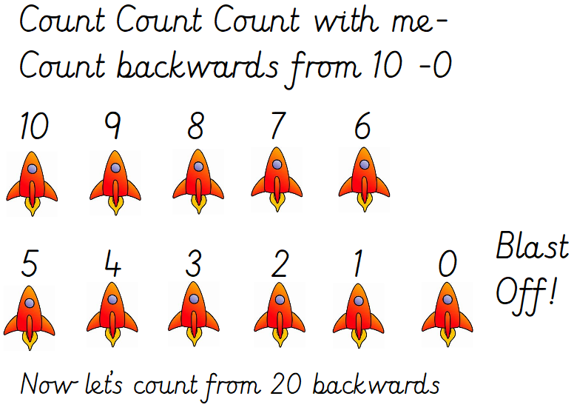
Starter
Sing the ‘count with me’ song - https://www.youtube.com/watch?v=D0Ajq682yrA

Slide 5
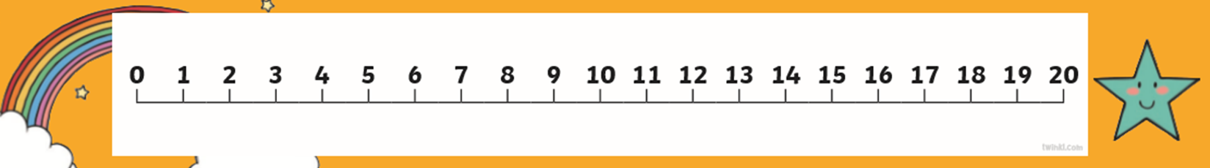
Main Input
Using a number line can be difficult today we are going to continue to use a number line to reinforce this method of taking away.
Print me off and use me to help you work out the answers to these take away number sentences.

Slide 6
Main Activity
Work me out using the number Line to support you.
6 – 4 = 9 – 3 =
3 – 3 = 8 – 6 =
8 – 4 = 12 – 7 =
11 – 6 = 15 – 3 =
14 – 3 = 20 – 3 =
If you are finding these tricky – get Mummy or Daddy to write some single digit number sentences.

