Slide 1
Maths PowerPoint
WB 1.3.21

Slide 2
Tuesday
I am working towards taking a number away from another number to find the answer

Slide 3
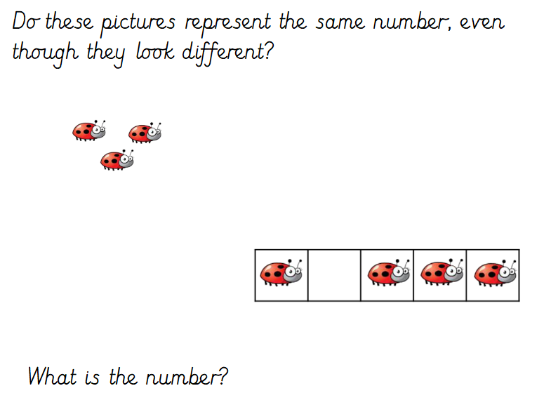
White rose starter

Slide 4
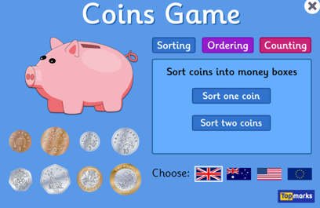
Starter
https://www.topmarks.co.uk/money/coins-game
Can you sort the coins into the correct boxes – challenge yourself can you sort two coins?

Slide 5

Main Input
Use the globes to help you find the answer!
4 - 1 =

Slide 6
Use the globes to help you find the answer!
6 - 3 =

Slide 7
8 - 5 =
Use the globes to help you find the answer!

Slide 8
9 - 2 =
Use the globes to help you find the answer!

Slide 9
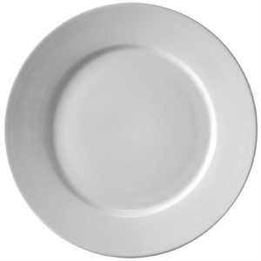
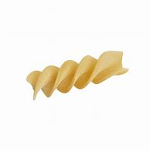
Main Activity
5 – 2 =
Today you will choose a number sentence.
You will then place that amount of objects on a plate and physically take the remaining amount away, you will then count the remaining objects and you will have found your answer.
Now take two shapes away?

