Slide 1
Maths PowerPoint
WB 1.3.21

Slide 2
Wednesday
I am working towards taking a number away from another number to find the answer

Slide 3
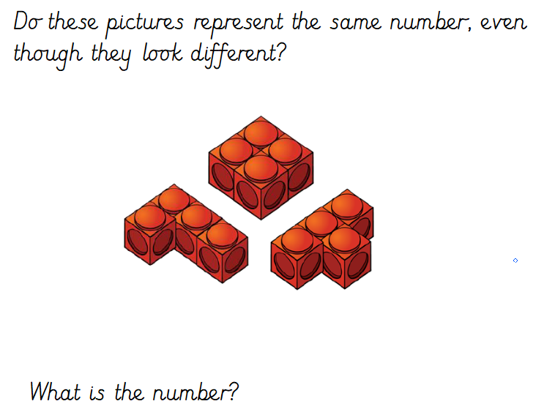
White rose starter

Slide 4
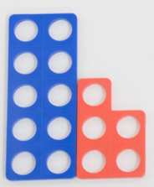
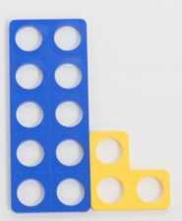
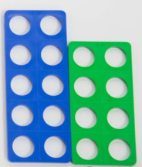
Starter
Lets look at the numicon plates – Which teen numbers have I made?
How do you write these numbers?

Slide 5
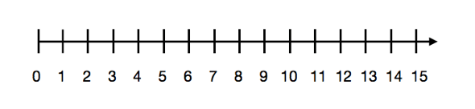
Main Input
Today we are learning to take away using a number line – using a number line can be tricky take your time and make sure you are jumping the correct amount of spaces.
2nd jump
1st jump
3 – 2 = ?

Slide 6
Use the number line to find the answer. Start at the first number and ‘jump’ backwards e.g. 6 – 2 =. Start at the number 6 and jump two steps backwards – you will land on number 4, this is your answer.
5 – 2 =

Slide 7
Use the number line to find the answer. Start at the first number and ‘jump’ backwards
7 – 4 =

Slide 8
Use the number line to find the answer. Start at the first number and ‘jump’ backwards
10 – 3 =

Slide 9
Use the number line to find the answer. Start at the first number and ‘jump’ backwards
12 – 5 =

Slide 10
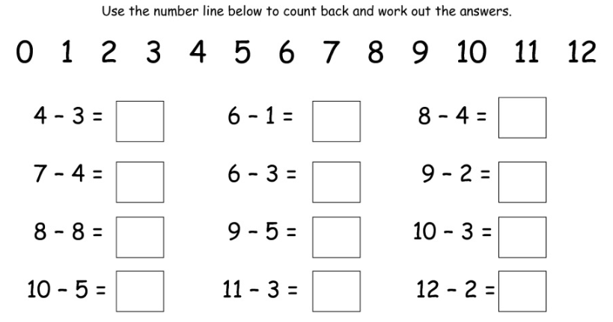
Main Activity

