Slide 1

Phonics
Friday 22nd January 2021

Slide 2
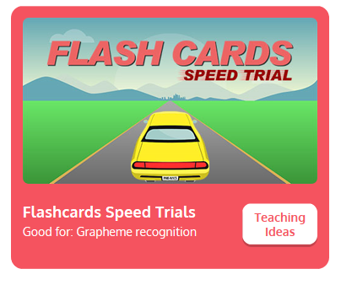
Practise your sounds using Flashcards Speed Trial on Phonics Play
Pick individual graphemes – Set 1-6 + y, z, qu
Username: jan21
Password: home
https://www.phonicsplay.co.uk/resources/phase/2/flashcards-speed-trials

Slide 3
Can you remember our tricky words from yesterday?
he

Slide 4
she

Slide 5

Practise reading your keywords using Tricky Word Trucks on Phonics Play
Pick Individual Tricky Words : Phase 2 + he, she
Username: jan21
Password: home
https://www.phonicsplay.co.uk/resources/phase/2/tricky-word-trucks

Slide 6
Spelling
to the
The words to and the are tricky words as we can’t sound them out.
Practise writing the words. You might want to do rainbow writing.
to
to
to
to
to
the
the
the
the
the

Slide 7
Spelling
Today we are going to use our segmenting skills to write some captions.
Listen to the words and see what sounds you can hear.
Don’t worry if you can not hear all the sounds. Only write down the sounds that you can hear.
Remember to spell the words to and the correctly.
* Captions are also on the daily guidance sheet

Slide 8


Slide 9
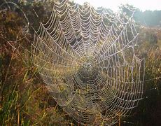

Slide 10
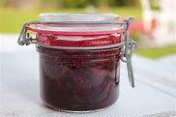

Slide 11
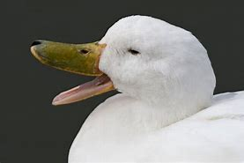

Slide 12


