Slide 1

Phonics
Thursday 21st January 2021

Slide 2
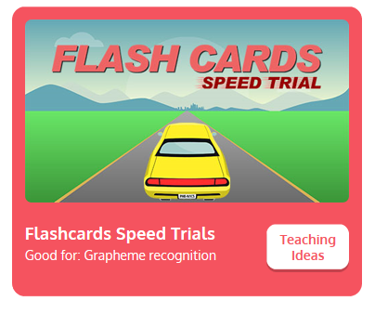
Practise your sounds using Flashcards Speed Trial on Phonics Play
Pick individual graphemes – Set 1-6 + y, z, qu
Username: jan21
Password: home
https://www.phonicsplay.co.uk/resources/phase/2/flashcards-speed-trials

Slide 3

Practise reading your keywords using Tricky Word Trucks on Phonics Play
Choose Phase 2 Tricky Words
Username: jan21
Password: home
https://www.phonicsplay.co.uk/resources/phase/2/tricky-word-trucks

Slide 4
Today we are going to be looking at some tricky words to read:
he

Slide 5
Today we are going to be looking at some tricky words to read:
she

Slide 6
Can you point to the words that say he?
How many can you find?
he
he
she
she
she
she
she
he
she
he
she
she
he
he
he

Slide 7
Can you point to the words that say she?
How many can you find?
he
he
she
she
she
she
she
he
she
he
she
she
he
he
he

Slide 8
Yes or No
Game
Read the following questions and decide if the answer is yes or no.

Slide 9
Can a duck quack?

Slide 10
You might want to add sound buttons to help.
Can a duck quack?

Slide 11
Can a fox get wet?

Slide 12
Can a rabbit yell at a man?

Slide 13
Can a hen peck?

Slide 14
Is a lemon red?

Slide 15
Is a robin as big as a jet?

Slide 16
Can a web buzz?

