Slide 1
Phonics
Wednesday 20th January 2021

Slide 2
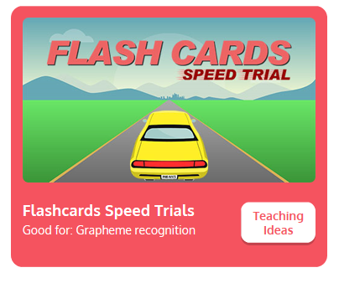
Practise your sounds using Flashcards Speed Trial on Phonics Play
Pick individual graphemes – Set 1-6 + y
Username: jan21
Password: home
https://www.phonicsplay.co.uk/resources/phase/2/flashcards-speed-trials

Slide 3

Practise reading your keywords using Tricky Word Trucks on Phonics Play
Choose Phase 2 Tricky Words
Username: jan21
Password: home
https://www.phonicsplay.co.uk/resources/phase/2/tricky-word-trucks

Slide 4
Today we are looking at the sound qu.
https://www.youtube.com/watch?v=JluAxsek-zQ
Can you draw the letters that make this sound in the air?

Slide 5
Watch the video and find the words that use the qu sound?
https://www.bbc.co.uk/bitesize/topics/zvq9bdm/articles/zrqtqp3
Watch the video of Geraldine the Giraffe looking at the qu sound:
https://www.youtube.com/watch?v=mYGGk0MH_xQ

Slide 6
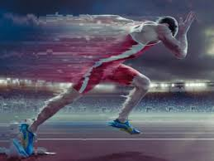
Can you write a word to match the picture? Write your words down in a list.
The man is running very …
Notes:
The word is - quick

Slide 7
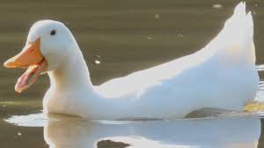
Can you write a word to match the picture? Write your words down in a list.
What noise does this animal make?
Notes:
The word is - quack

Slide 8

Can you write a word to match the picture? Write your words down in a list.
We are going to do a …
Notes:
The word is – Queen

Slide 9
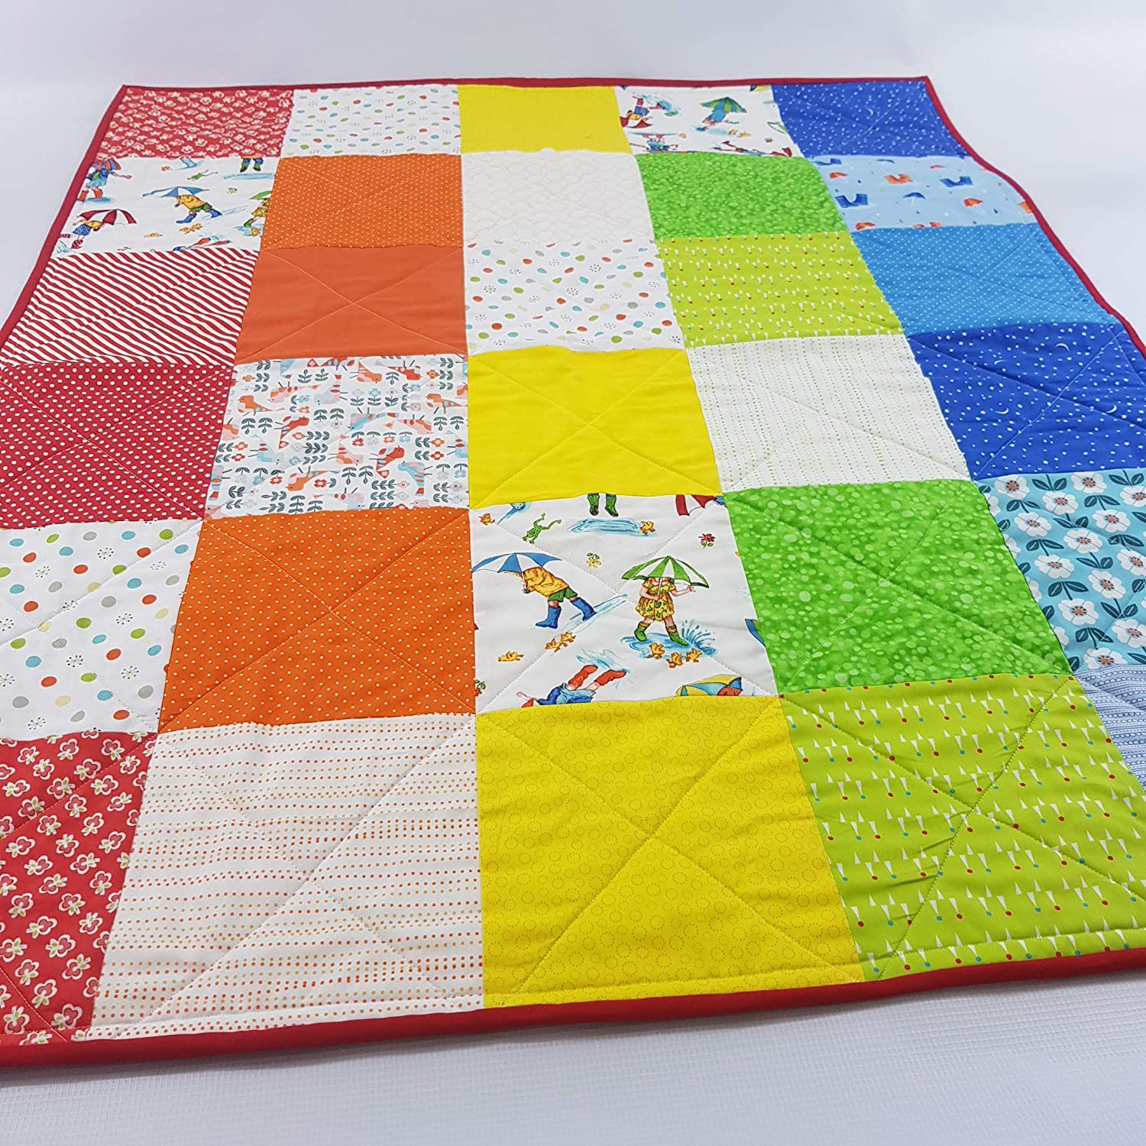
Can you write a word to match the picture? Write your words down in a list.
This keeps us warm, what is it called?

