Slide 1
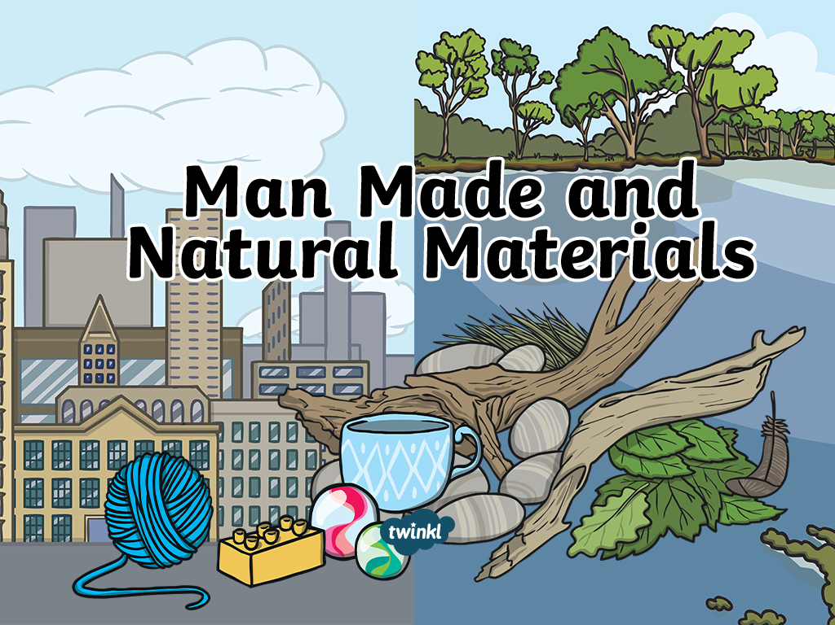

Slide 2
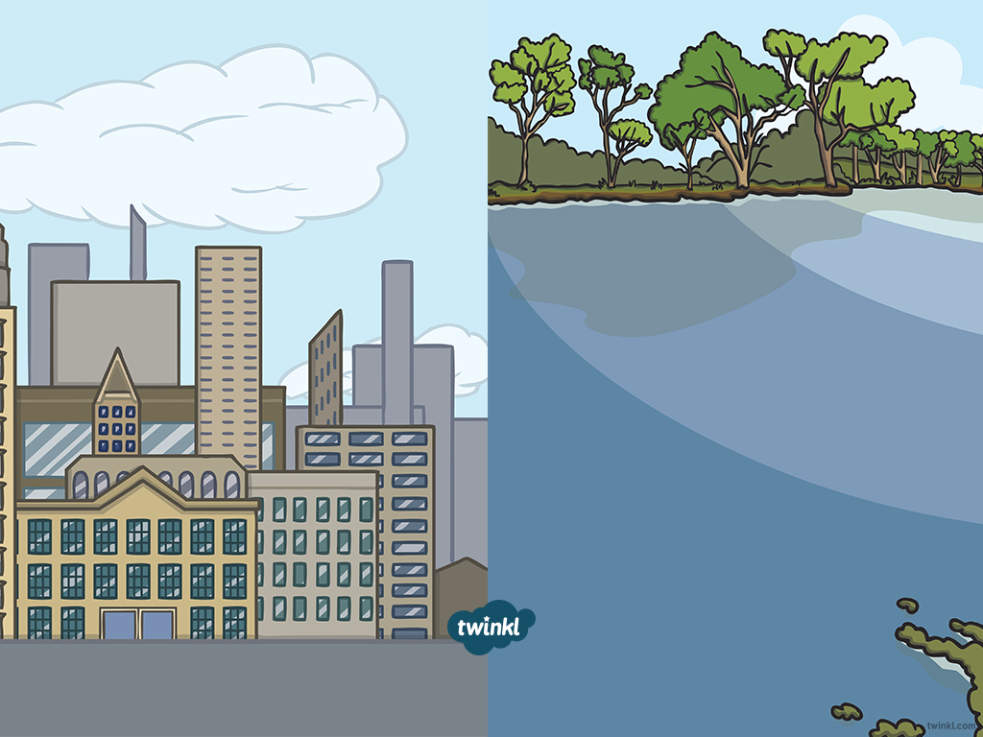


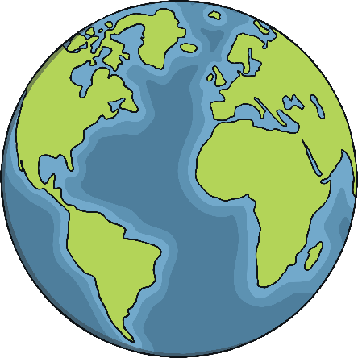
Natural Materials
These are materials that are ‘naturally’ found around us. We may have to dig them out of the ground, grow them, or take them from living things.

Slide 3
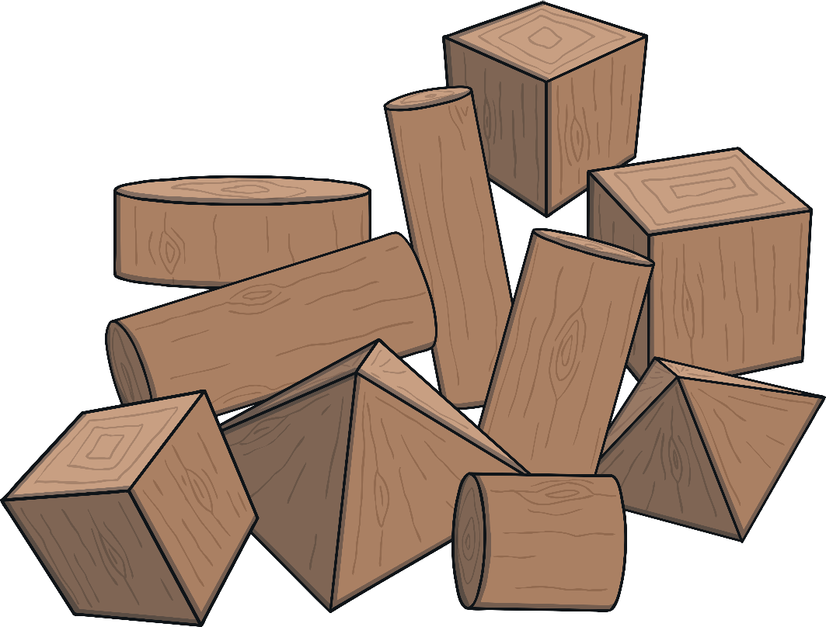
Wood
It is used for burning, building houses, benches, fences and lots of other things.
It isn’t chemically processed so it is natural.
Wood comes from stems and roots of trees and other woody plants.

Slide 4
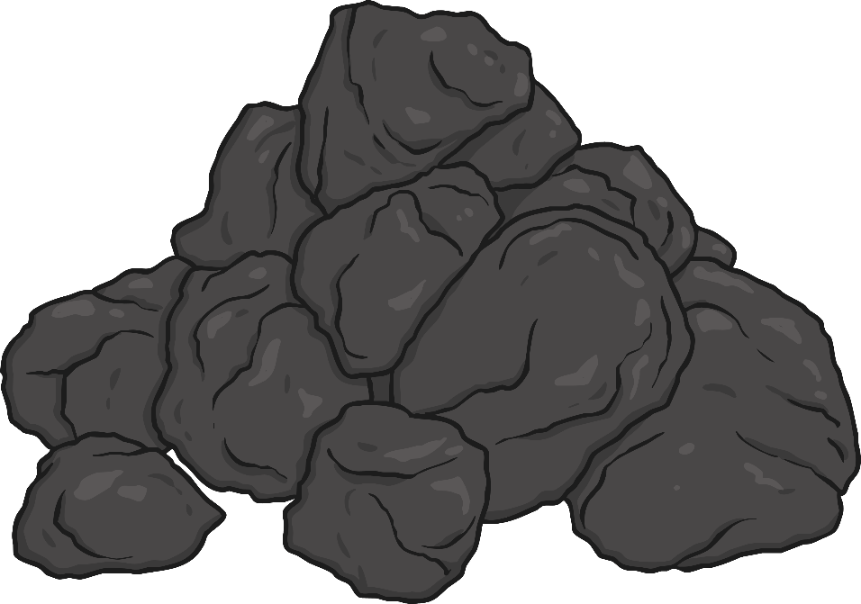
Coal
It does not go through any chemical processes so it is a natural material.
Coal is a black rock found underground.
It is burned for providing heat and producing electricity.

Slide 5

Cotton
Cotton is a soft, fluffy material that grows around the seed of the cotton plant.
There are no chemical processes used to make cotton so it is a natural material.
The cotton is spun into yarn to make a soft breathable fabric.
Cotton is used to make clothes and furnishings.

Slide 6

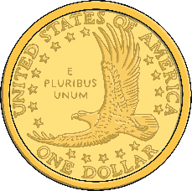
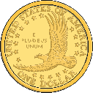
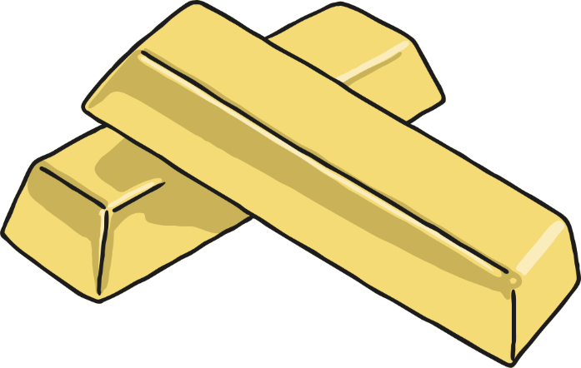
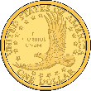

Gold
Gold is a metal found as nuggets in rocks.
It is not chemically processed so it is a natural material.
Gold is melted down to make jewellery, gold teeth and used in industry.
Gold is also used for investment. It is kept in bars which are worth lots of money.

Slide 7
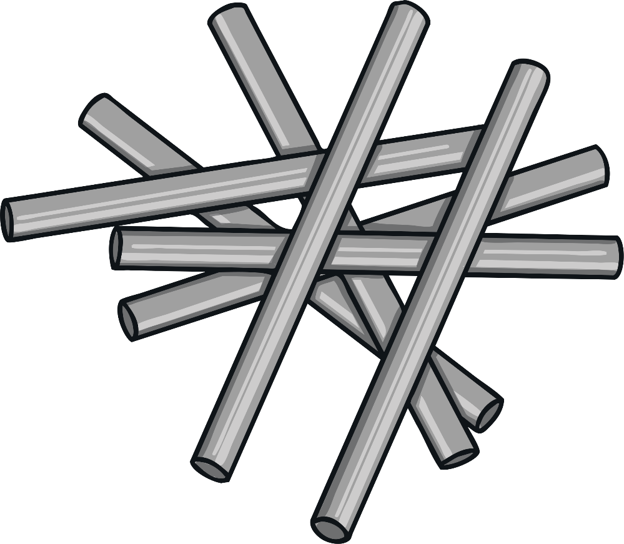
Iron
Iron is a metal. There is lots and lots of iron on earth. It is found in the earth’s crust and core.
It is not chemically processed therefore it is a natural material.
It is used to make gates, buildings, tools, fireplaces, piping and many more.

Slide 8


Leather
Leather is a material created by the tanning of animal hide and skins. Usually from cattle.
It is not chemically processed therefore it is a natural material.
It is used for shoes, jackets, other clothing, upholstery and also used in industry.

Slide 9

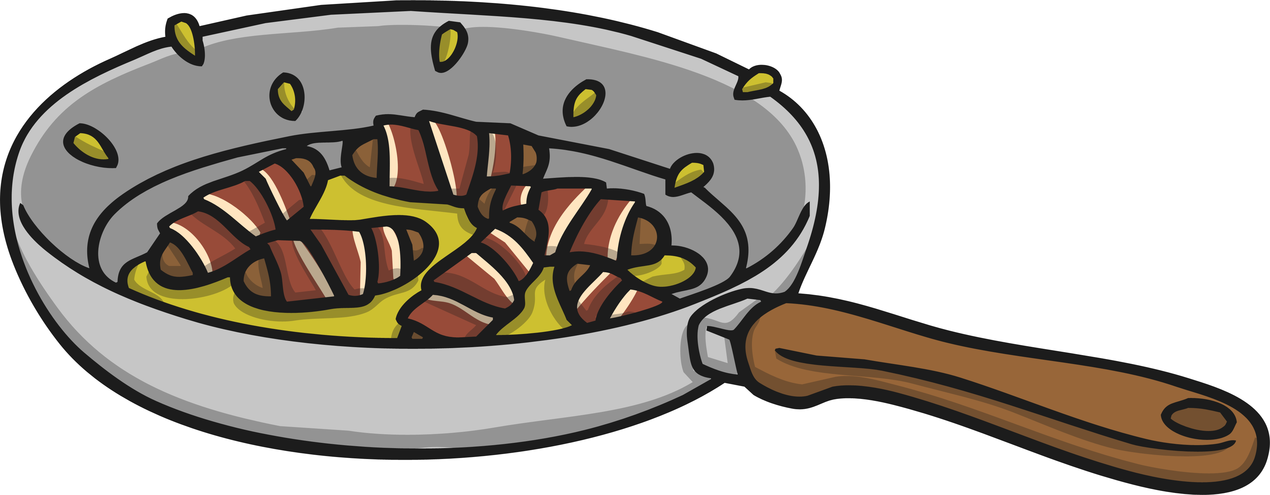
Organic Oil
Organic oil comes from animals and vegetables. Oil is a liquid.
It is not chemically processed therefore it is a natural material.
Organic oil can be used in cooking.

Slide 10

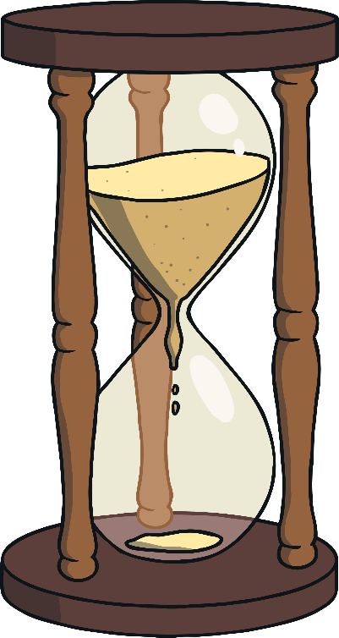
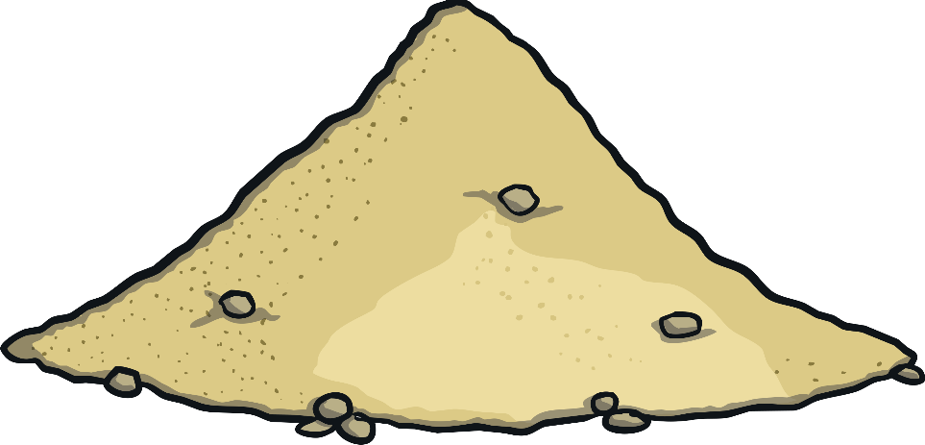
Sand
Sand is made from ground up rock and mineral particles.
It is not chemically processed so it is a natural material.
It is used in concrete and making glass. It also has lots of other uses.

Slide 11

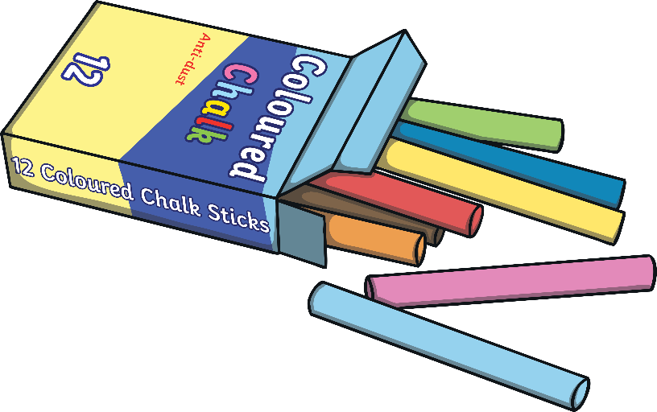
Chalk
Chalk is a soft white rock. It forms in and around the sea.
It isn’t chemically processed so it is a natural material.
It is used for drawing/writing, it is in toothpaste and it is also used in sport.

Slide 12

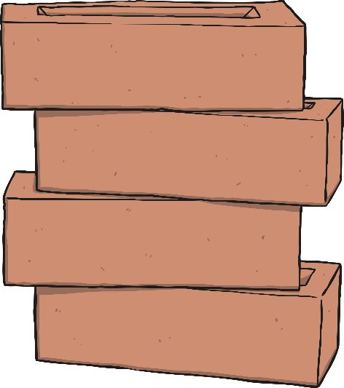
Man-made Materials
These are natural materials that are changed through chemical processes by ‘man’.

Slide 13
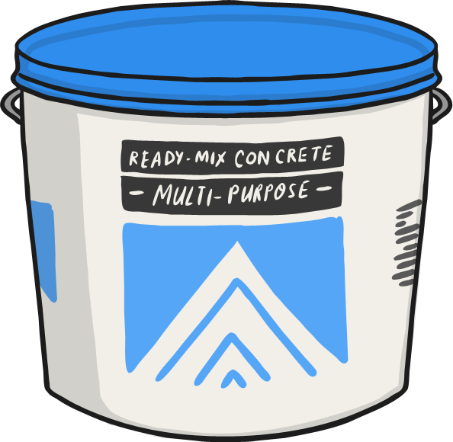
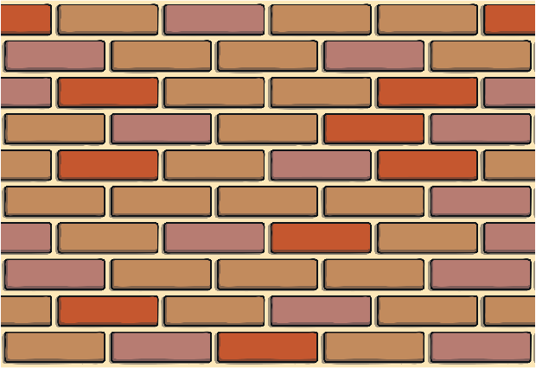
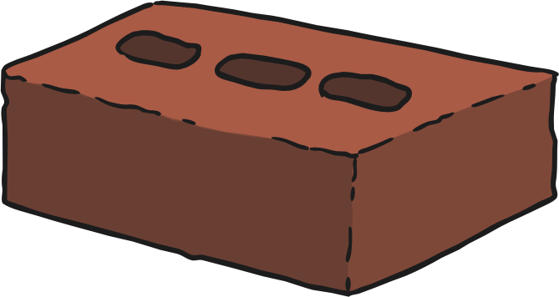
Concrete
Concrete is a mixture of water, rock, sand and cement.
Cement causes a chemical reaction (process) which binds the water, rock and sand.
Because it is processed it is a man-made material.
It is used for buildings, walls, flooring and statues.

Slide 14




Glass
Glass is man-made as silica and other materials are melted down and fused together (chemically processed) to create it.
It is used for glasses, bottles and windows.

Slide 15
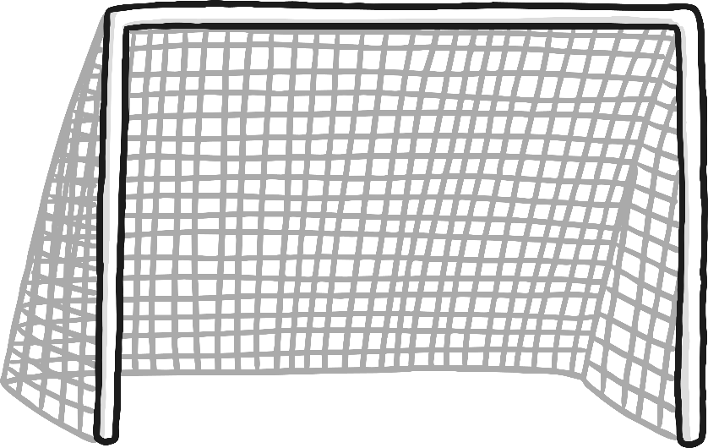
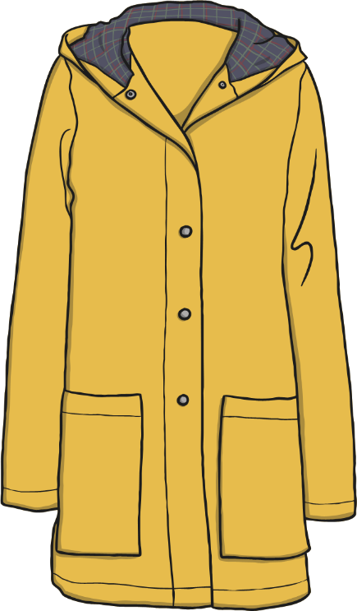
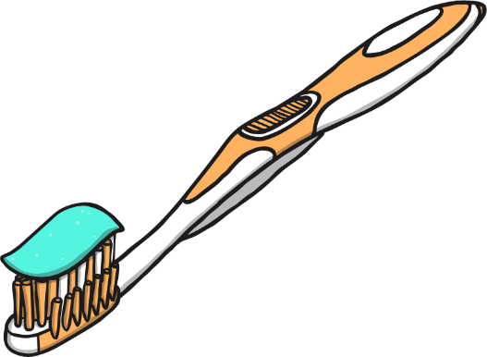
Nylon
Nylon is man-made as it is made from man-made polymers which are chemically processed.
It is used a lot in sportswear.
It is also used in other clothing, nets, toothbrushes and many other items.

Slide 16


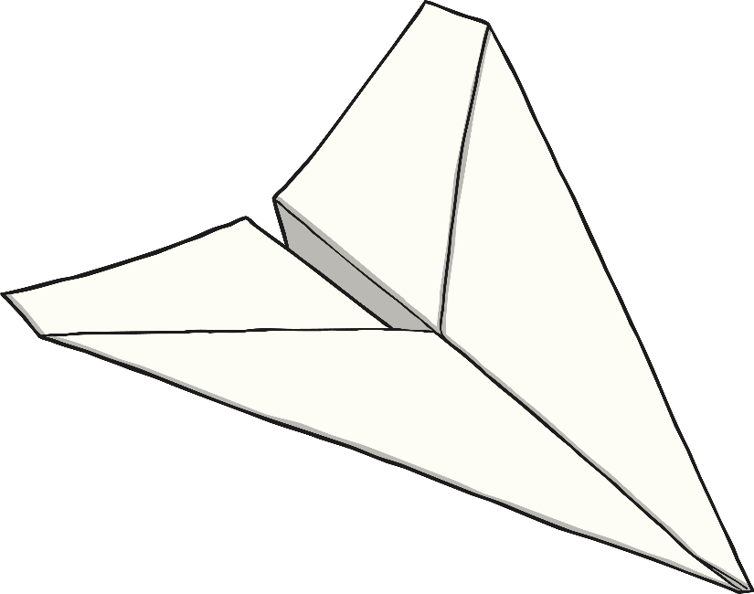

Paper
Paper is made from wood (a natural material).
Although the wood is chemically processed to make paper so therefore it is man-made.

Slide 17
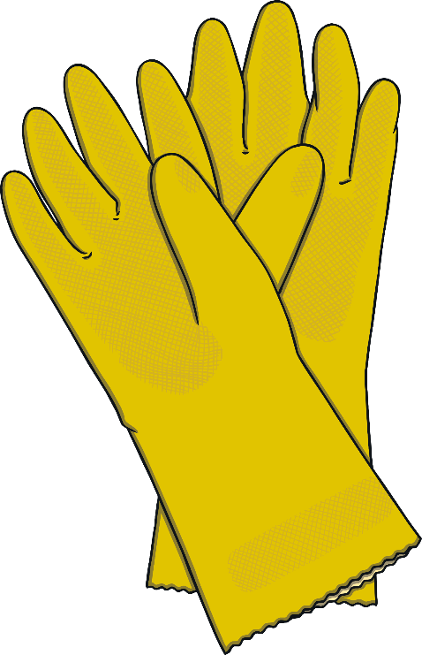
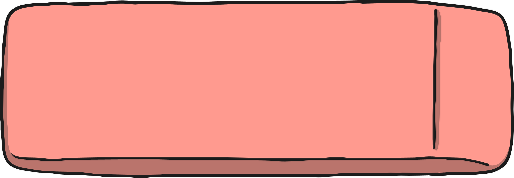

Rubber
Rubber is made from a material from trees or petroleum.
Both ways the natural materials are chemically processed therefore rubber is man-made.
Rubber is used for tyres, shoe soles, erasers, toys and many more.

Slide 18

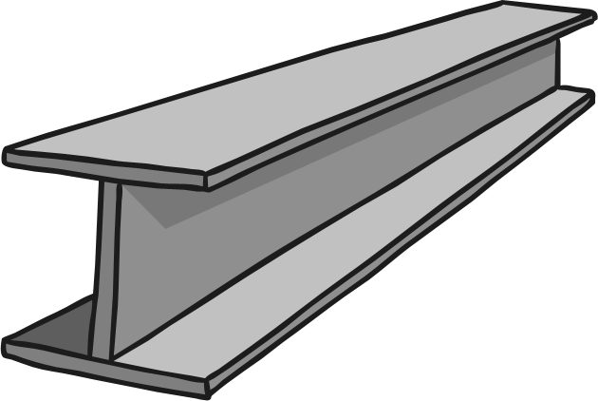
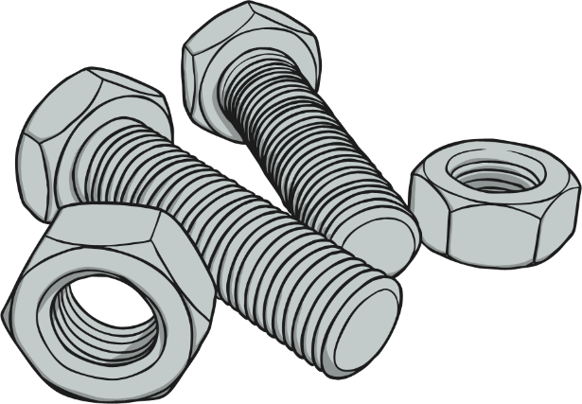
Steel
Steel is made from 2 natural materials: Iron and carbon.
Because natural materials have been chemically processed in the making, it is man-made.
Steel is used for pans, utensils, buildings, aeroplanes and many other things.

Slide 19

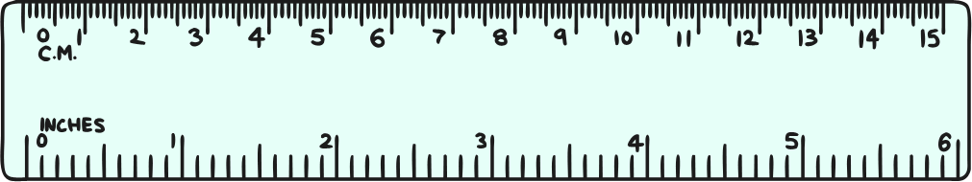
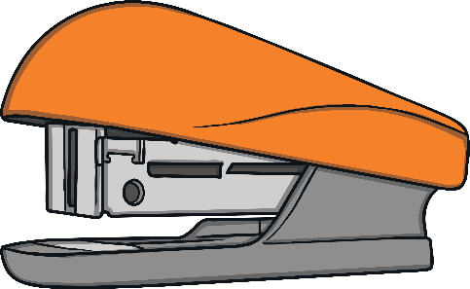

Plastic
There are many types of plastic.
Plastics are man-made because they are made from chemically processed oil (a natural material).
Plastics are all around us. Some uses are plastic bottles, toys, stationary and technology casing.

Slide 20
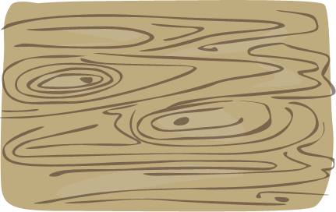
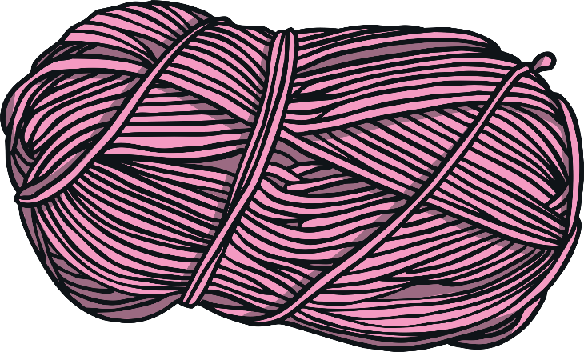
Rayon
Rayon is a material made mostly from wood pulp.
The wood pulp is chemically processed so Rayon is man-made.
Rayon is used for clothing and furnishings.

Slide 21
Summary Table
Natural Materials | Man-made materials
Wood | Glass
Leather | Nylon
Oil | Rayon
Coal | Paper
Cotton | Steel
Iron | Polyester
Chalk | Rubber
Gold | Concrete
Sand | Plastic

Slide 22


Questions
Which is chemically processed? Man-made or natural material?
Is glass a natural material?
Is rubber man-made?
Is coal man-made?
Is leather a natural material?

Slide 23

?
?
Look around the class. What objects can you see that are made from man made and natural materials?

Slide 24
