Slide 1
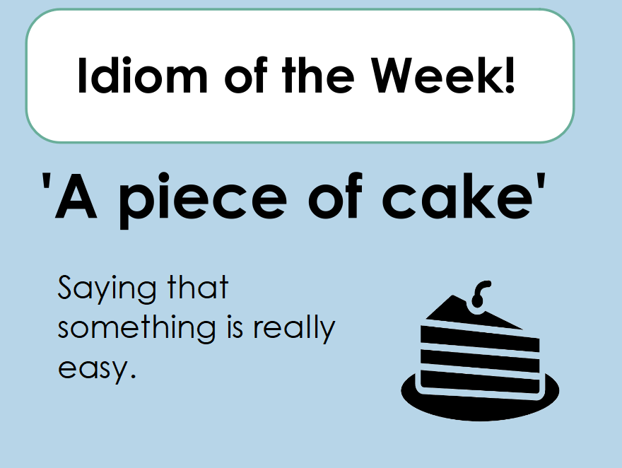

Slide 2
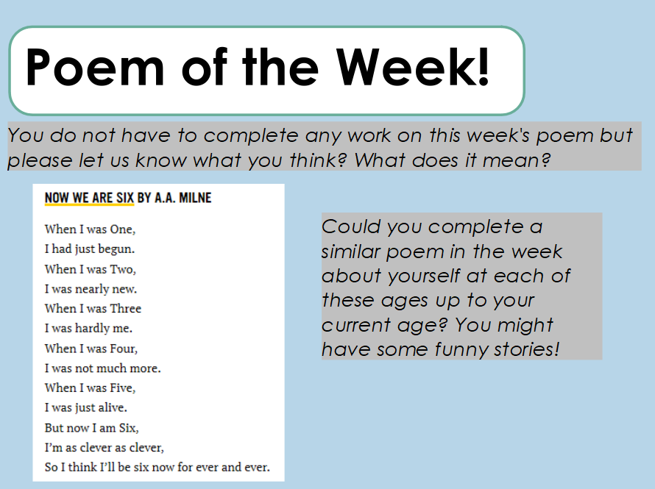


Slide 3
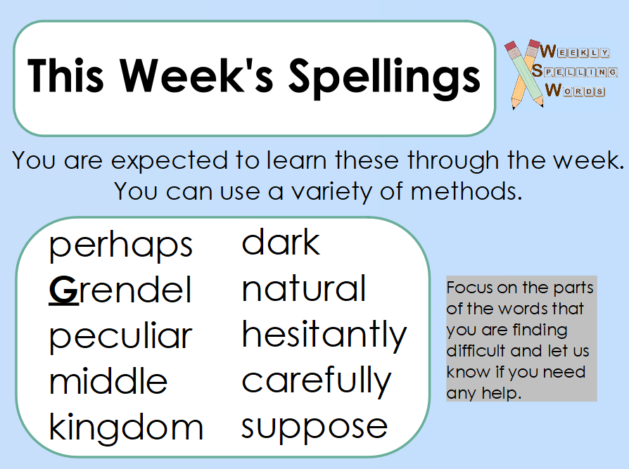

Slide 4
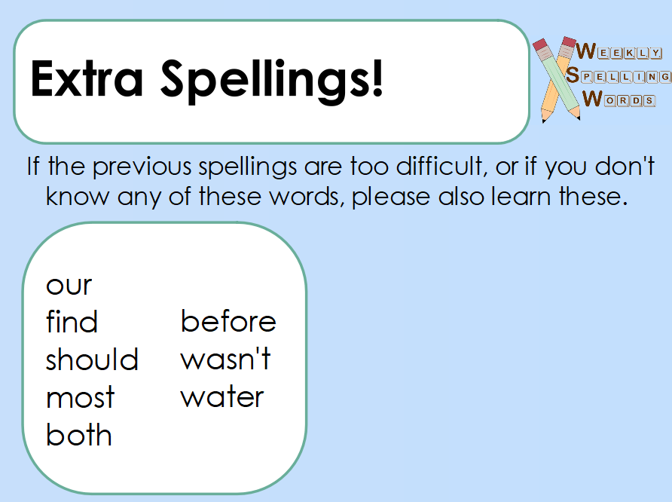

Slide 5
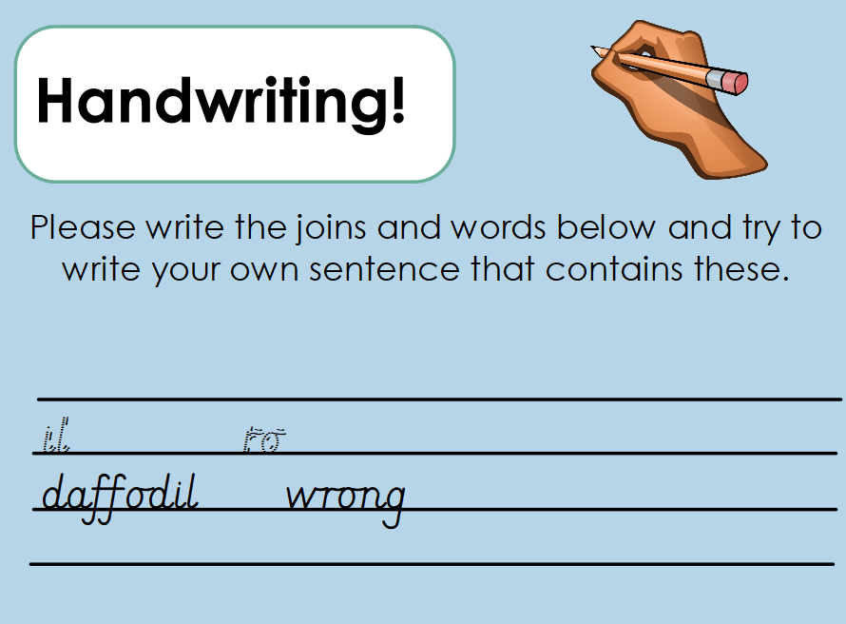

Slide 6
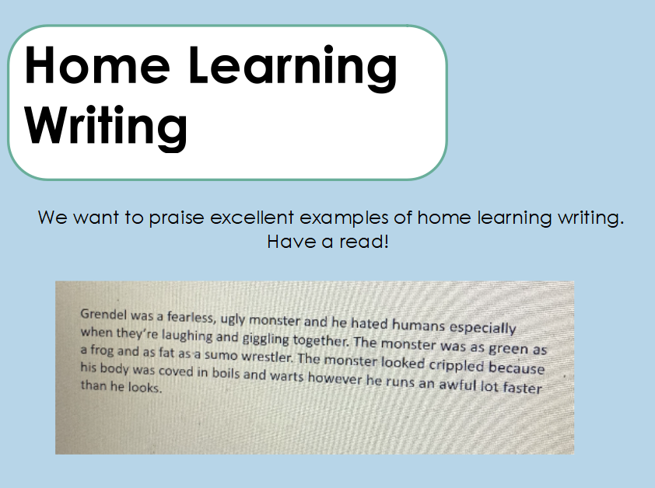

Slide 7
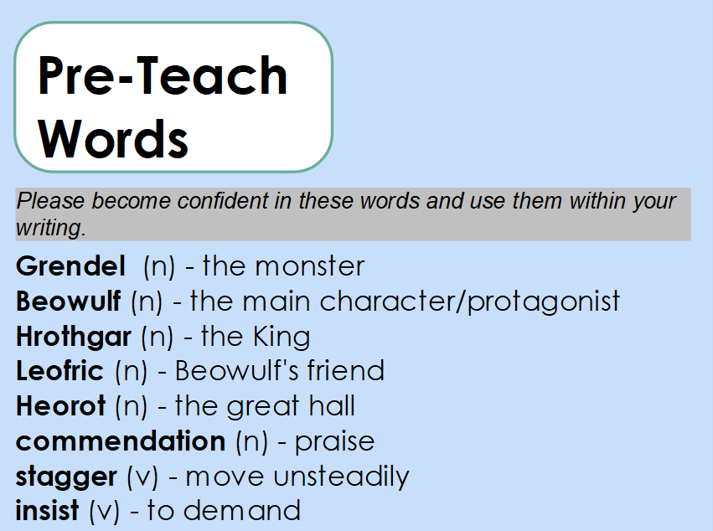

Slide 8
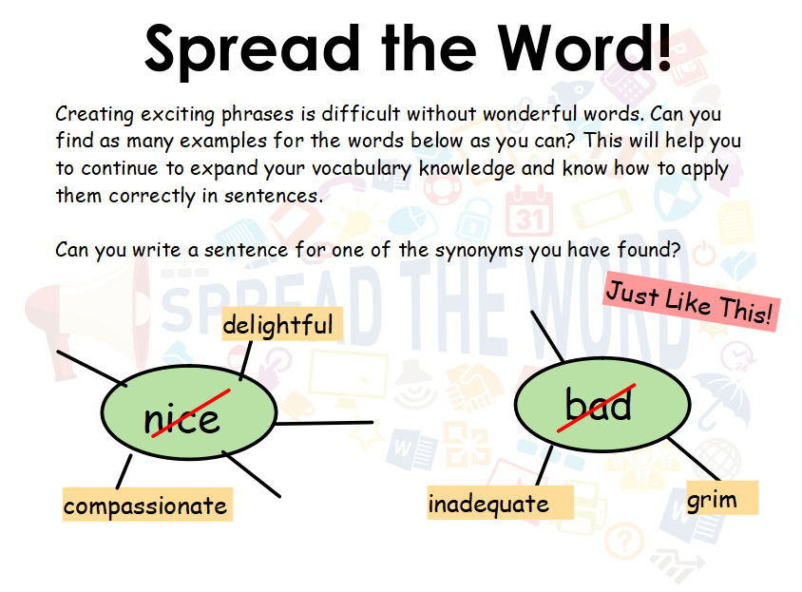
Notes:
Please use today’s spread the word to find as many synonyms as you can for the following words. You can find these easily on the internet. If you collect these, you will be able to use them in your writing this week.

Slide 9
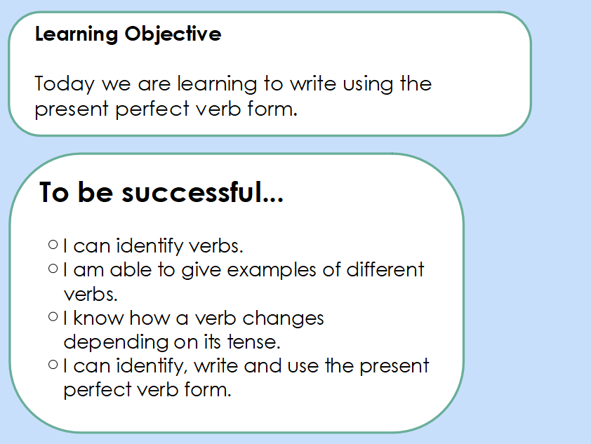

Slide 10
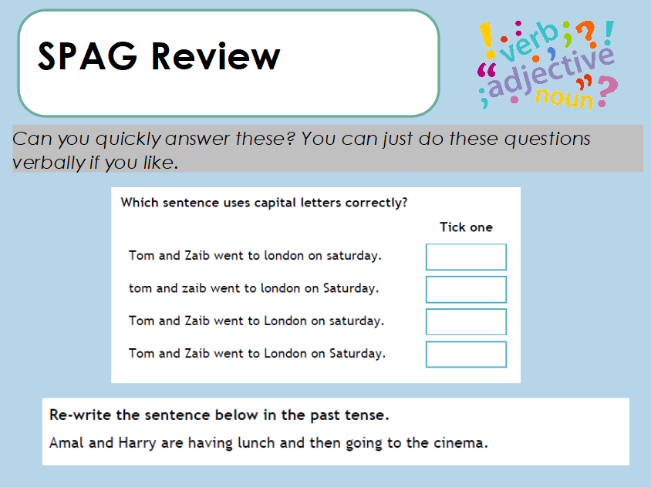

Slide 11
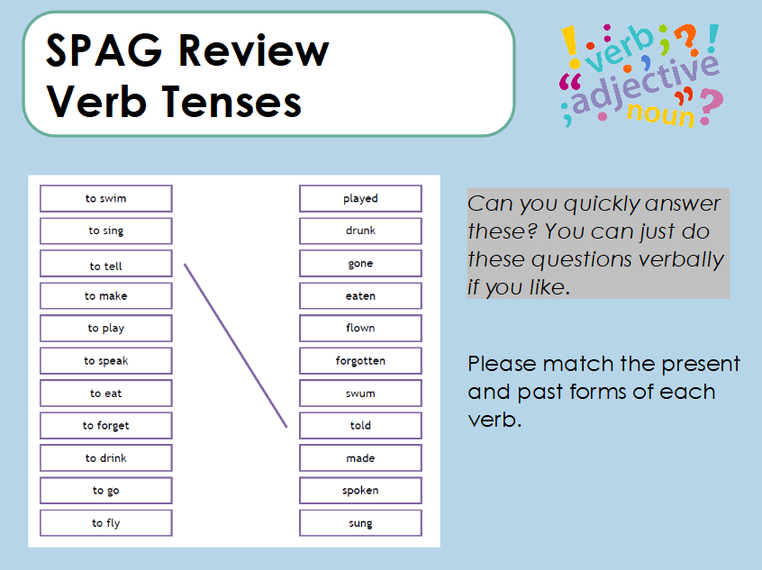
Notes:
For today’s grammar focus – we want you to think again about tenses. Tenses tell us when something happens – such as the past, present or future. Verbs can change based on their tense. For example I drink but yesterday I drank I walk but yesterday I walked. Sometimes we add a suffix such as ed and sometimes it is irregular and the verb itself changes. Look at each of these present tense verbs and match them to their past tense form.

Slide 12
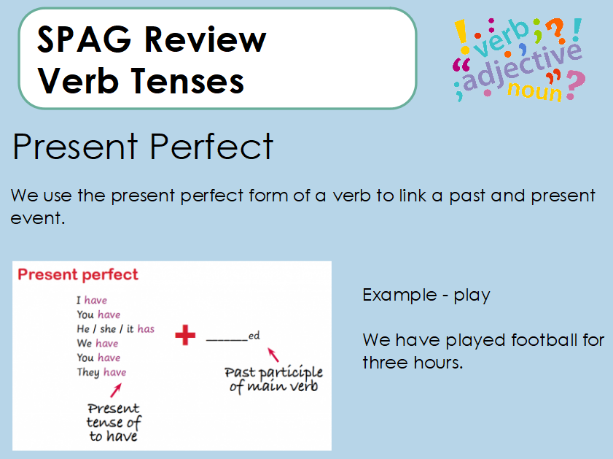
Notes:
This can be confusing due to its name. However, these types of verbs provide a link between the past and present. So I might play but have played for hours. We might eat but we have eaten a whole plate.

Slide 13
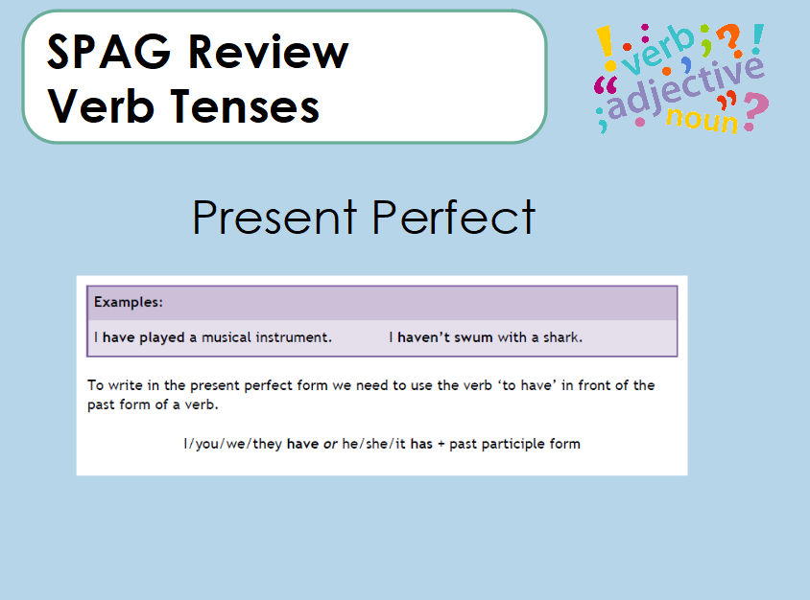

Slide 14
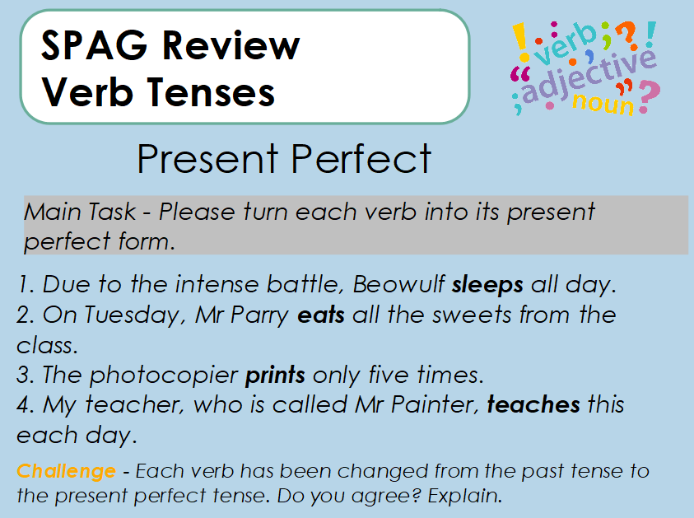

Slide 15
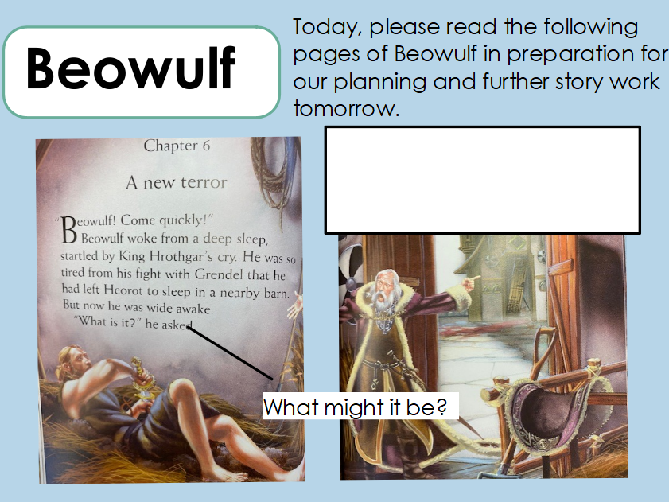

Slide 16
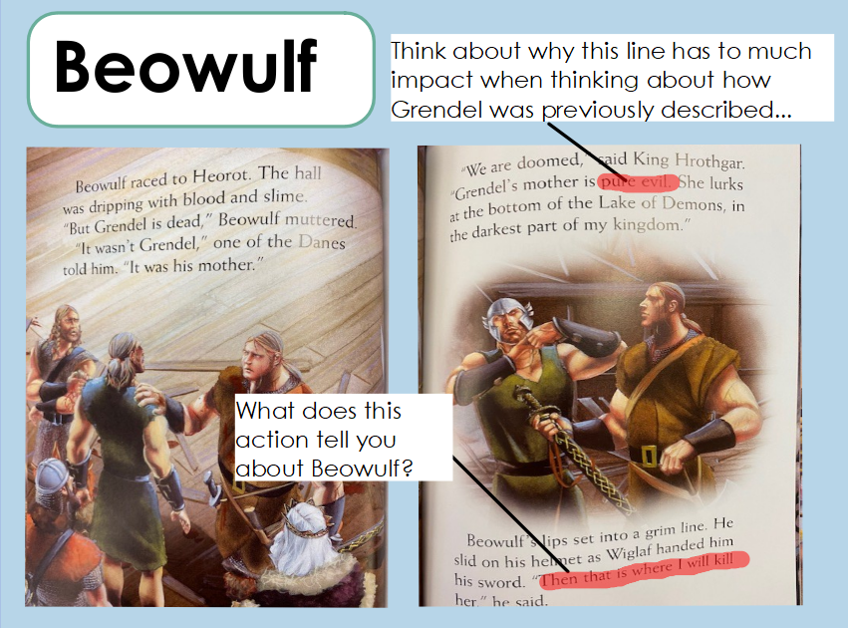

Slide 17
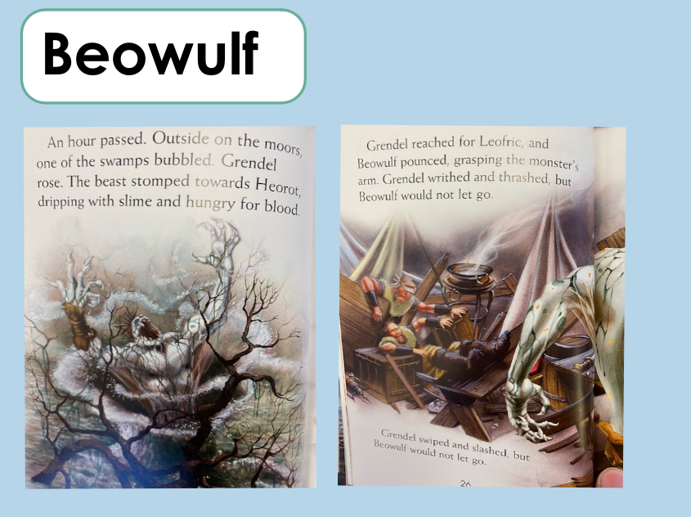

Slide 18
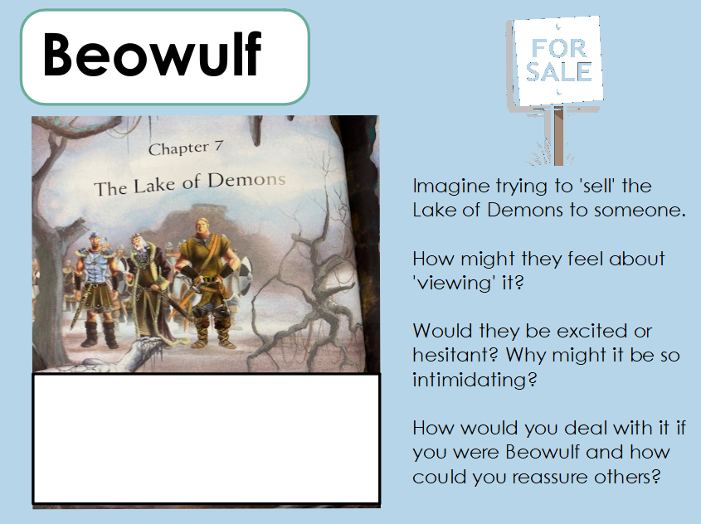
Notes:
As an additional task today try to think about what the lake of demons might be like. Would you like to go there? How might Beowulf react based on what you know and what he has previously done? Imagine you are trying to advertise the lake to someone. How might you describe it?

