Slide 1


Slide 2


Slide 3
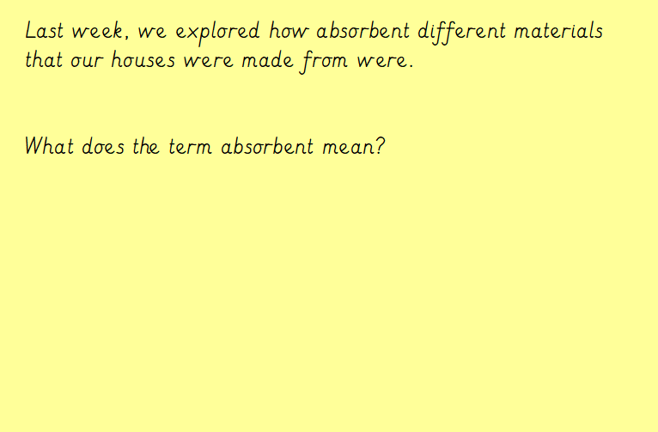

Slide 4
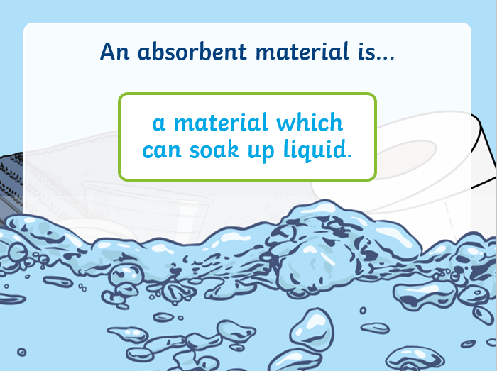

Slide 5
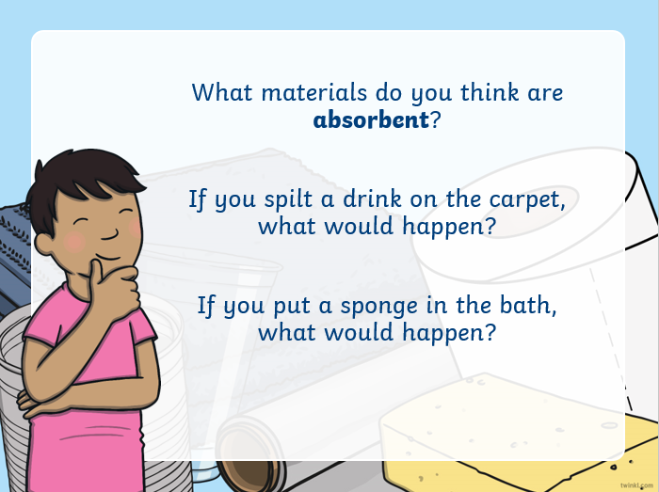

Slide 6
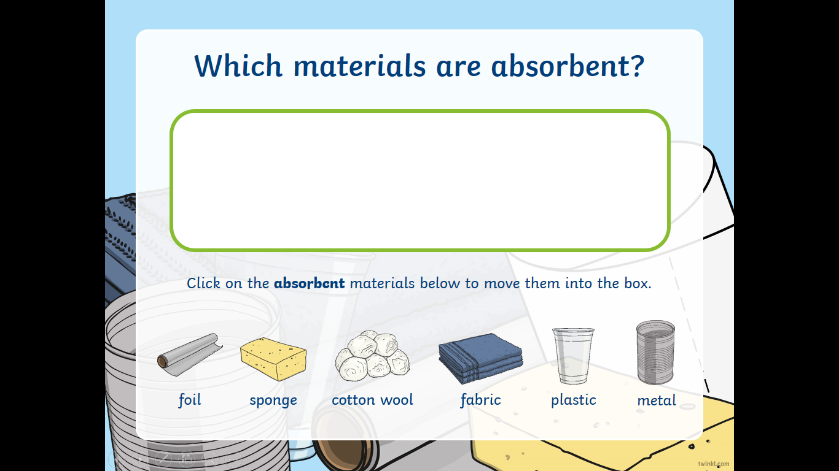

Slide 7
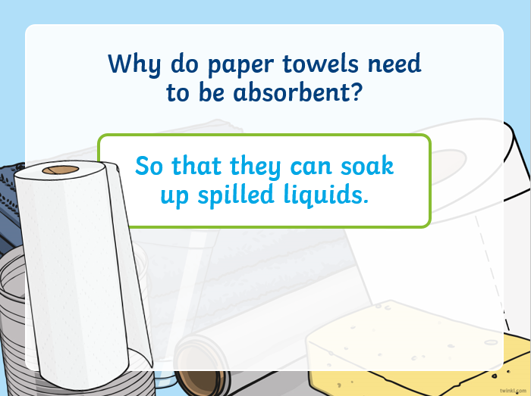

Slide 8
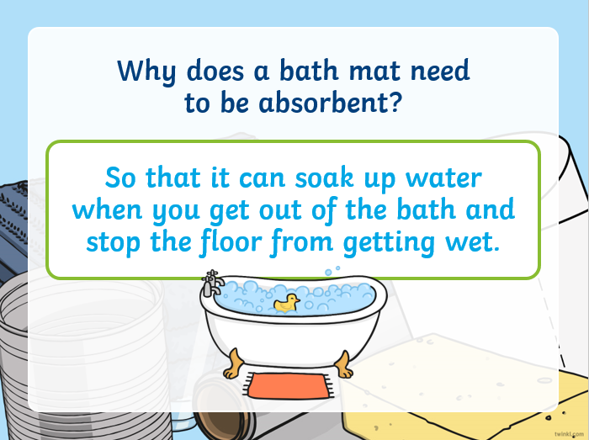

Slide 9
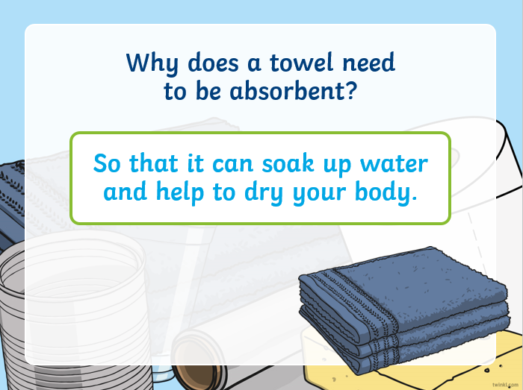

Slide 10
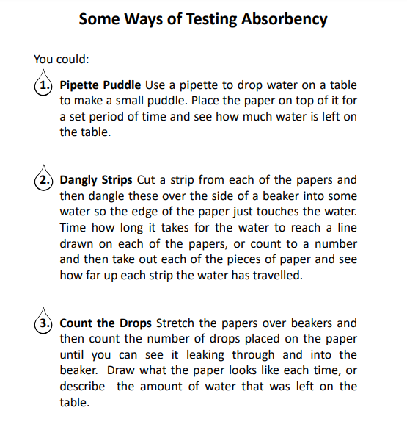
These are some ideas about how we can test for absorbency.
Perhaps choose one of the methods and test a range of materials around your house.
It is not an expectation that all tests are completed.
Complete the record sheet depending on which method you decide to use.

Slide 11
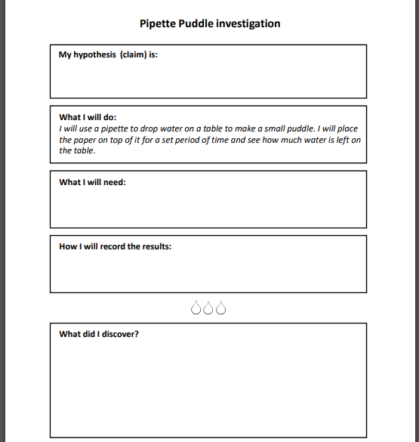
Use this sheet to record on if you are following the pipette puddle investigation.

Slide 12
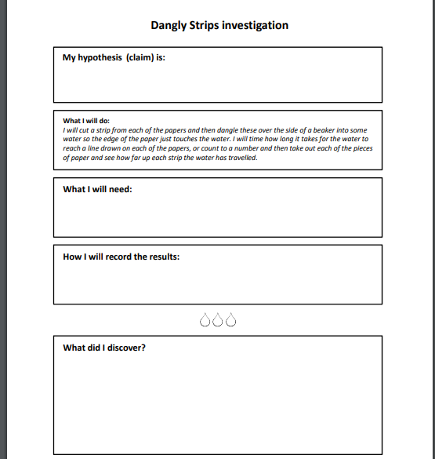
Use this sheet to record on if you are following the dangly strips investigation.

Slide 13
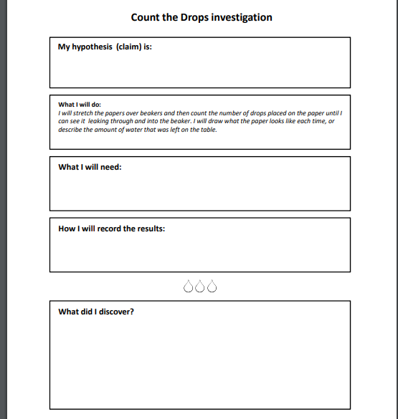
Use this sheet to record on if you are following the count the drops investigation.

