Slide 2
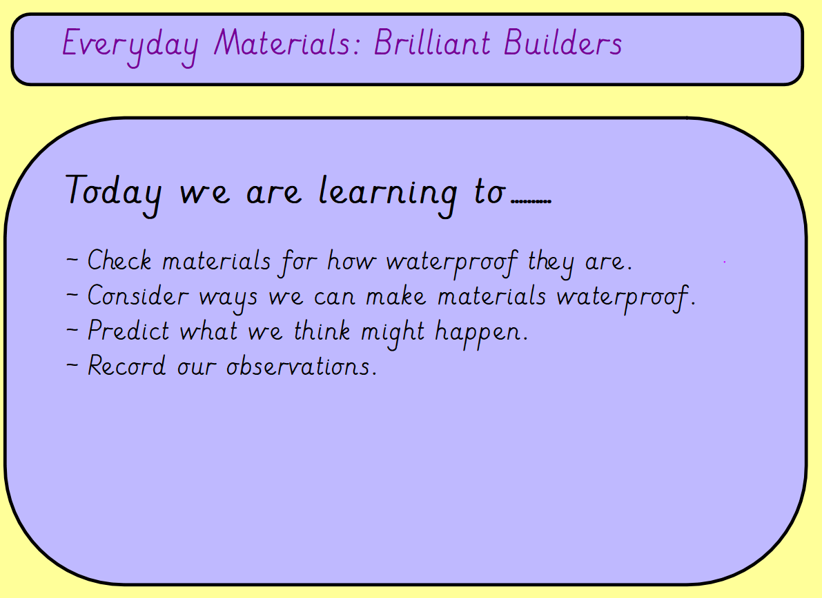

Slide 3
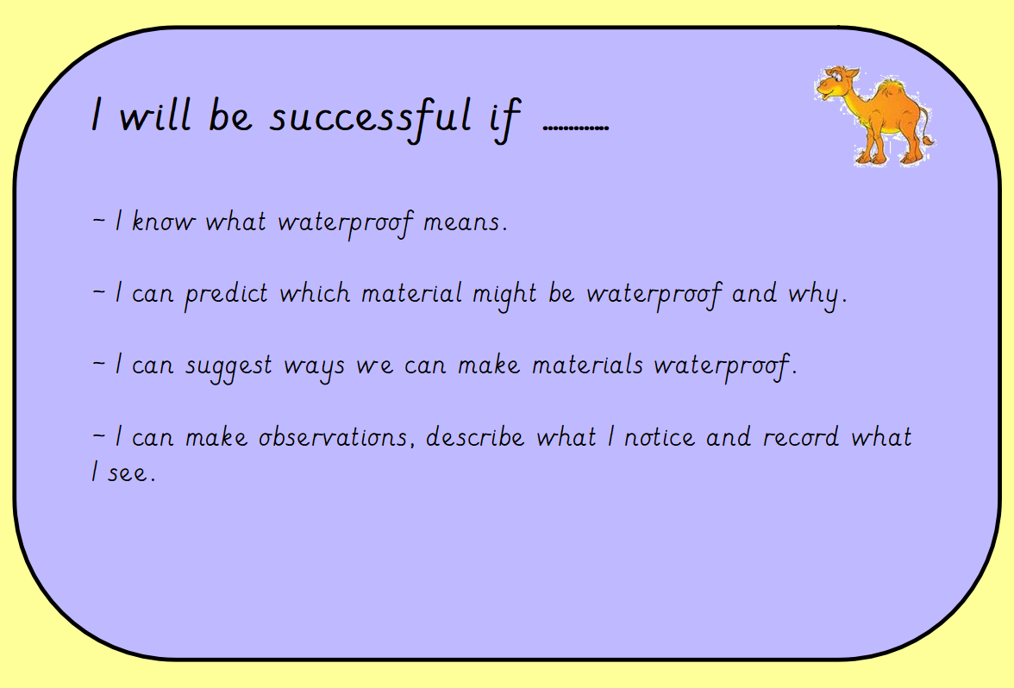

Slide 4
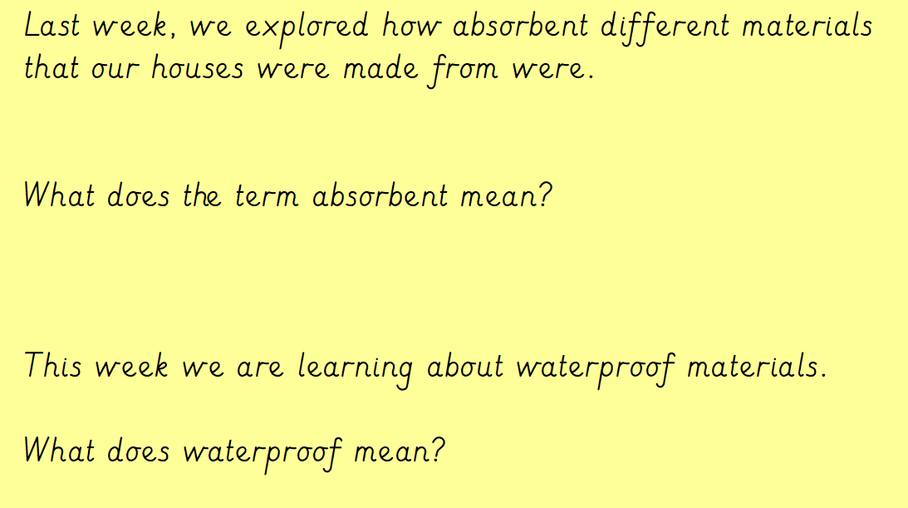

Slide 5
Watch the video about waterproof materials at:
https://www.youtube.com/watch?v=4nd42ISTOJI

Slide 6
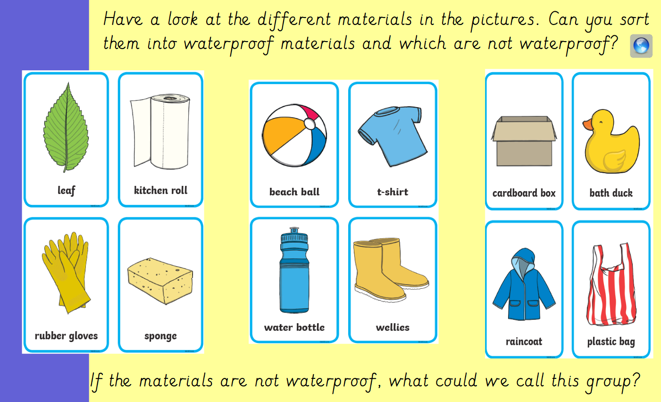

Slide 7
