Slide 1
Science
Everyday Materials
Absorbency
20.1.21

Slide 2
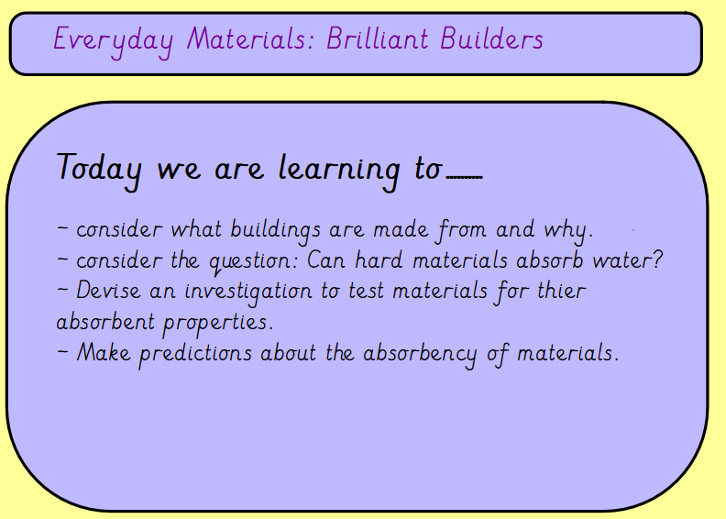

Slide 3
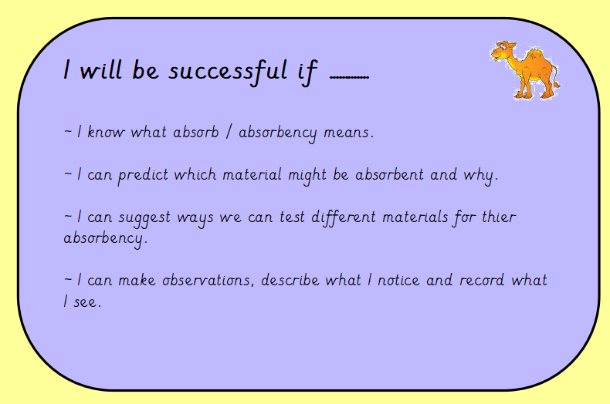

Slide 4
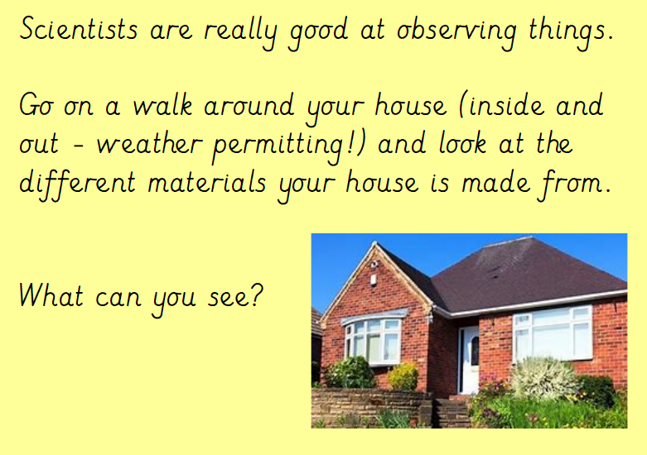
Hopefully the children should spot the following materials:
~ bricks
~ wood
~ plastic
~ metal
They will probably find lots more examples.

Slide 5
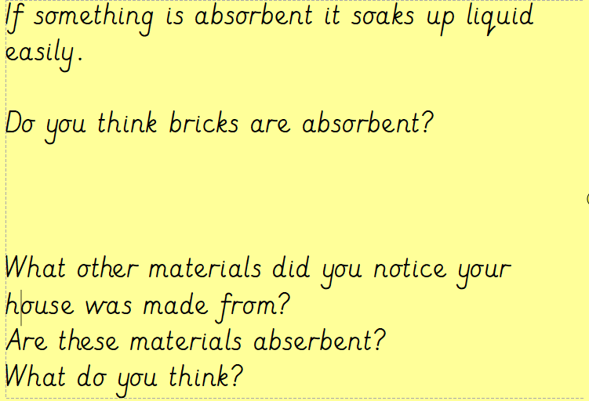

Slide 6
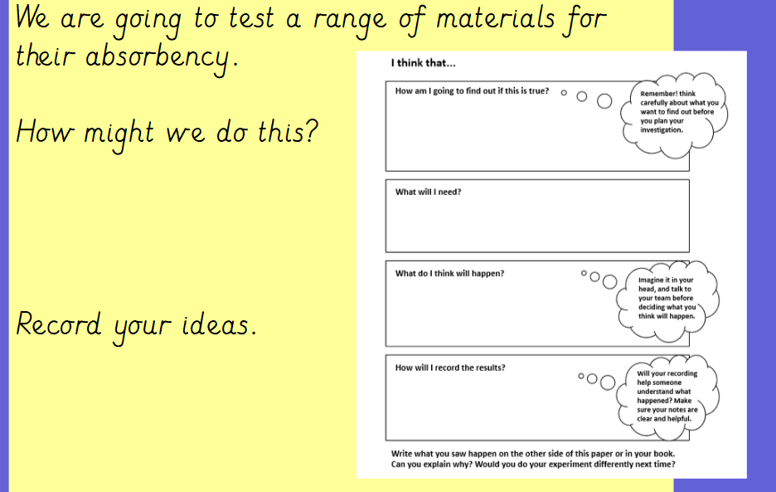

Slide 7


