Slide 1
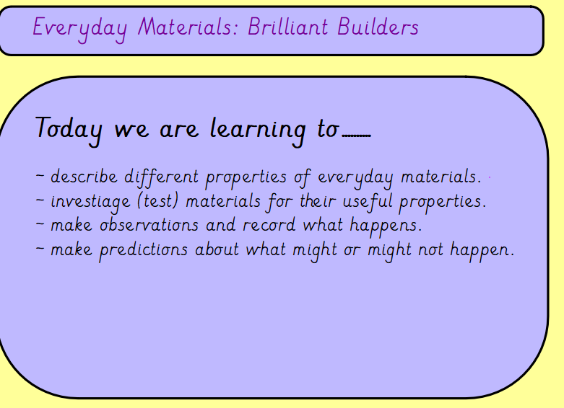

Slide 2
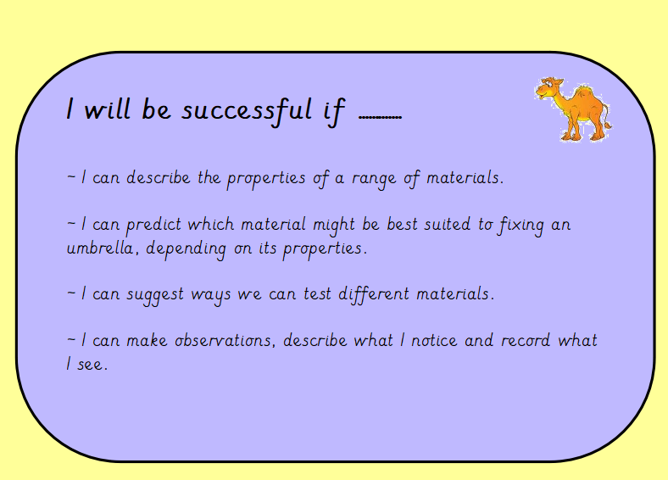

Slide 3
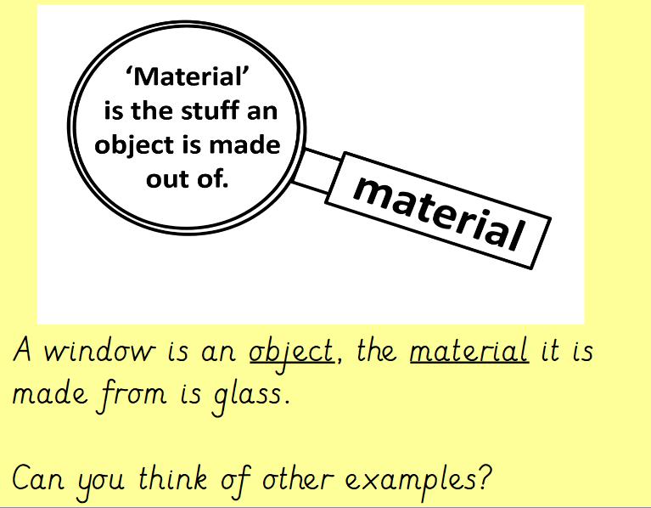
Just a recap on some of vocabulary introduced last week.
Can children identify an object and recognise the material it is made from?

Slide 4
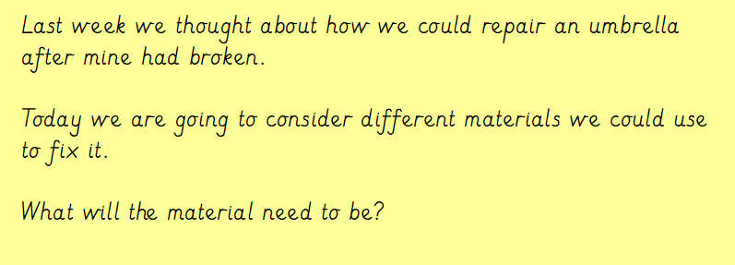
The material would need to be:
Strong (so it didn’t easily rip)
Waterproof (to keep the person dry)
Flexible (so it can move slightly in different types of weather)

Slide 5
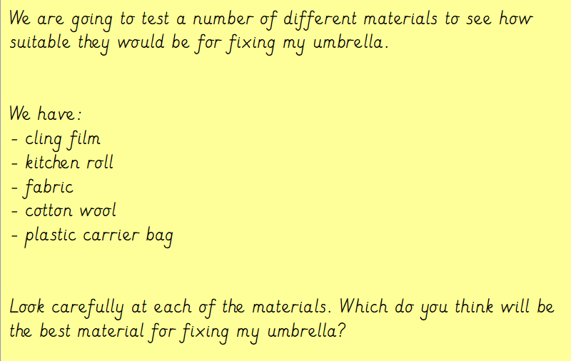
If you do not have these materials at home, you could substitute them for something else.

Slide 6
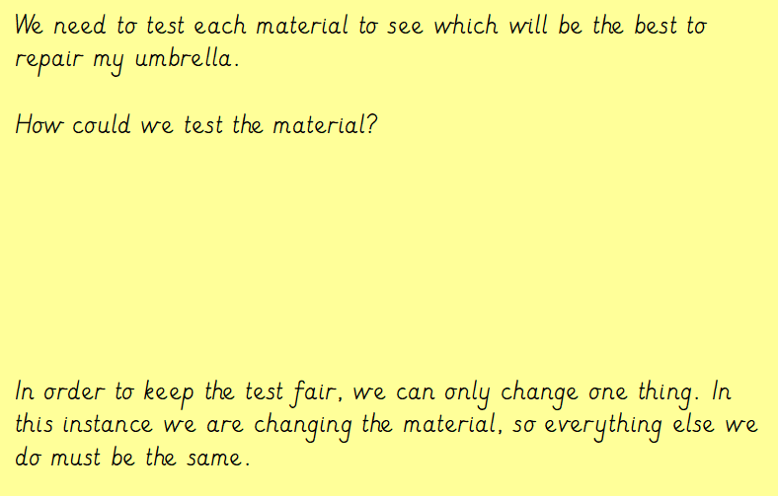
Discuss ideas.

Slide 7
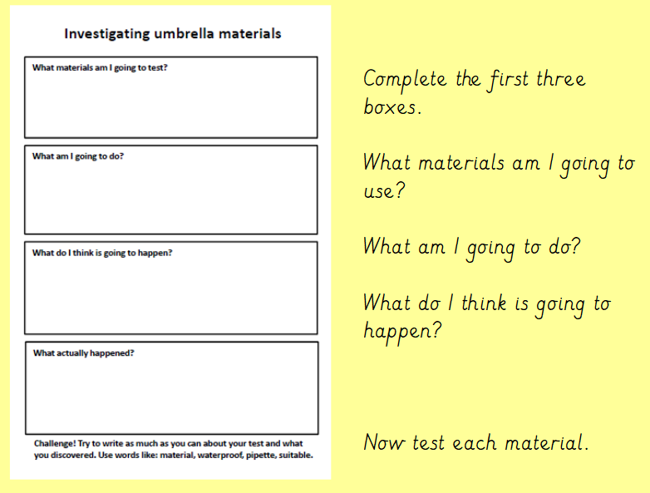
The sheet required has been sent via parentmail.
If you cannot print it out, use the headings on a piece of paper.

Slide 8
