Slide 2
Learning Objective
Today I am learning how to use social media responsibly and how to protect my wellbeing when online.
Success Criteria
I will be successful if:
I can identify problems with social media and possible solutions.
I understand the ways in which I can protect my physical wellbeing when using social media.
I understand the ways in which I can protect my mental and emotional wellbeing when using social media.
This resource is fully in line with the Learning Outcomes and Core Themes outlined in the PSHE Association’s Programme of Study.

Slide 3
The Big Questions

Slide 4

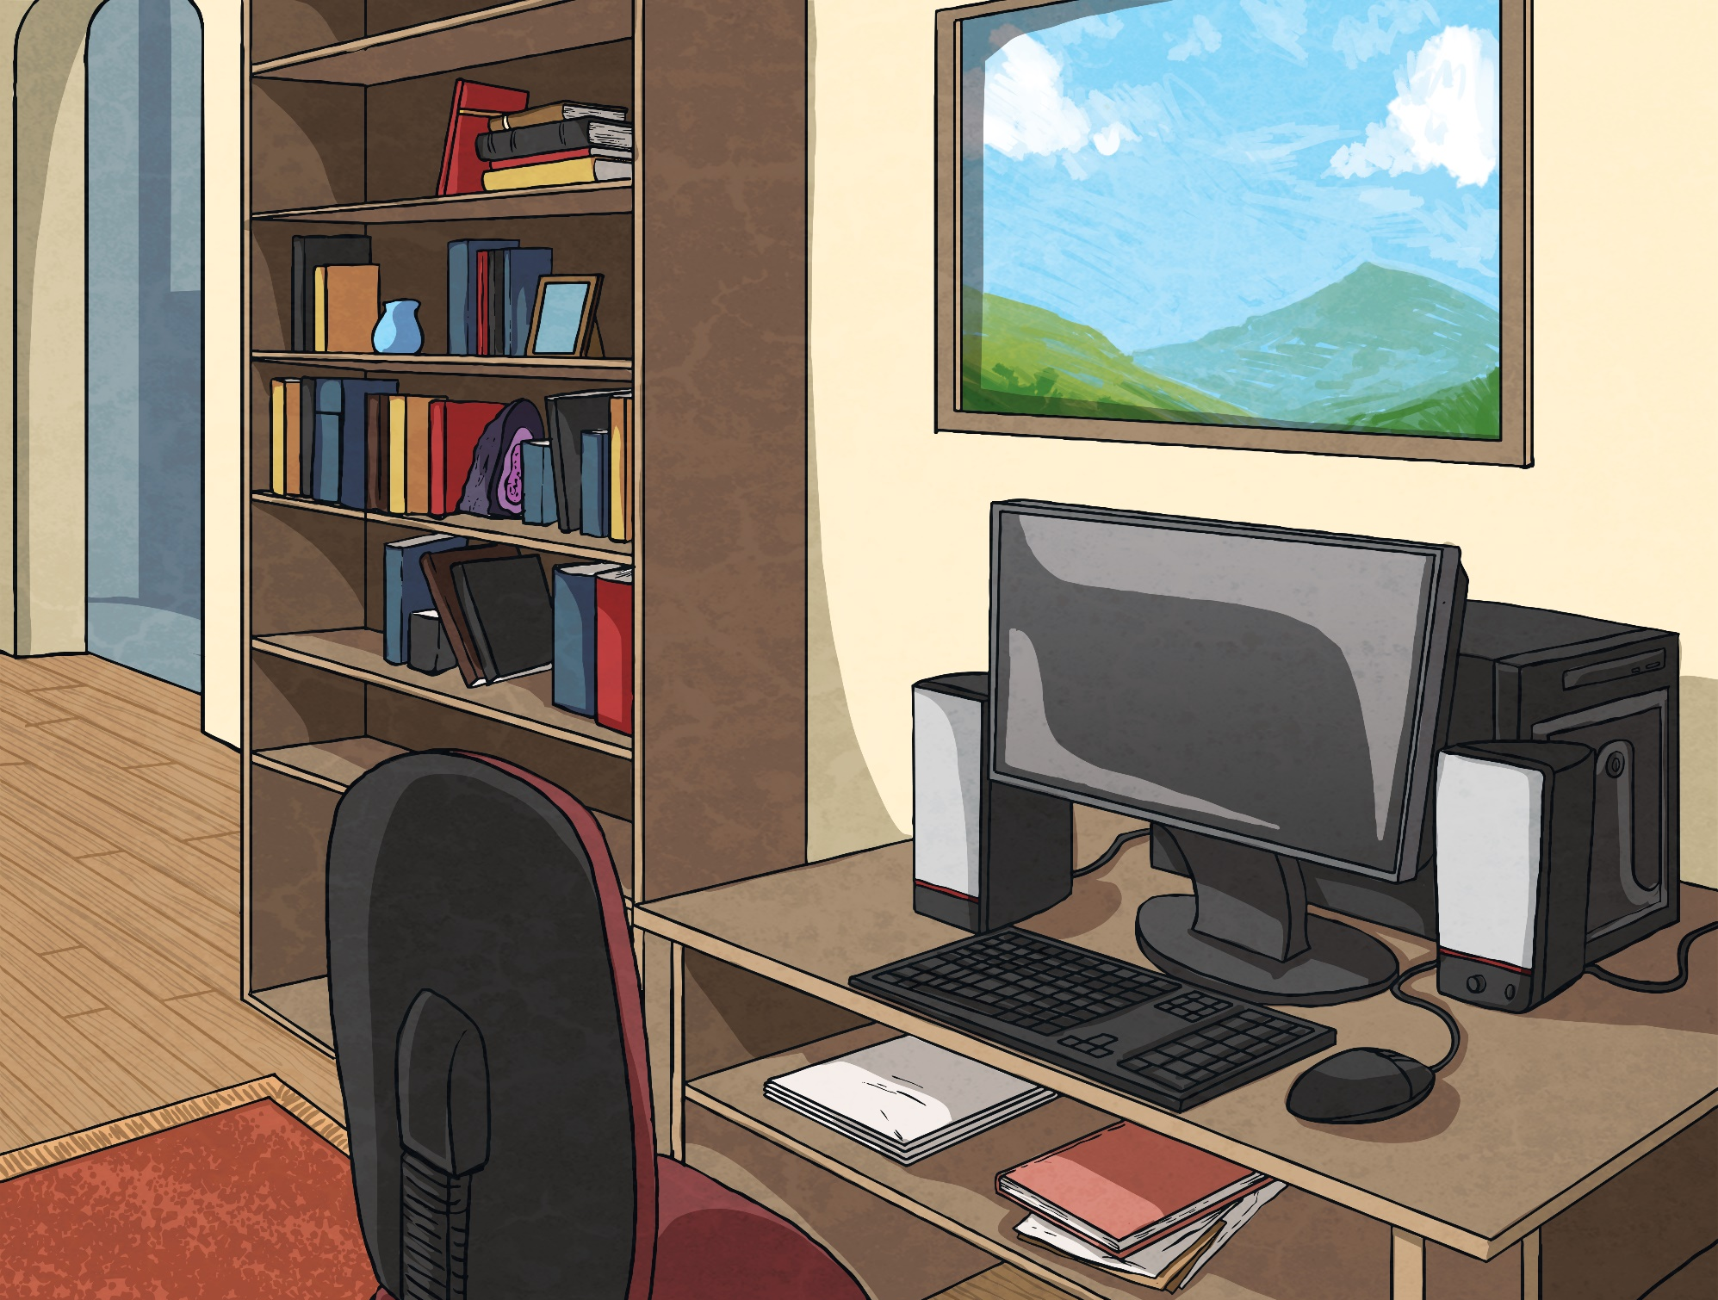
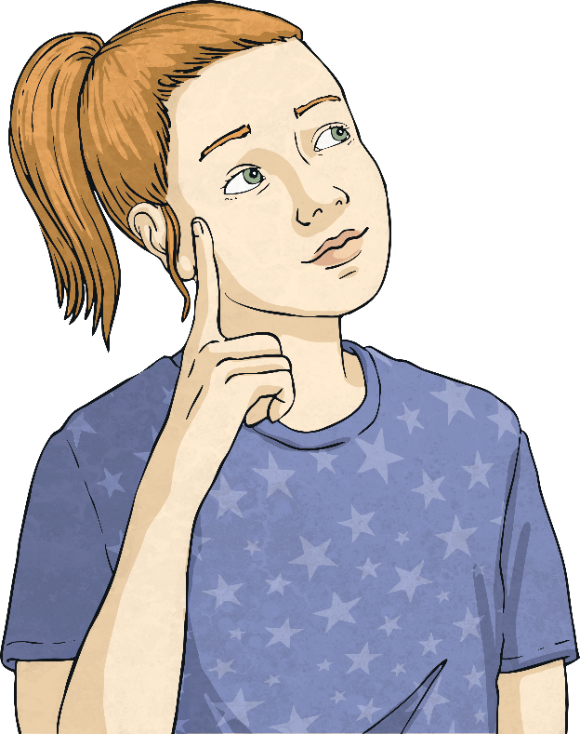
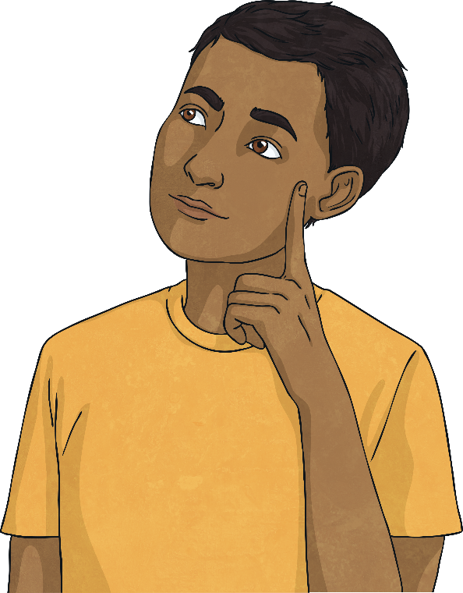
What problems might we experience when using social media?
How can we address these problems to protect our wellbeing?

Slide 5
Reconnecting

Slide 6

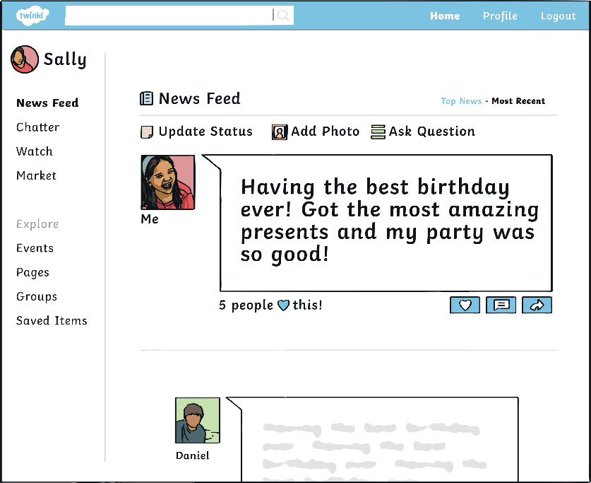
Social Media Problems
What is social media?
Spend a moment thinking about what is meant by the term social media.
Social media refers to websites and apps that let people chat and share information, opinions, photos and videos.

Slide 7

Social Media Problems
Using social media sites and apps can be a great way to keep in contact with friends and family.
A lot of social media sites have age restrictions so you shouldn’t have an account until you reach a certain age.
Which social media sites or apps have you heard of?
Many people have accounts on social media sites that allow them to chat with others, share photos, send videos and comment on other people’s posts.

Slide 8
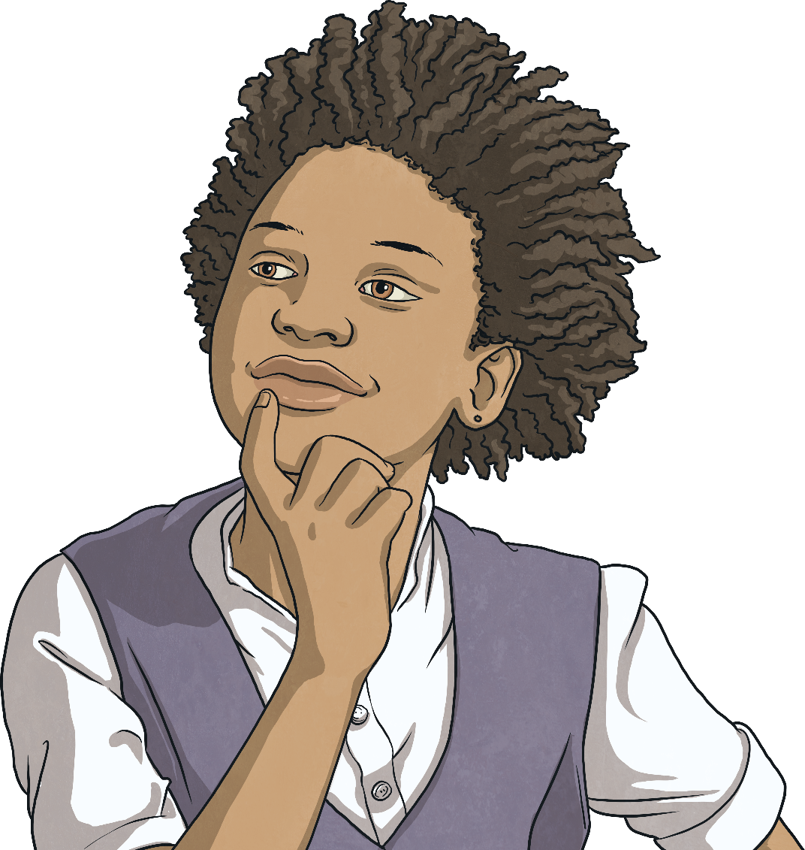
Social Media Problems
It’s time for a challenge...
Can you think of 10 problems that are associated with social media, that could be caused by social media or that could occur while using social media?
What problems did you think of?

Slide 9
Exploring

Slide 10


Issues and Solutions
The Problem: Screen Time
Have a think – how much time do you think you spend on the Internet each day?
Screen time might not seem like a problem, until we think about what else we might be missing out on and how it might be affecting our physical wellbeing.
Using social media might take up time that could be spent exercising and getting fresh air, and might prevent us from getting a good night’s sleep.
It can also make us miss out on spending time with family and friends or doing other things we enjoy.

Slide 11

Issues and Solutions
The Solution: Setting Limits
Monitoring and measuring the time we spend online and on social media is the best way to make sure we are not spending too long on these sites and apps.
You might not realise how much time you are spending online, looking at other people’s posts, comments, photos and videos.
Some people set a timer so they know when they have reached a sensible limit for that day.
Try not to use any devices just before bed. Many studies show that the light prevents us from feeling sleepy and can stop us from dropping off.

Slide 12
Issues and Solutions
The Problem: Reliability
It is easy to believe that everything you see or read on social media sites is real.
However, from photoshopped images and cleverly edited videos, to made-up stories and fake news, we have to remember that the things other people post on social media may not be real or accurate.
Another problem that many people might not be aware of is the reliability of what we see on social media.
There may be inaccurate information, an unfair version of events or something completely untrue.

Slide 13
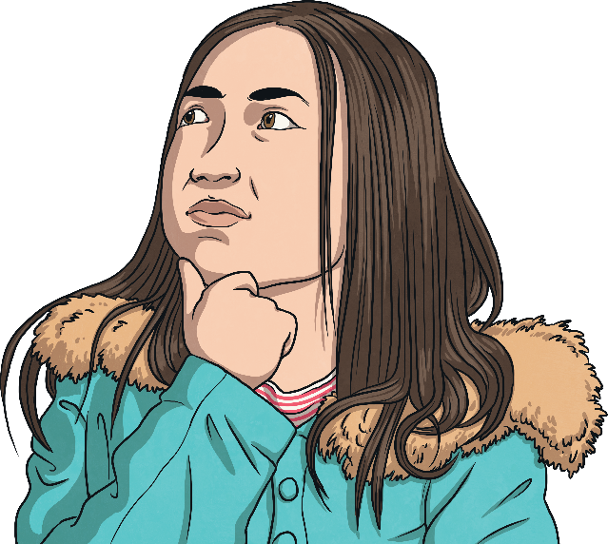
Issues and Solutions
The Solution: Think and Check
When viewing a photo, video, post or article online, remember that whoever created it, wrote it or posted it may or may not be trustworthy.
If you see something that upsets or worries you, tell a trusted adult about it.
Don’t forward things to others unless you are absolutely sure that it isn’t going to upset someone, mislead them or cause any problems.

Slide 14
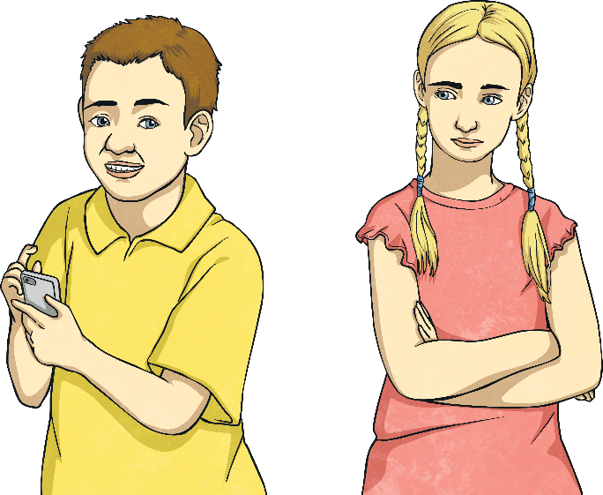
Issues and Solutions
The Problem: Worrying What Others Think
It’s not good for our wellbeing if we are constantly worrying about what others think of us.
Sadly, social media for many can mean constantly checking to see if others have liked their post or their photo.
Many people want to be part of lots of groups on social media and worry that they might be missing out if they are not involved in some of them.

Slide 15
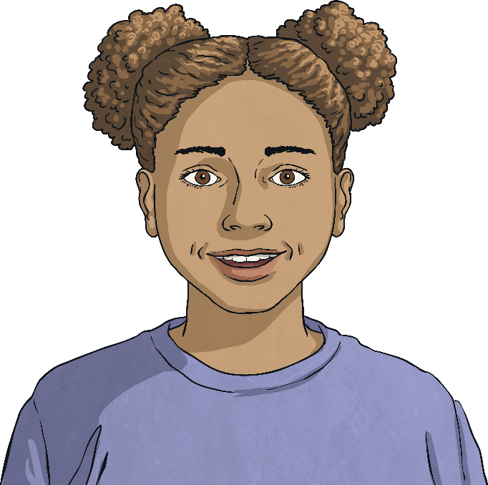
Issues and Solutions
The Solution: Have Confidence to be Yourself Online
Just like in real life, it’s important to be comfortable with who you are and to have the confidence to be you!
Remind yourself that it doesn’t matter what others think of you on social media and your real friends will like you for who you are, not for how you look in a photo posted online!

Slide 16
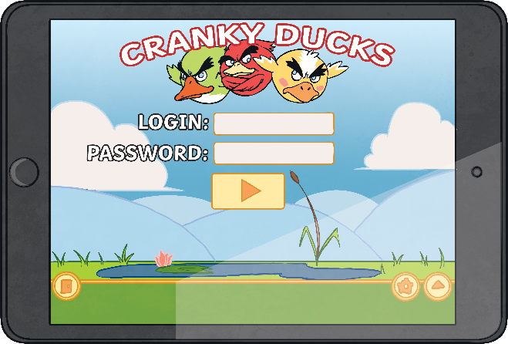
Issues and Solutions
The Problem: Privacy
There are some people who want to find out information about others – information they do not and should not need to know.
This is why keeping your password safe is really important.
Just like anything we do online, such as gaming, we need to be extra careful about privacy when using social media sites and apps.

Slide 17
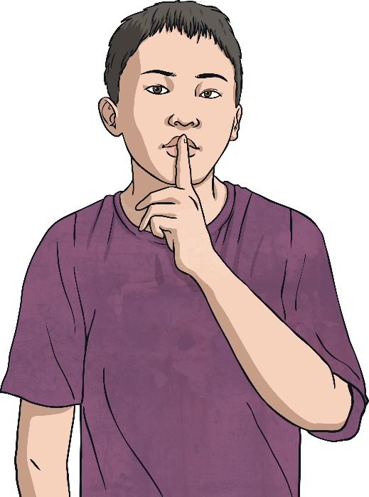
Issues and Solutions
The Solution: Confidentiality
Think carefully before posting photos and videos of yourself too. Are these pictures that you are happy for people to see? Remember, once uploaded, you might not be able to fully delete them as they can be copied or sent on to other people.
Set your privacy settings so that only people you know can see your information. If you are unsure how to do this, check with a trusted adult.
The best way to stay safe is to remember that anything you wouldn’t share with a stranger who approached you at the park is information that you shouldn’t share online.
Never give personal information to someone on social media. That includes your name, address and the school you attend.

Slide 18
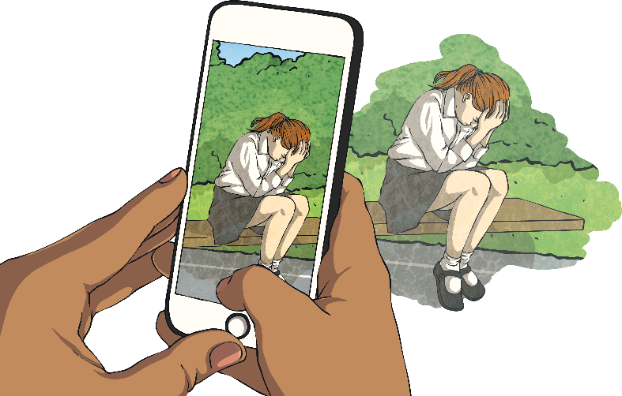
Issues and Solutions
The Problem: Disrespecting Others
Some people post photos or videos of others that they have not had permission to post.
They might not realise how harmful it can be to share things about others but this is very disrespectful.
Respecting other people’s privacy is just as important as keeping your own personal information private.
Unfortunately, some people share information (that may or may not be true) about others.

Slide 19
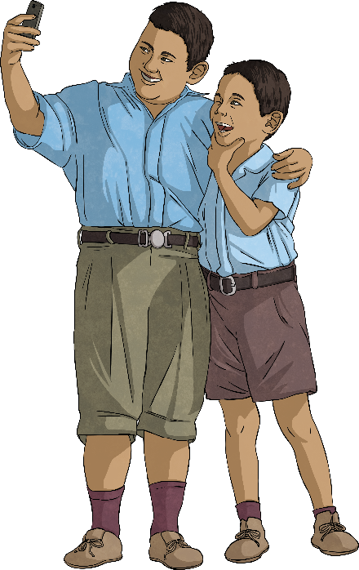
Issues and Solutions
The Solution: Treat Others As You Wish To Be Treated
It is never OK to take a photo of someone else and post it on a social media site without their permission. The same goes for information you might know about someone.
Consider whether you would be OK if someone shared a photo of you that you didn’t want online or if they posted information about you that was private.
If you wouldn’t want it to happen to you, don’t do it to someone else.
If it happens to you, make sure you tell a trusted adult.

Slide 20
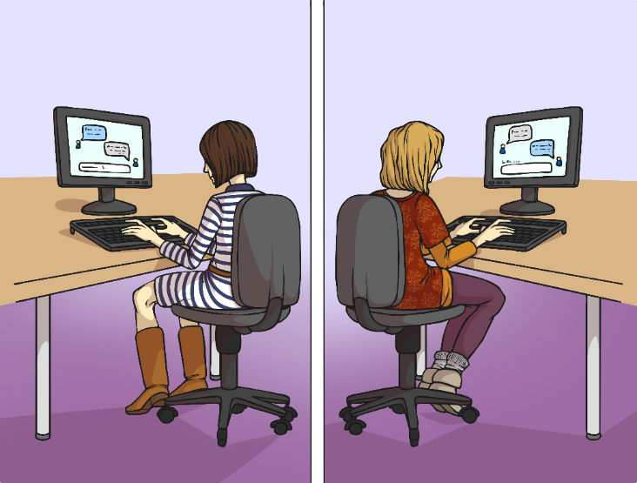
Issues and Solutions
The Problem: Online Strangers
Social media, just like gaming sites, allows us to chat with people we have never met, who may seem really nice.
They might have lots in common with us and we might think we have found a new, special friend.
But people aren’t always who they say they are online.
It could be someone playing a trick on you.
It could be a stranger trying to find out more about you.
?

Slide 21
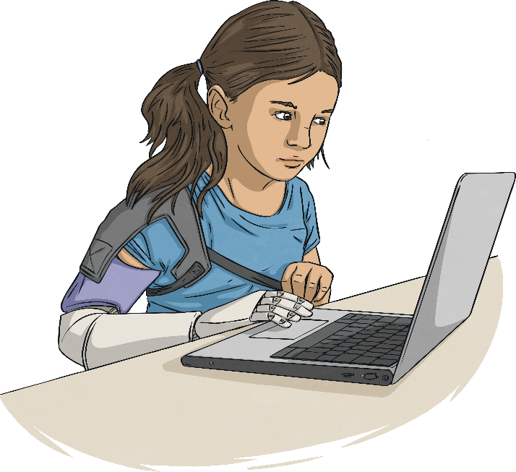
Issues and Solutions
The Solution: Block and Report
You can block someone who is sending inappropriate or upsetting messages.
Report anything that someone does online that makes you upset or uncomfortable and remember to tell a trusted adult what has happened.
Just have friends, that you know in real life, on your social media accounts.
Remember it’s OK to not reply to someone who sends you messages on social media.

Slide 22
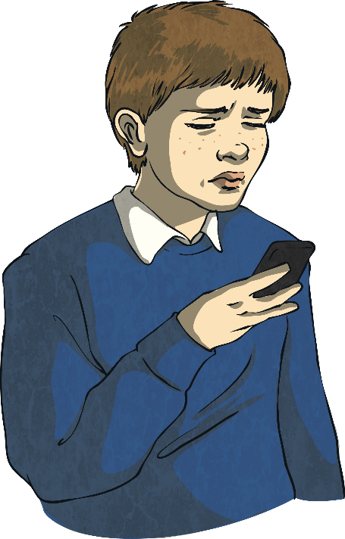
Issues and Solutions
The Problem: Cyberbullying
Sadly, many young people forget about being respectful or kind and use social media sites, as well as text messages or emails, to send unpleasant, mean or even threatening messages to or about others.
Lastly, a really serious issue with social media is that it can serve as a platform for online bullying, or cyberbullying.

Slide 23
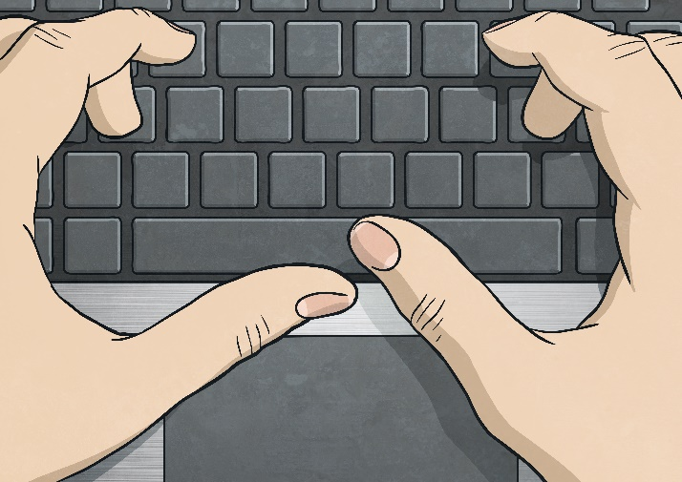
Issues and Solutions
The Solution: Be Kind and Report Cyberbullying
Before you post, think about how your words might make someone feel.
If you or someone that you know are experiencing online bullying, it is crucial that you report it to a trusted adult.
Try to always remember to be kind online.
Any type of bullying, including cyberbullying, has a big impact on people’s lives. It can make them withdrawn, anxious and frightened.

Slide 24

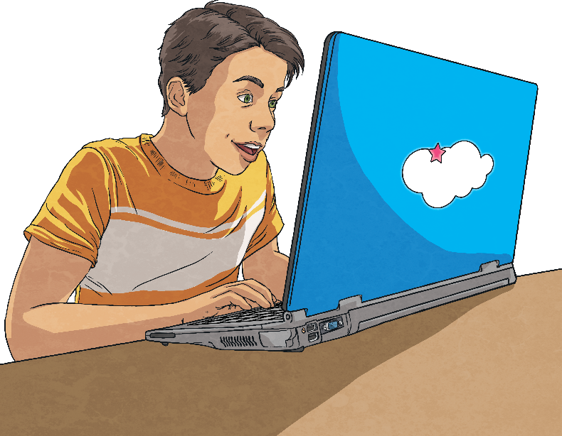
Issues and Solutions
We can all enjoy social media…
Consolidating
Reflecting
…and stay safe.

Slide 25
Consolidating

Slide 26
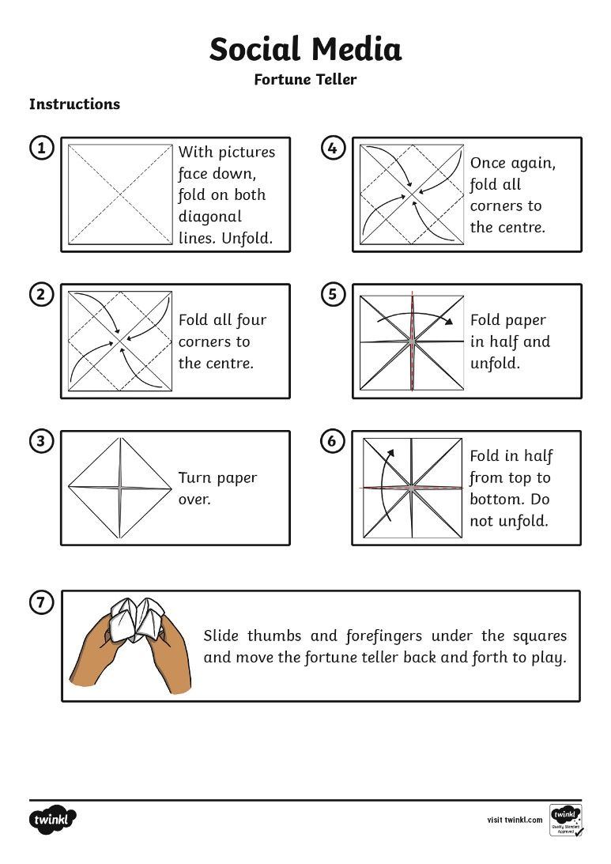
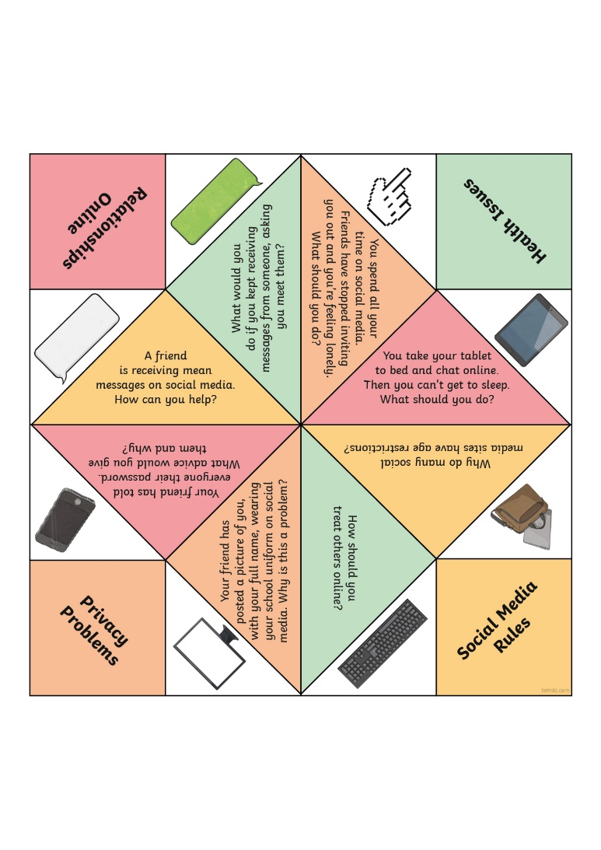
What Would You Do?
You are now going to apply what you have learnt about social media using a fortune teller.
Ask a family member or a friend if there is anything you can’t remember or you are not sure of.
Once you have cut it out and folded it up, you need to answer each of the questions in your own words by discussing it with someone at home.
You can ask to look back at certain slides from this Lesson Presentation too.

Slide 27
Reflecting

Slide 28
Social Media Top Tips
What have you learnt today?
Social Media
Top Tips
Use information from today’s lesson to come up with a list of five Social Media Top Tips.
You could make them into a poster.

