Slide 1


Slide 3






1) How much money is there?
2) What is £1 more than £5 and 42p?
3) What is £2 more than £5 and 42p?
True or false?
19 $+$ 6 $=$ 20 $+$ 5

Slide 4
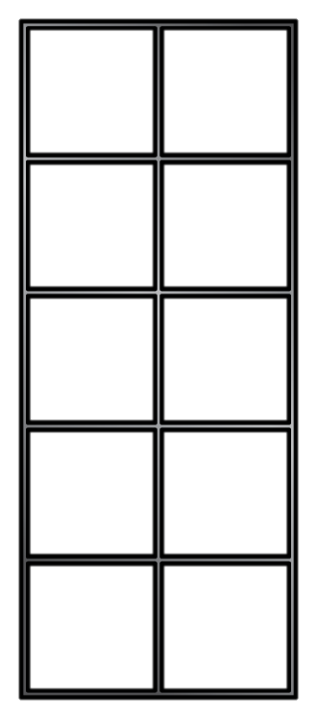
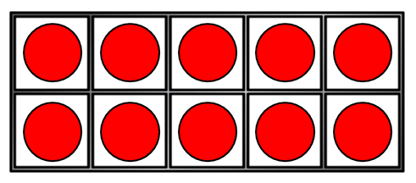
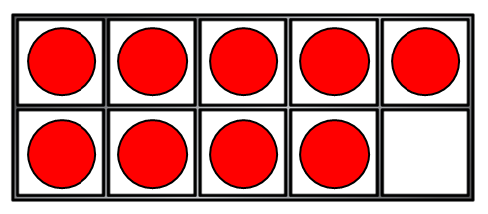


1) How much money is there?
2) What is £1 more than £5 and 42p?
3) What is £2 more than £5 and 42p?
True or false?
19 $+$ 6 $=$ 20 $+$ 5
£3 and 75p
£6 and 42p
£7 and 42p
$$+$$

Slide 6
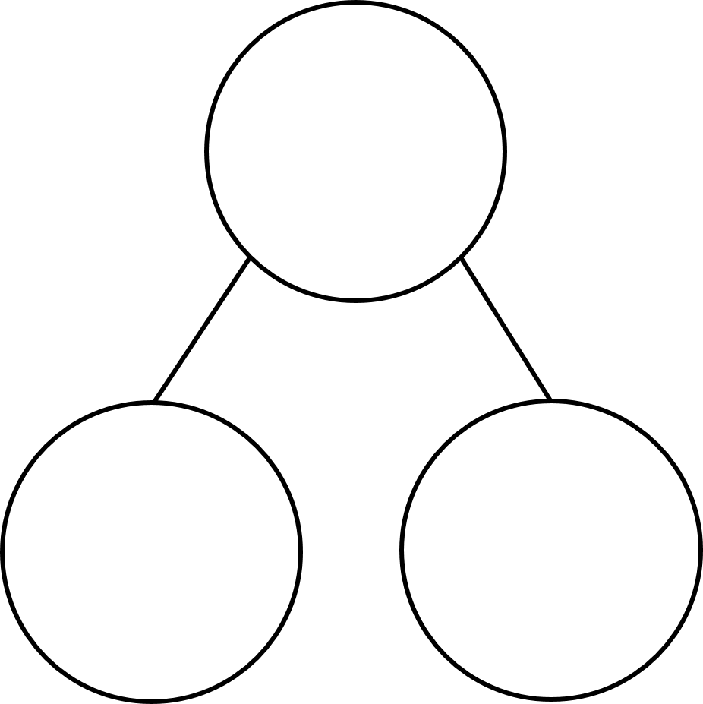



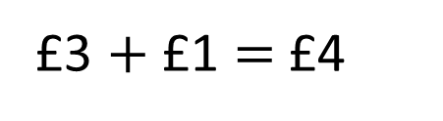
Complete the part-whole model.
£4 and 73p
£3 $+$ £1 $=$ £4
50p $+$ 23p $=$ 73p

Slide 7
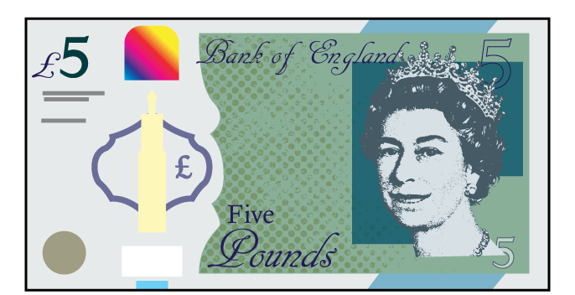


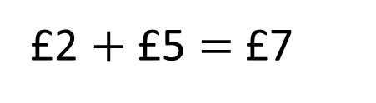
Complete the part-whole model.
£7 and 50p
£2 $+$ £5 $=$ £7
45p $+$ 5p $=$ 50p
Have a think

Slide 8




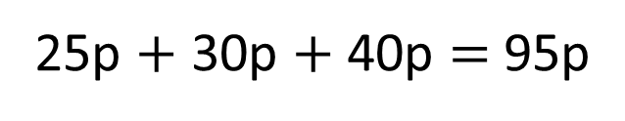
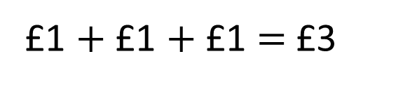
Whitney buys some apples, pears and bananas.
£1 and 30p
£1 and 40p
£1 and 25p
How much does Whitney spend in total?
£1 $+$ £1 $+$ £1 $=$ £3
25p $+$ 30p $+$ 40p $=$ 95p
Whitney spends £3 and 95p
Have a think

Slide 9


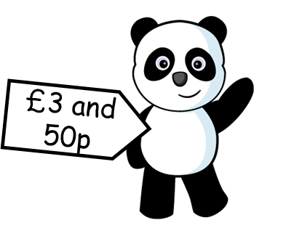


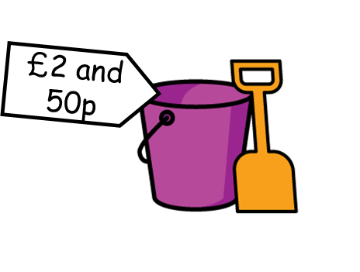

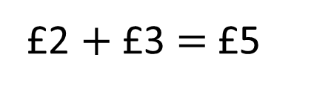


Jack is selling some things he no longer needs.
How much does Amir spend?
£2 $+$ £3 $=$ £5
60p $+$ 50p $=$
$$+$$
£1 and 10p
Have a think
Amir spends £6 and 10p

Slide 10



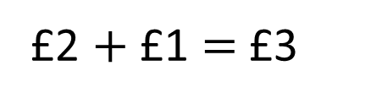
How much does Ron spend?
£2 $+$ £1 $=$ £3
50p $+$ 90p $=$
$$+$$
£1 and 40p
Have a think
Ron spends £4 and 40p

Slide 11
Have a go at questions
1 - 4 on the worksheet

Slide 12




£2 and 70p
£1 and 99p
Have a think
I will find the total cost.
Wait there is an easier way.

Slide 13
£2 and 70p
£1 and 99p
Rosie you do have enough money!

Slide 14
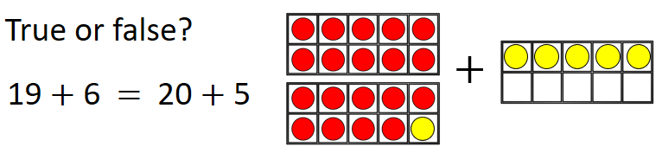
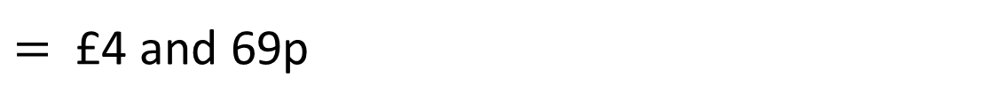
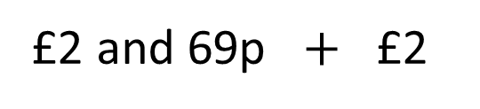
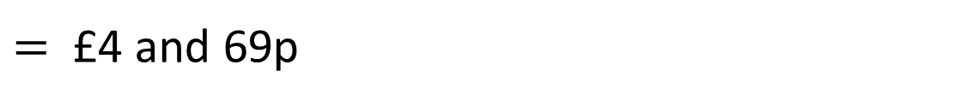

I know a fun way to find the total cost.
£2 and 70p
£1 and 99p
£2 and 70p $+$ £1 and 99p
$=$ £4 and 69p
£2 and 69p $+$ £2
$=$ £4 and 69p

Slide 15
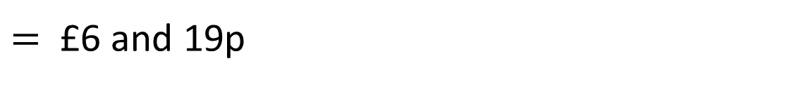

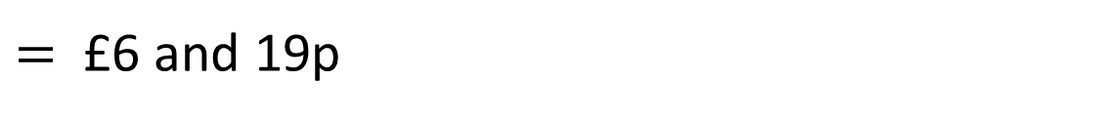
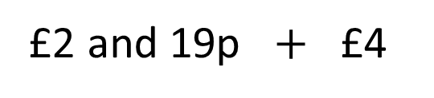
I know a fun way to find the total cost.
£2 and 20p $+$ £3 and 99p
$=$ £6 and 19p
£2 and 19p $+$ £4
$=$ £6 and 19p
Have a think

Slide 16
Have a go at the rest of the questions on the worksheet

