Slide 1


Slide 3
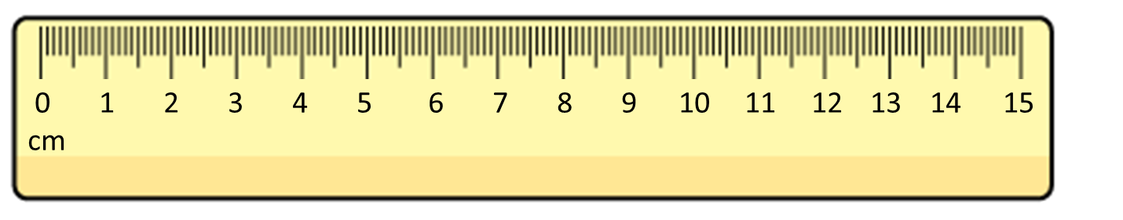
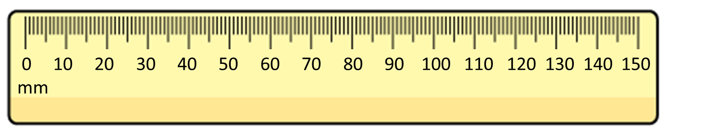
Complete the statements
There are ____ centimetres in 1 metre
There are ____ centimetres in half a metre
How long is the line?
How long is the line?

Slide 4
Complete the statements
There are ____ centimetres in 1 metre
There are ____ centimetres in half a metre
How long is the line?
How long is the line?
100
50
11 cm
98 mm

Slide 6


Annie is comparing lengths to 1 metre
The table is longer than 1 metre

Slide 7
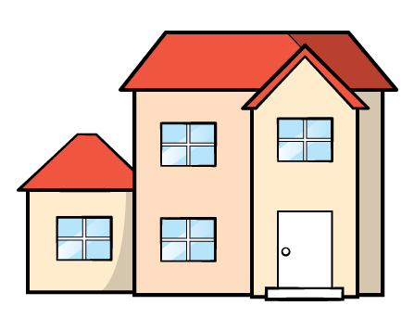
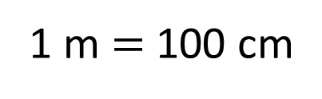
Annie is comparing lengths to 1 metre
The dolls house is shorter than 1 metre
1m
90 cm
80 cm
The dolls house is 60 cm tall.
70 cm
60 cm
50 cm
40 cm
1 m $=$ 100 cm
30 cm
20 cm
10 cm

Slide 8
Annie makes a table to show her results.
Shorter than 1 m | Longer than 1 m

Slide 9
Have a go at question 1 on the worksheet.

Slide 10
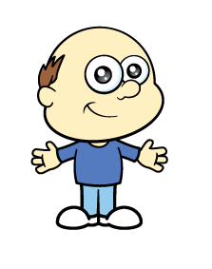
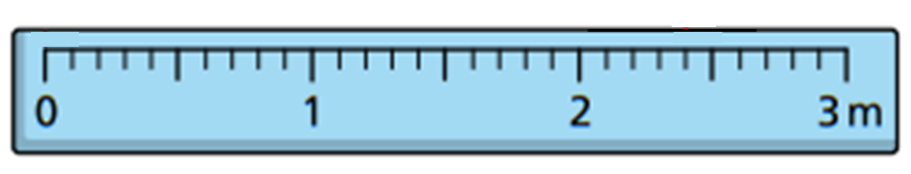
The children are measuring Mr Rose.
Mr Rose is 1 m and 70 cm tall.

Slide 11


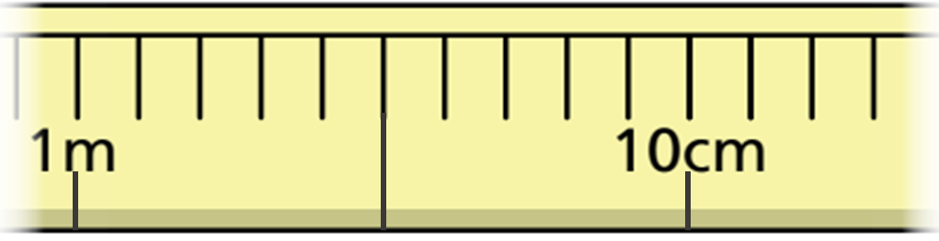
Ron and Amir have been measuring
their arm span.
Here is part of a tape measure.
Ron
How long is Ron’s arm span?
Ron’s arm span is 1 m and 4 cm

Slide 12

Amir’s arm span is longer than Ron’s.
Amir
How long is Amir’s arm span?
Have a think
Amir’s arm span is 1 m and 13 cm

Slide 13
Ron and Amir decide to measure the length and width of the classroom.
Altogether they measure 12 metres.
The classroom is twice as long as it is wide.
How long and how wide is the classroom?
Have a think

Slide 14
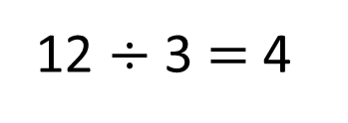
Altogether they measure 12 metres.
The classroom is twice as long as it is wide.
How long and how wide is the classroom?
Width
4
12 $÷$ 3 $=$ 4
12 m
Length
4
4
The classroom is 8 m long and 4 m wide.

Slide 15
Have a go at the rest of the questions on the worksheet.

