Slide 1


Slide 3
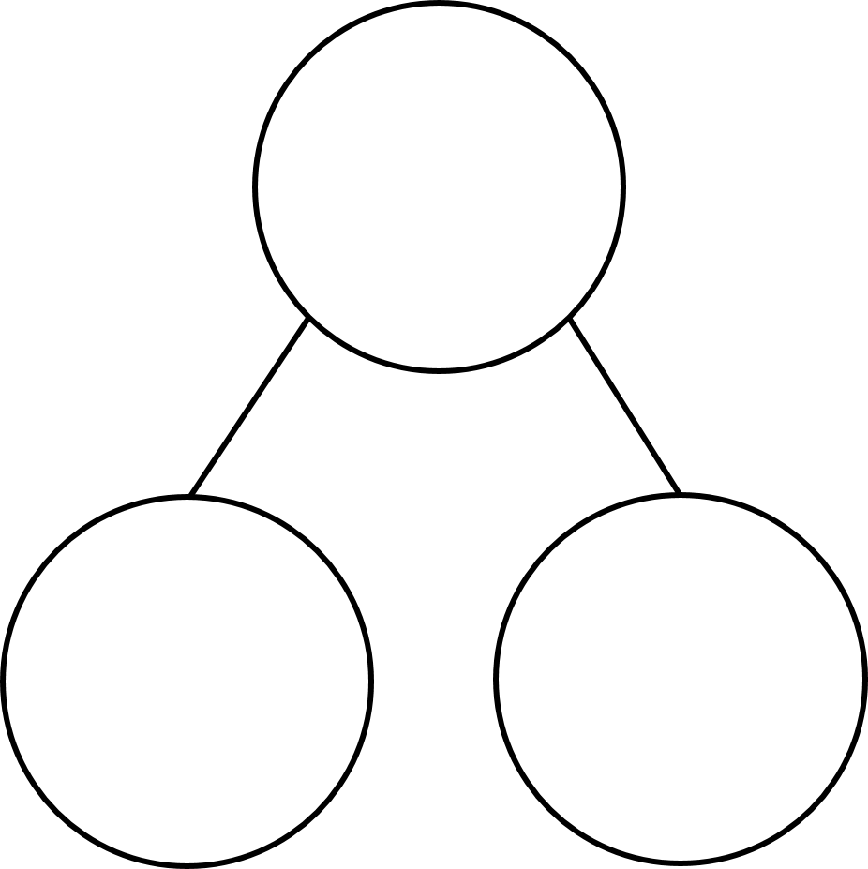
Complete the sequence.
100, 200, 300, 400, _____, _____
2) How many hundreds are in 870?
3) Complete the part-whole model.
490
9 tens

Slide 4
Complete the sequence.
100, 200, 300, 400, _____, _____
500
600
2) How many hundreds are in 870?
8 hundreds
3) Complete the part-whole model.
490
4
hundreds
9 tens

Slide 6
Equivalent lengths
Equal lengths
metres
0
1
2
3
4
5
6
7
8
9
10
0
100
200
300
400
500
600
700
800
900
1,000
centimetres
1,000 cm = 10 m
500 cm = 5 m
600 cm = 6 m
700 cm = 7 m
8 m = 800 cm
9 m = 900 cm
1 m = 100 cm
2 m = 200 cm
3 m = 300 cm
4 m = 400 cm
0 m = 0 cm

Slide 7
4 m =
400 cm
1 m = 100 cm
1 m
100 cm
1 m | 1 m | 1 m | 1 m
100 cm
100 cm
100 cm
100 cm
200 cm =
2 m
1 m
1 m
100 cm
100 cm

Slide 8

Have a think
600
6 m
590
5 m 90 cm
580
5 m 80 cm
570
5 m 70 cm
510 cm
520 cm
560
5 m 60 cm
550
5 m 50 cm
540
5 m 40 cm
5 m
500 cm
10 cm
20 cm
530
5 m 30 cm
520
5 m 20 cm
510
5 m 10 cm
cm
500
5 m
m and cm

Slide 9
Have a go at questions
1 and 2 on the worksheet

Slide 10
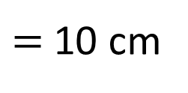
Have a think
10 cm
1 m and 35 cm
= 135 cm
100 cm
0 m
1 m
2 m
70 cm
130 cm
1 m and 30 cm
100 cm ÷ 10
$=$ 10 cm

Slide 11
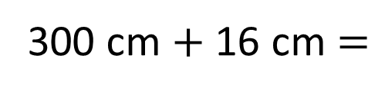
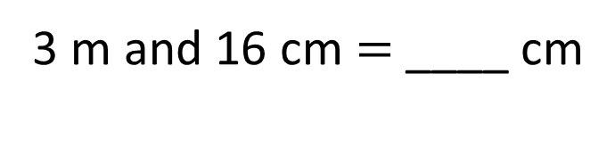
316
3 m and 16 cm $=$ ____ cm
316 cm
316 cm
3 m | 16 cm
300 cm
16 cm
3 m
300 cm $+$ 16 cm $=$
316 cm

Slide 12
Have a go at the rest of the questions on the worksheet

