Slide 1


Slide 3
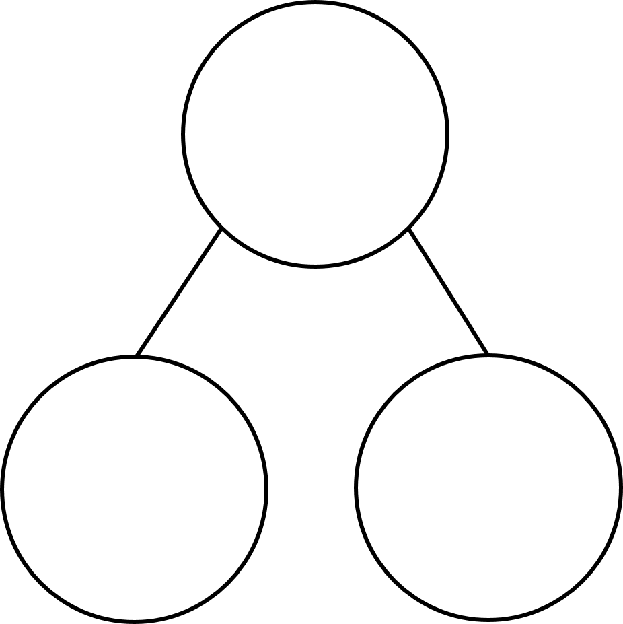
Complete the sequence.
10, 20, 30, 40, _____, _____
2) How many tens are in 38?
3) Complete the part-whole model.
72
2 ones

Slide 4
Complete the sequence.
10, 20, 30, 40, _____, _____
50
60
2) How many tens are in 38?
3 tens
3) Complete the part-whole model.
72
7 tens
2 ones

Slide 6

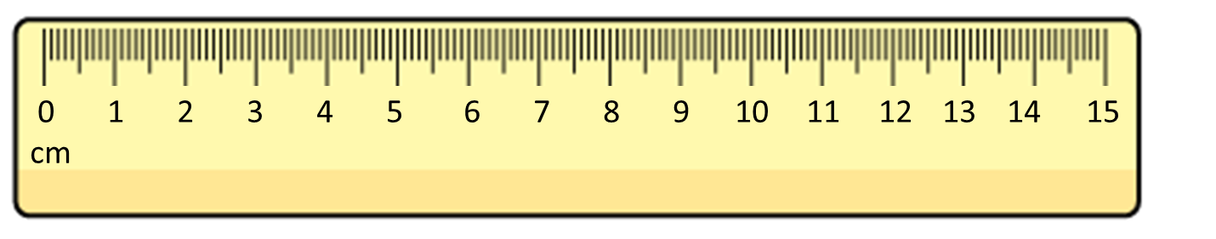

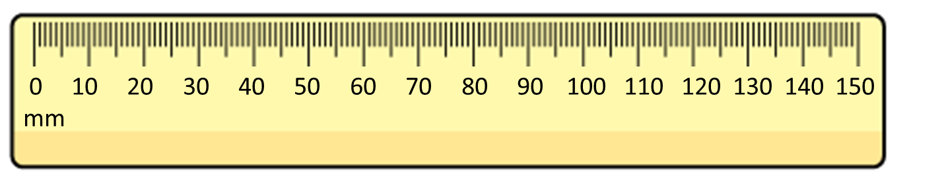
What is the length of the bar?
The bar is 8 cm long.
The bar is 80 mm long.
8 cm = 80 mm

Slide 7
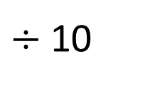
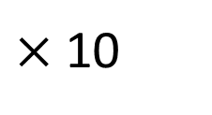
centimetres
0
1
2
3
4
5
6
7
8
9
10
0
10
20
30
40
50
60
70
80
90
100
millimetres
$×$10
$÷$10
1 cm = 10 mm
70
7 cm = mm
30 mm = cm
3

Slide 8
4 cm =
1 cm = 10 mm
40 mm
1 cm | 1 cm | 1 cm | 1 cm
1 cm
10 mm
10 mm
10 mm
10 mm
10 mm
20 mm =
2 cm
1 cm
1 cm
10 mm
10 mm

Slide 9
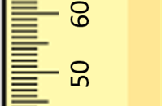
60
59
58
57
56
55
54
53
52
51
mm
50

Slide 10

Have a think
60
6 cm
59
5 cm 9 mm
58
5 cm 8 mm
57
5 cm 7 mm
56
5 cm 6 mm
51 mm
5 cm 5 mm
52 mm
55
54
5 cm 4 mm
53
5 cm 3 mm
5 cm
1 mm
52
5 cm 2 mm
50 mm
2 mm
51
5 cm 1 mm
mm
50
5 cm
cm and mm

Slide 11
Have a go at questions 1 and 2 on the worksheet

Slide 12
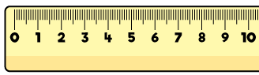
20 mm
45 mm
Have a think
82 mm
2 cm
4 cm 5 mm
8 cm 2 mm
cm
40 mm
45 mm
48 mm
50 mm
41
42
43
44
46
47
4 cm
4 cm
5 mm
4 cm
8 mm
5 cm

Slide 13
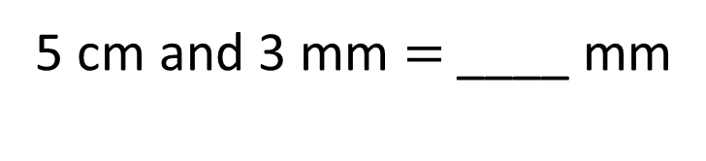
53
5 cm and 3 mm $=$ ____ mm
53 mm
53 mm
5 cm | 3 mm
50 mm
3 mm
5 cm
50 mm + 3 mm =
53 mm

Slide 14
Have a go at the rest of the worksheet

