Slide 1


Slide 3
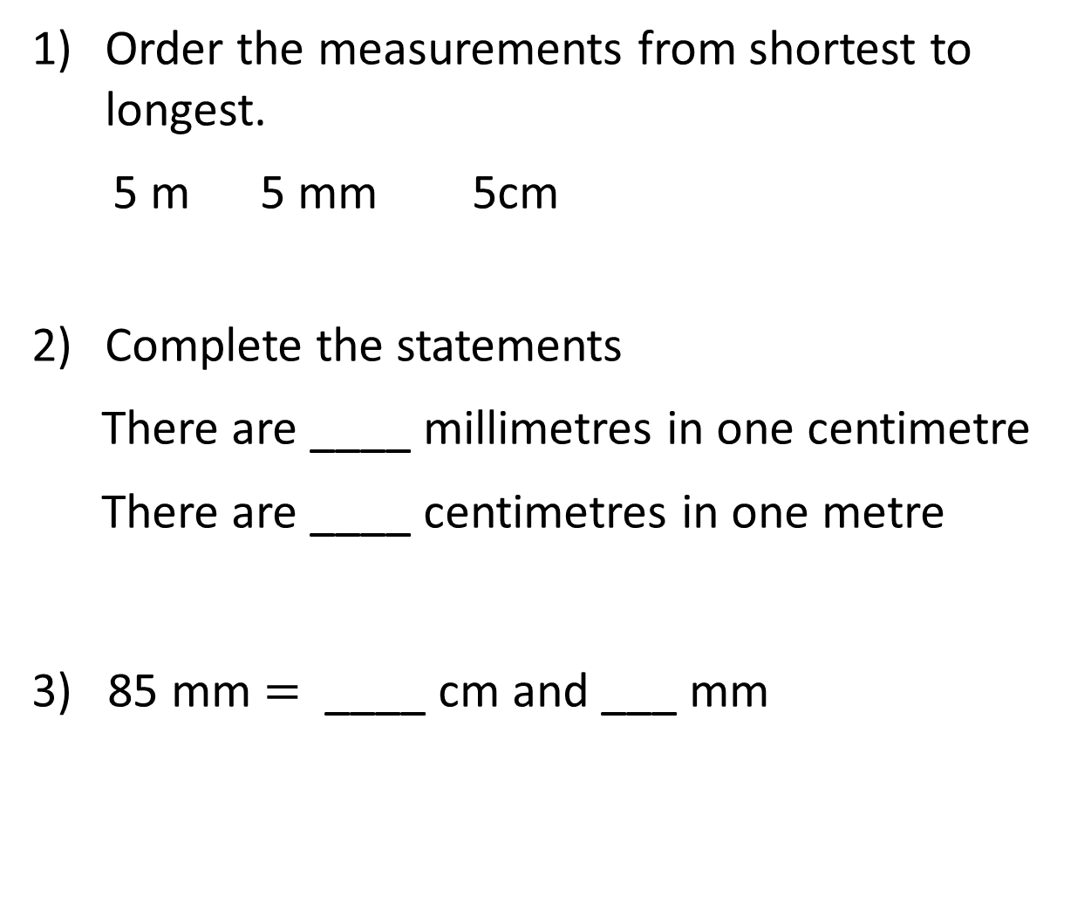
Order the measurements from shortest to longest.
5 m 5 mm 5cm
Complete the statements
There are ____ millimetres in one centimetre
There are ____ centimetres in one metre
3) 85 mm $=$ ____ cm and ___ mm

Slide 4
Order the measurements from shortest to longest.
5 m 5 mm 5cm
Complete the statements
There are ____ millimetres in one centimetre
There are ____ centimetres in one metre
3) 85 mm $=$ ____ cm and ___ mm
5 mm, 5 cm, 5 m
10
100
8
5

Slide 6

True or False?
The yellow pencil is longer than the blue pencil.
It is false. Both pencils are the same length.

Slide 7
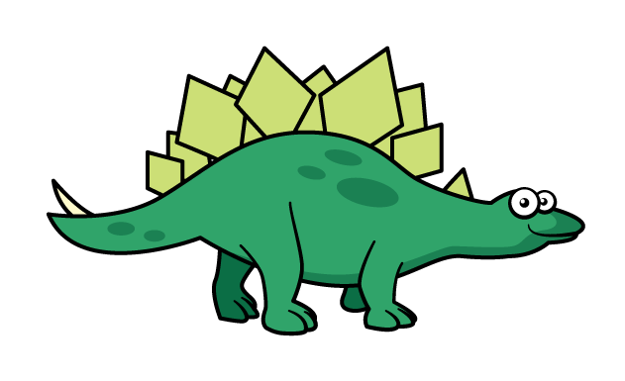
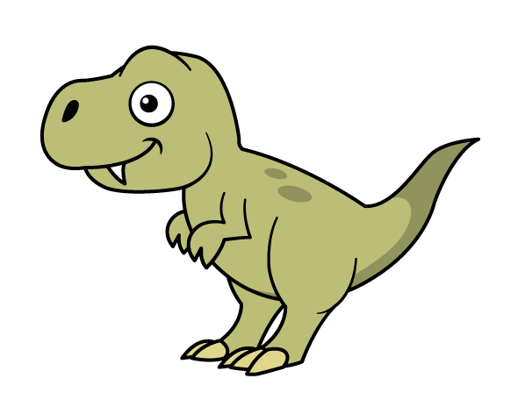
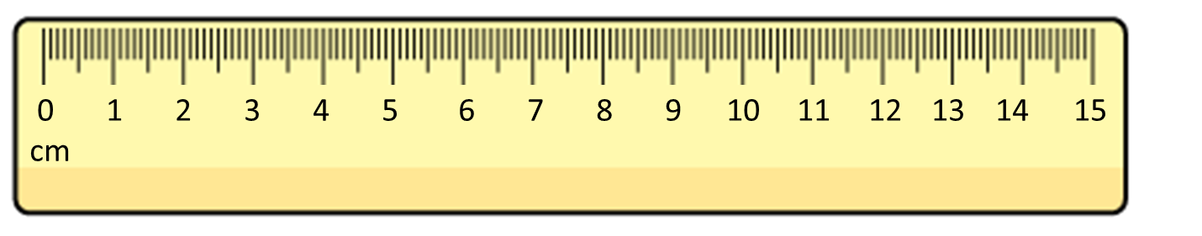

What do you notice?
8 cm
5 cm
The Stegosaurus is longer than the T-rex.
Have a think
The T-rex is shorter than the Stegosaurus.

Slide 8
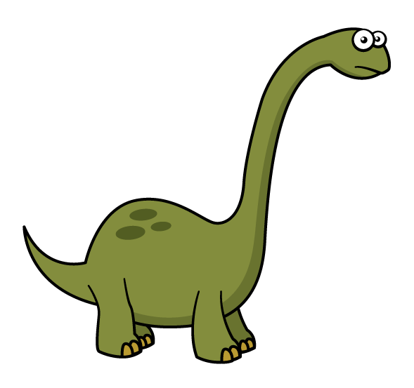
What do you notice?
taller
shorter
11 cm tall
5 cm tall

Slide 9




Use $<$, $>$ or $=$ to complete the comparisons
$$>$$
10 cm 10 mm
$$=$$
20 mm 2 cm
50 mm + 20 mm 10 cm
$$<$$
2 cm
20 mm
70 mm
10 cm
10 mm
10 cm
Have a think

Slide 10
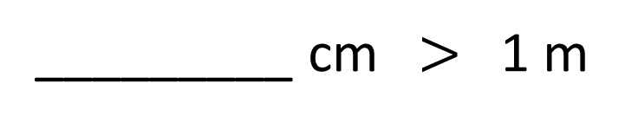
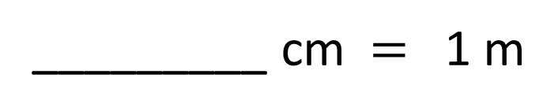
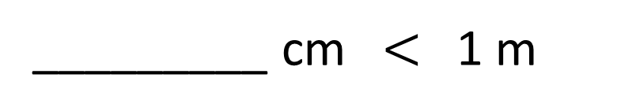
Add measurements to complete the comparisons
Have a think
100
_________ cm $=$ 1 m
99, 98, 97…
_________ cm $<$1 m
101, 102…
_________ cm $>$ 1 m

Slide 11
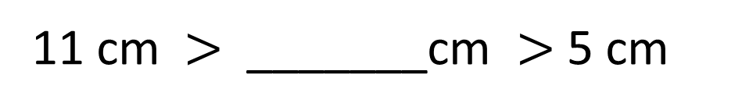
How tall could the Stegosaurus be?
11 cm tall
? cm tall
5 cm tall
10, 9, 8,
7, 6
11 cm $>$ _______cm $>$ 5 cm
Have a think

Slide 12
Have a go at questions 1 – 6 on the worksheet

Slide 13
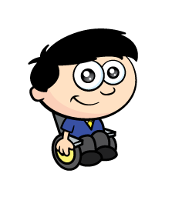
A red block is twice the height of a blue block.
6 cm
3 cm
Dexter builds a tower.
What is the height of the tower?
3 cm
3 cm
6 $+$ 3 $+$ 3 $+$ 3 $=$ 15 cm
6 cm
Have a think

Slide 14
Have a go at the last question on the worksheet

