Slide 1

1.3.21

Slide 3

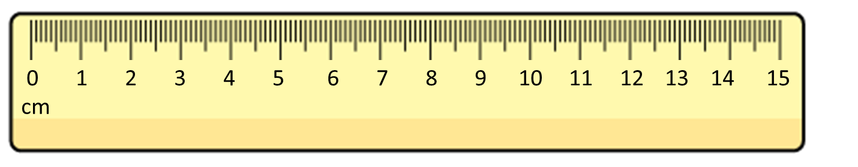
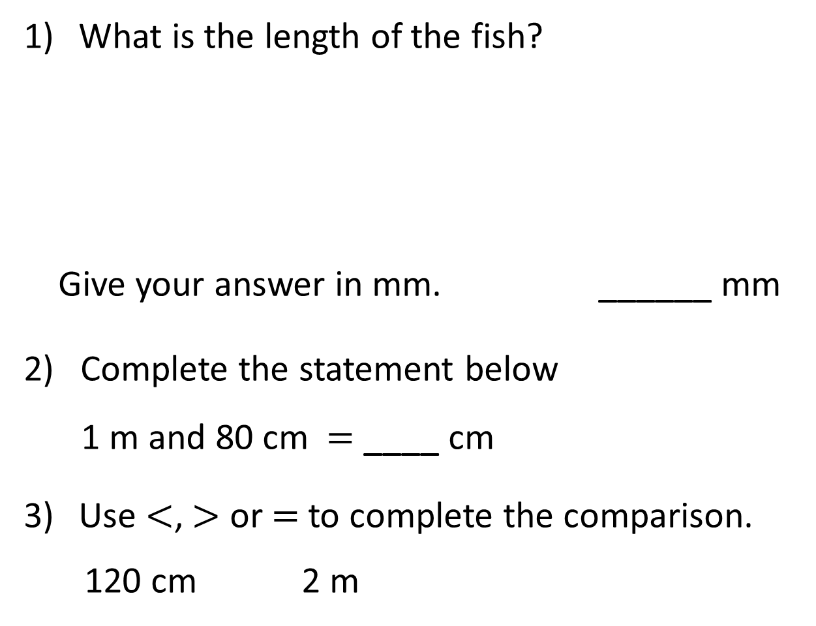
What is the length of the fish?
Give your answer in mm. ______ mm
2) Complete the statement below
1 m and 80 cm $=$ ____ cm
Use $<$, $>$ or $=$ to complete the comparison.
120 cm 2 m

Slide 4

What is the length of the fish?
Give your answer in mm. ______ mm
2) Complete the statement below
1 m and 80 cm $=$ ____ cm
Use $<$, $>$ or $=$ to complete the comparison.
120 cm 2 m
35
180
$$<$$
200 cm

Slide 6



Circle the longest measurement in each pair.
10 mm $=$ 1 cm
100 cm $=$ 1 m
1 m
100 mm
1 m 3 cm
130 cm
100 cm
103 cm
10 cm
185 cm
2 m
20 cm
250 mm
200 cm
25 cm
Have a think

Slide 7




I wonder how many millimetres there are in one metre.
There are 100 cm in one metre
Each cm has 10 mm
10 $×$ 100 $=$ 1,000
There are 1,000 millimetres in 1 metre.
Have a think

Slide 8
Sort the measurements into the table below.
Shorter than 1 m | Longer than 1 m
140 cm
850 mm
1 m 11 cm
1050 mm
97 cm
Have a think

Slide 9
Have a go at questions
1 – 4 on the worksheet

Slide 10



Order the children from shortest to tallest.
The children have been measuring their height.
1 m 30 cm
115 cm
1 m 90 mm
125 cm
130 cm
109 cm
shortest
tallest

Slide 11
I wonder if taller people have longer feet.
Let’s investigate!
Name | Height in cm | Length of foot in cm
Whitney | 109
Ron | 115
Eva | 125
Amir | 130
I am tallest and I have the longest feet!
17
21
19
22
I am shorter than Eva but my feet are longer.

Slide 12
Have a go at the rest of the questions on the worksheet

