Slide 1


Slide 3

Calculate
10 $+$ 20 $+$ 15 $+$ 20 $=$
2) What is double 100 $+$ double 50?
3) How would you work out 7 $+$ 5 $+$ 7 $+$ 5?

Slide 4
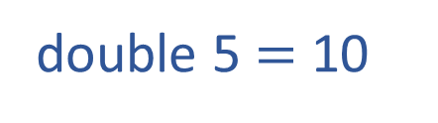
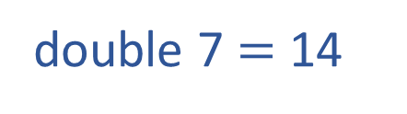
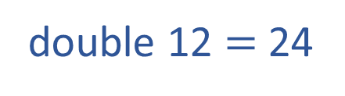

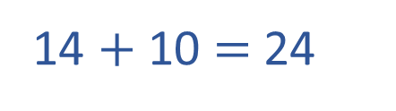
Calculate
10 $+$ 20 $+$ 15 $+$ 20 $=$
2) What is double 100 $+$ double 50?
3) How would you calculate 7 $+$ 5 $+$ 7 $+$ 5?
65
300
double 7 $=$ 14
12
12
double 5 $=$ 10
double 12 $=$ 24
14 $+$ 10 $=$ 24

Slide 6
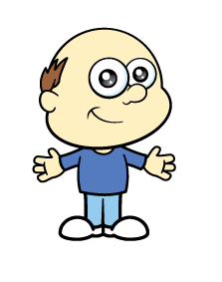

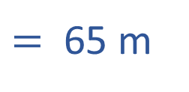

Mr Rose wants to put up a new fence around the perimeter of his garden.
10 m $+$ 20 m $+$ 15 m $+$ 20 m
How many metres of fencing does he need to buy?
10 m
20 m
20 m
15 m
$=$ 65 m
Mr Rose will need to buy 65 metres of fencing.

Slide 7
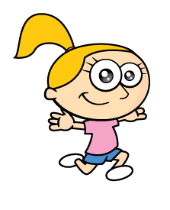
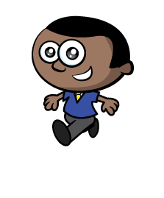


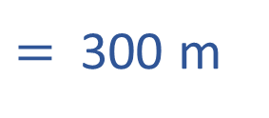
The children are running around the perimeter of the playground.
100 m $+$ 50 m $+$ 100 m $+$ 50 m
How far do they run on each lap?
100 m
50 m
50 m
100 m
$=$ 300 m
Each lap is 300 metres.

Slide 8
What is the perimeter of the rectangle?
1 cm
1 cm
24 cm

Slide 9

What is the perimeter of these shapes?
1 cm
1 cm
12 cm
14 cm
14 cm
Have a think

Slide 10
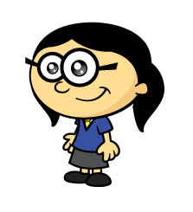
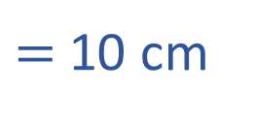

Annie has a 3 cm by 2 cm rectangular tile.
What is the perimeter of Annie’s tile?
1 cm
1 cm
3 cm $+$ 2 cm $+$ 3 cm $+$ 2 cm
$=$ 10 cm

Slide 11
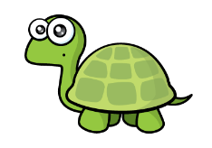

Annie joins 2 tiles together
1 cm
1 cm
6 cm
2 cm
2 cm
6 cm
If one tile has a perimeter of 10 cm, two tiles must have a perimeter of 20 cm.
6 cm $+$ 2 cm $+$ 6 cm $+$ 2 cm $=$ 16 cm

Slide 12

Annie joins 2 tiles together
1 cm
1 cm
3 cm
4 cm
4 cm
3 cm
3 cm $+$ 4 cm $+$ 3 cm $+$ 4 cm $=$ 14 cm

Slide 13
How many different perimeters can you make using 3 of Annie’s tiles?
What is the longest possible perimeter?
What is the shortest?
What if you used 4 tiles?
3 cm
2 cm
Have a think

Slide 14
Using 3 tiles
1 cm
1 cm
22 cm
18 cm
20 cm

Slide 15
Using 4 tiles
28 cm
22 cm
20 cm
24 cm
26 cm
26 cm

